Slide 1
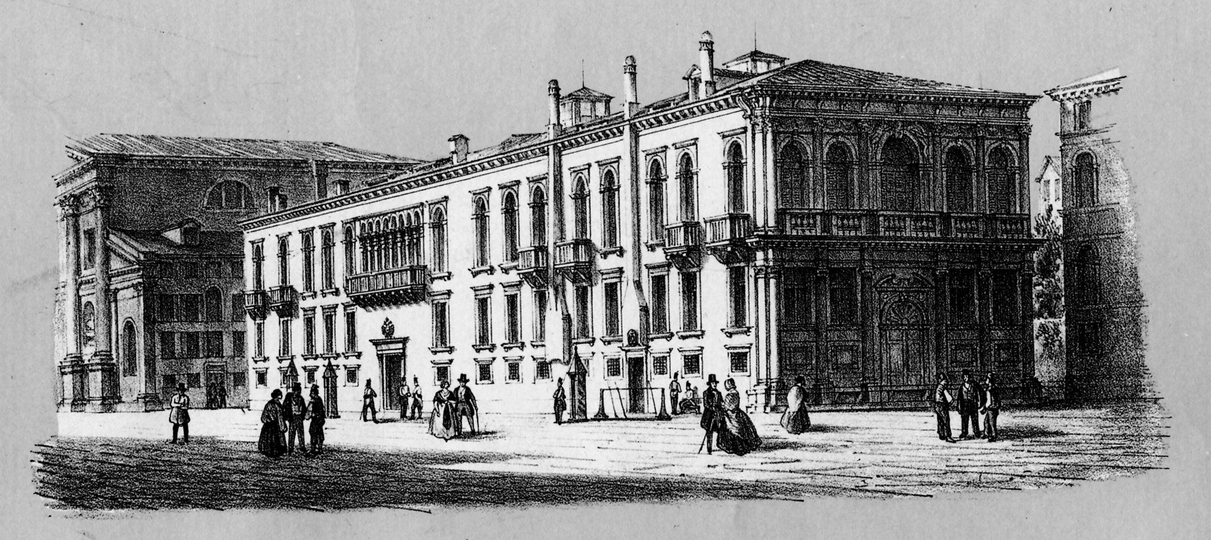
SNO, KamLAND and neutrino oscillations: θ₁₃
Venice, March 10, 2009
Gianluigi Fogli
XIII International Workshop on “Neutrino Telescopes”
17th of the series “Un altro modo di guardare il cielo”

Slide 2
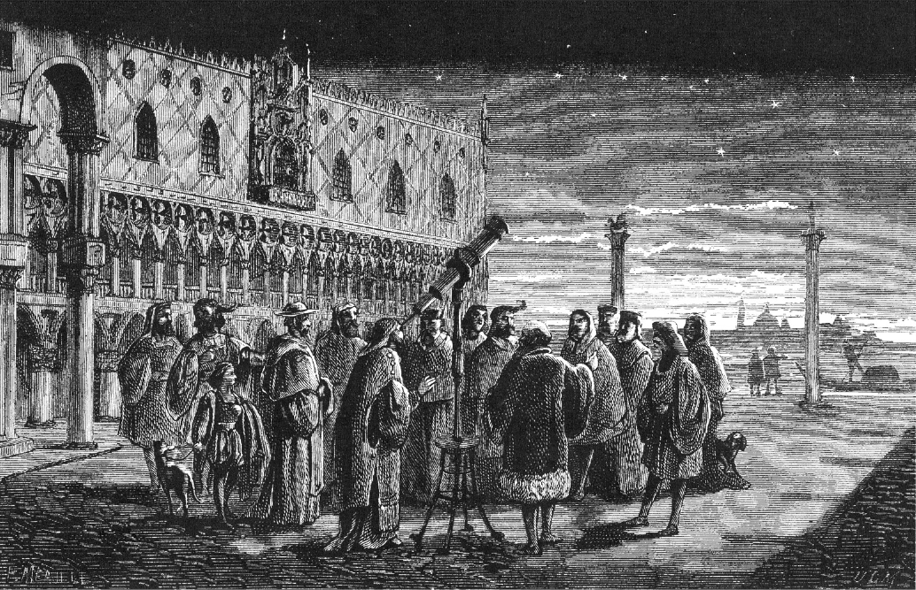
Outline (Three-acts structure)
FLASH-BACK: From NO-VE 2008
ACT ONE: The solar+KamLAND hint for θ₁₃ > 0
ACT TWO: The atmospheric (+CHOOZ+LBL) hint for θ₁₃ > 0
ACT THREE: An approximate updated value for θ₁₃
Based on work done in collaboration with: E. Lisi, A. Marrone, A. Palazzo, A.M. Rotunno

Slide 3
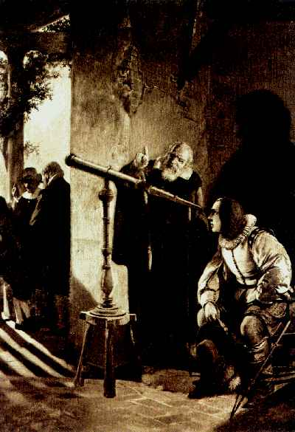
FLASH-BACK: Four slides from NO-VE 2008
NO-VE 2008, April 15
(prepared after the KamLAND 2008 release, but before SNO 2008 release)

Slide 4
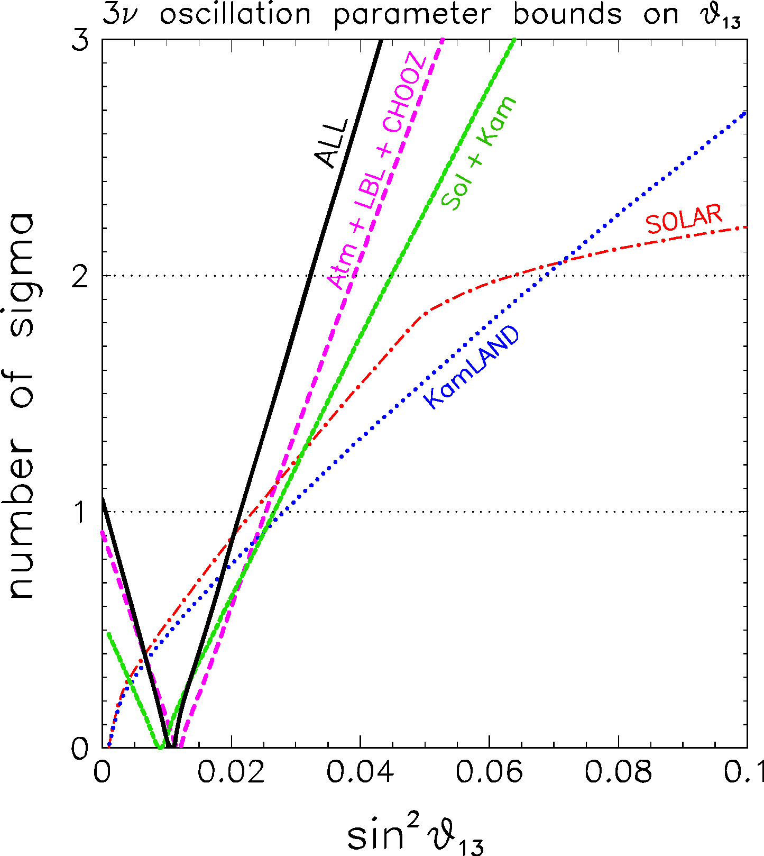
Concerning
(1/4)
Hierarchy (normal or inverted) CP in the ν sector θ₁₃ mixing
What we would like to know
Some aspect is currently “hidden” below 1σ C.L.
A recent example:
slight preference for
sin²θ₁₃ ~ 0.01
from the combination of
solar+reactor 2008 data
(green curve in the figure)
4

Slide 5
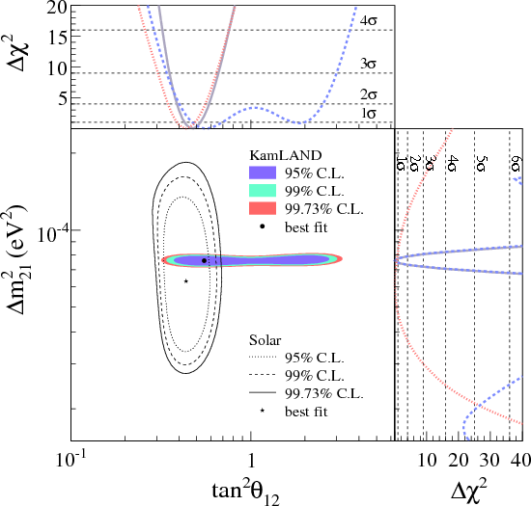
Reason:
(2/4)
Slight disagreement between
Solar data (SNO dominated)
KamLAND data (at θ₁₃ = 0)
when the two best-fits are compared
in the usual plane (m²₁₂, tan²θ₁₂)
[figure taken from the official Kamland site (2008)]

Slide 6
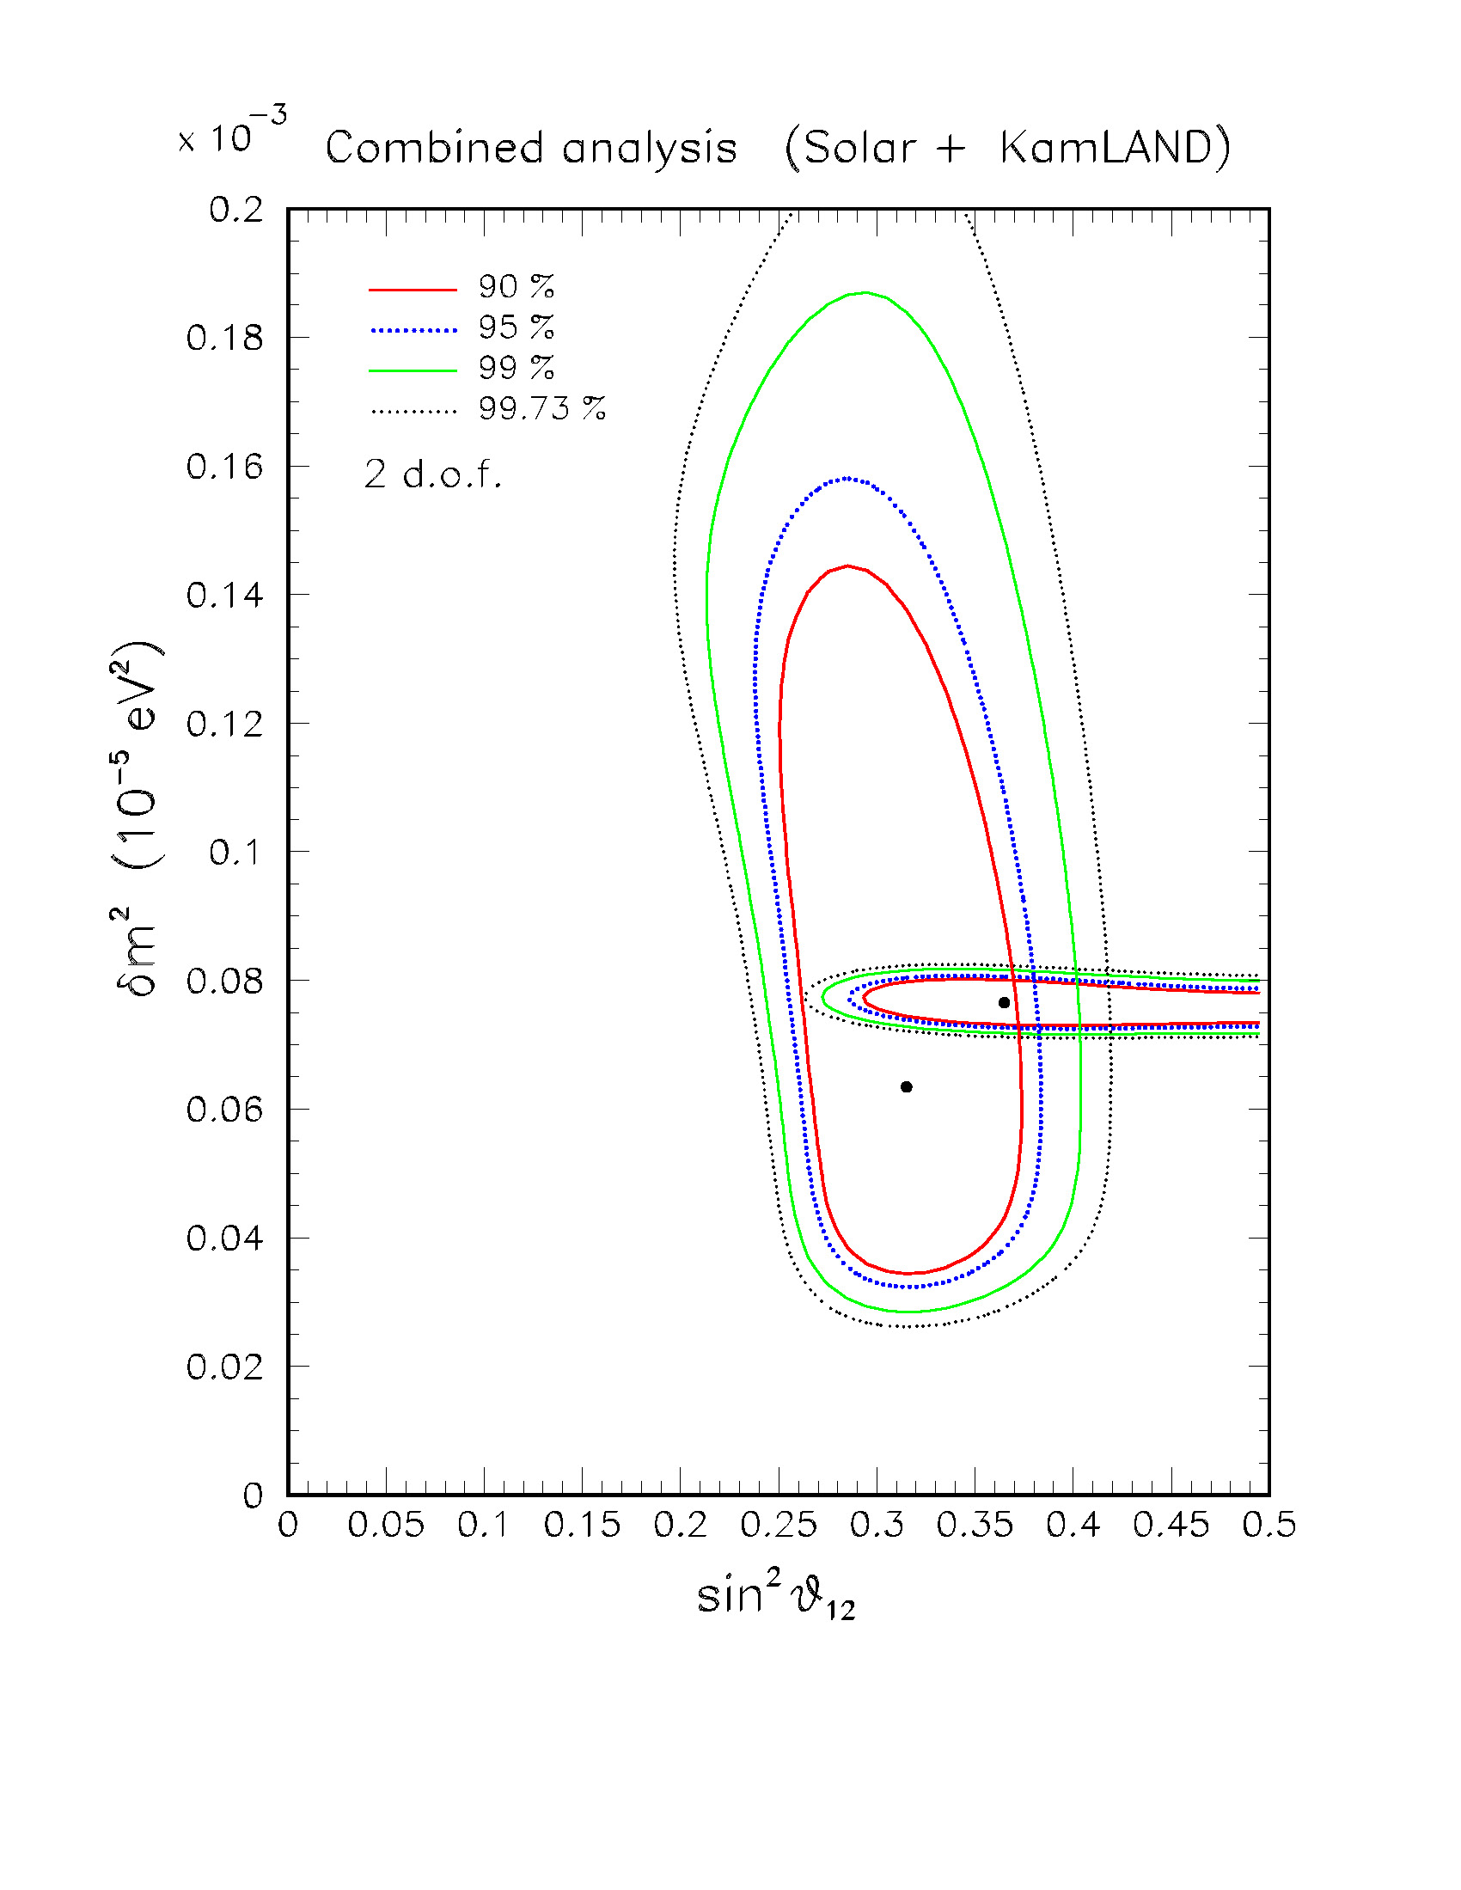
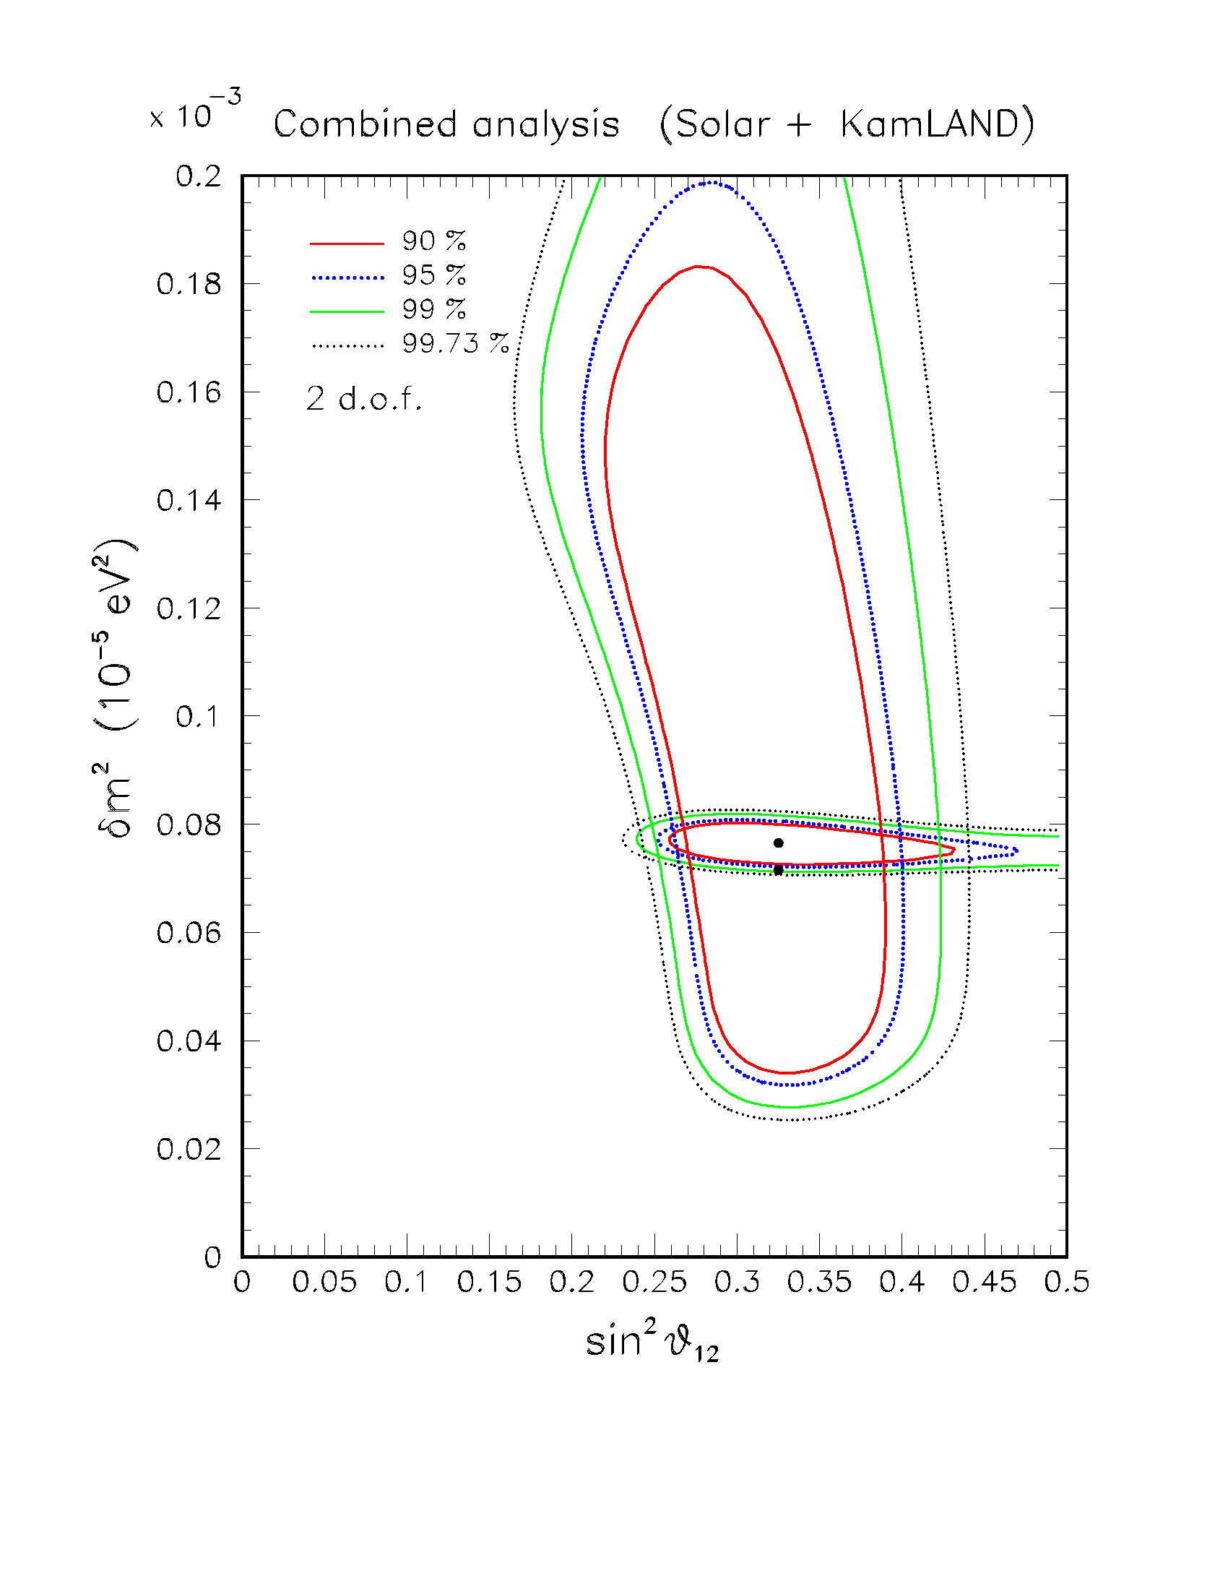
Disagreement reduced for θ₁₃ > 0 …
(3/4)
sin²θ₁₃ = 0
sin²θ₁₃ = 0.03
(figures prepared by A.M. Rotunno for this talk)
… thanks to the different dependence in SNO and KamLAND from (θ₁₂ , θ₁₃).
Notes:
6

Slide 7
(4/4)
A tiny effect, of course,
but with some potential for improvement, once final SNO data and further KamLAND data will be available.
This one year ago …
… what happened next?

Slide 8
Time-table of “events”
Concerning solar + KamLAND (S+K) neutrinos:
2008, Apr: Effect discussed independently (Balantekin & Yilmaz)
2008, May: SNO-III data release (Neutrino 2008 conference)
2008, Jun: sin²θ₁₃ = 0.021 ± 0.017 from our S+K analysis (PRL)
2008, Aug: Independent S+K analysis (Schwetz, Tortola, Valle)
Concerning atmospheric + long-baseline neutrinos:
5. 2008, Jun: sin²θ₁₃ = 0.016 ± 0.010 from all data in our analysis (PRL)
6. 2008, Dec: Comments on atmospheric hint of θ₁₃ > 0 (Maltoni, Schwetz)
7. 2008, ???: New three-flavor atmospheric analysis from SK (upcoming?)
8. 2009, Feb: First MINOS results on electron neutrino appearance
This talk will be concerned with all such 8 “events”, and will be concluded with an approximate “update estimate” for
sin²θ₁₃
(the number only in the last slide, be patient!)

Slide 9
ACT ONE: Solar + KamLAND hint for θ₁₃>0
[where we find out what the main problem is …]

Slide 10
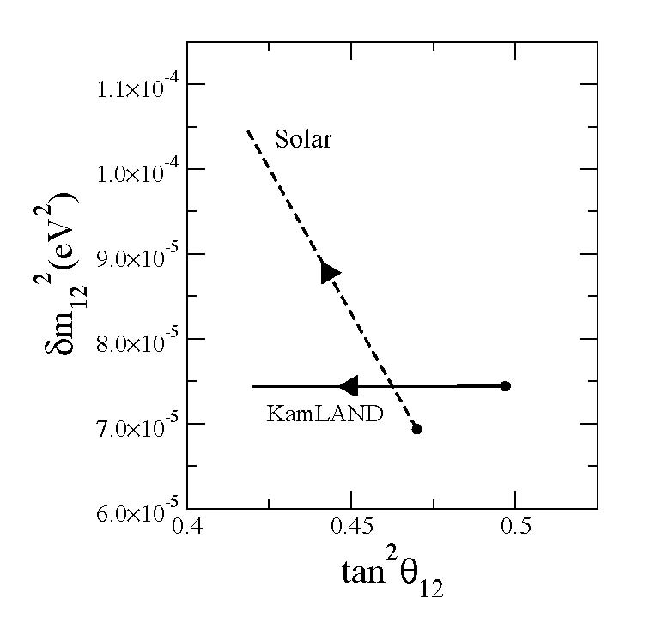
Event 1
Independently, in April, Balantekin & Yilmaz [arXiv:0804.3345, J.Phys. G 35, 075007 (2008)]
studying the “migration” in the plane (δm²₁₂, tan²θ₁₂) of the two best fit points with θ₁₃ …
… note a better convergence of solar and KamLAND best fit trajectories for θ₁₃ > 0.

Slide 11
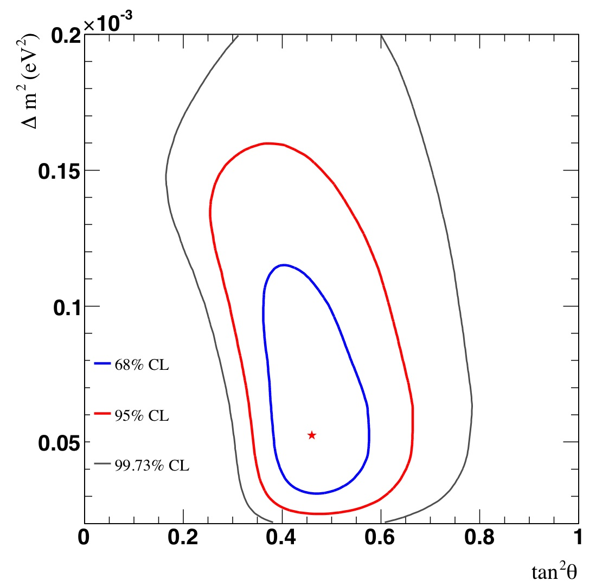
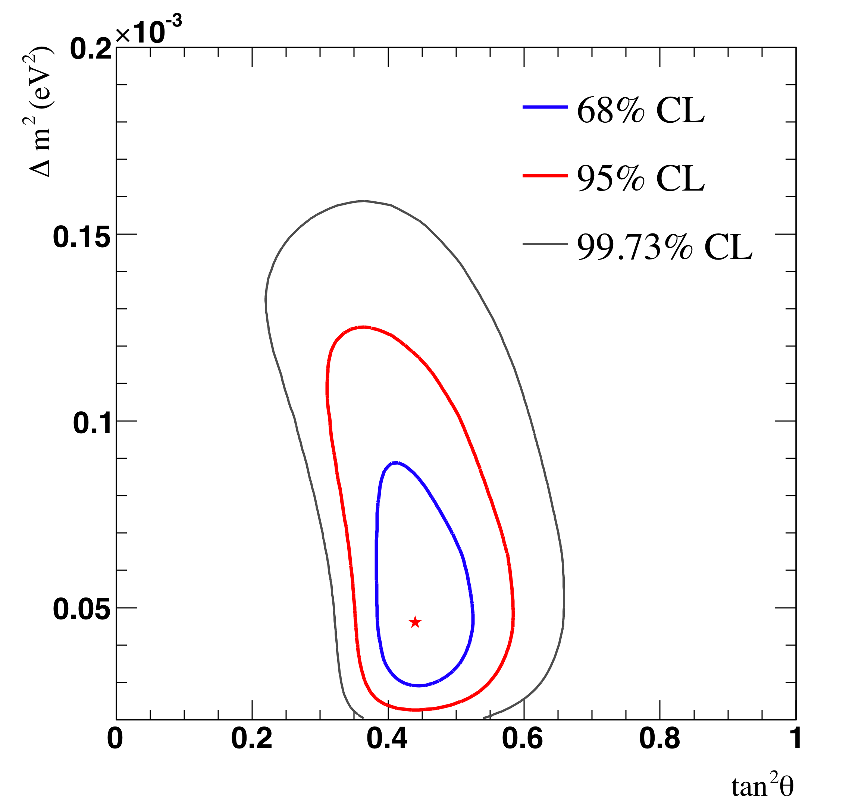
Event 2
Release of the SNO-III data (arXiv:0806.0989) at the Neutrino ’08 Conference
SNO only, 2005
SNO only, 2008
(figures taken from the
SNO official website)
Slightly lower CC/NC ratio, with smaller errors
slightly lower values of θ₁₂ preferred

Slide 12
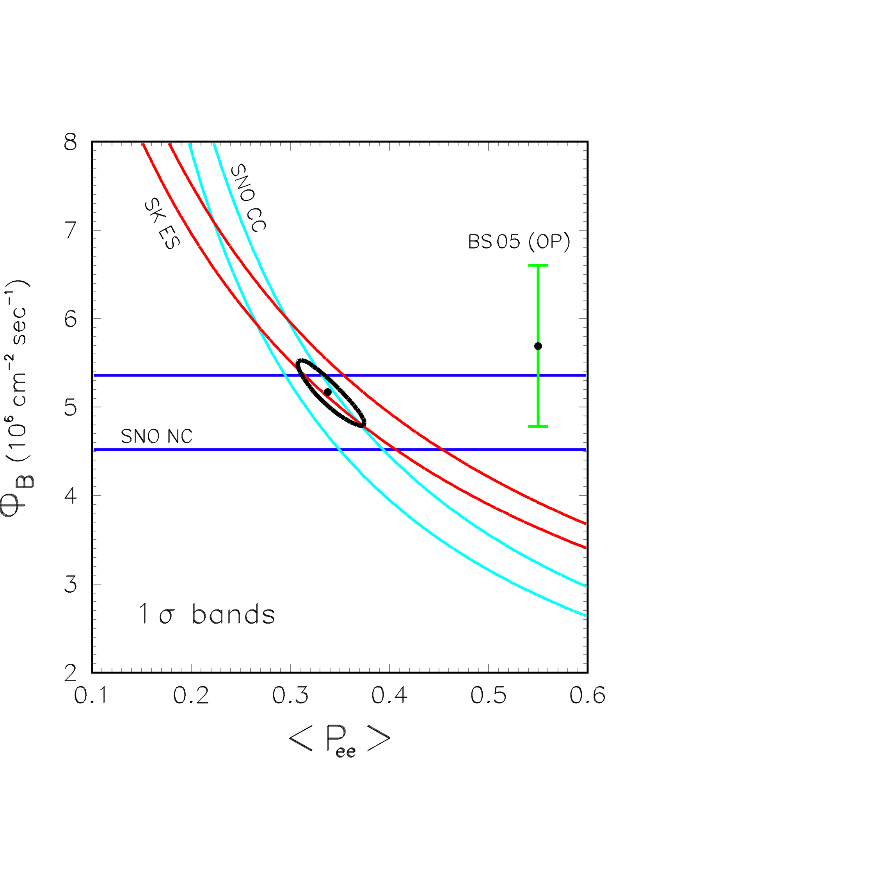
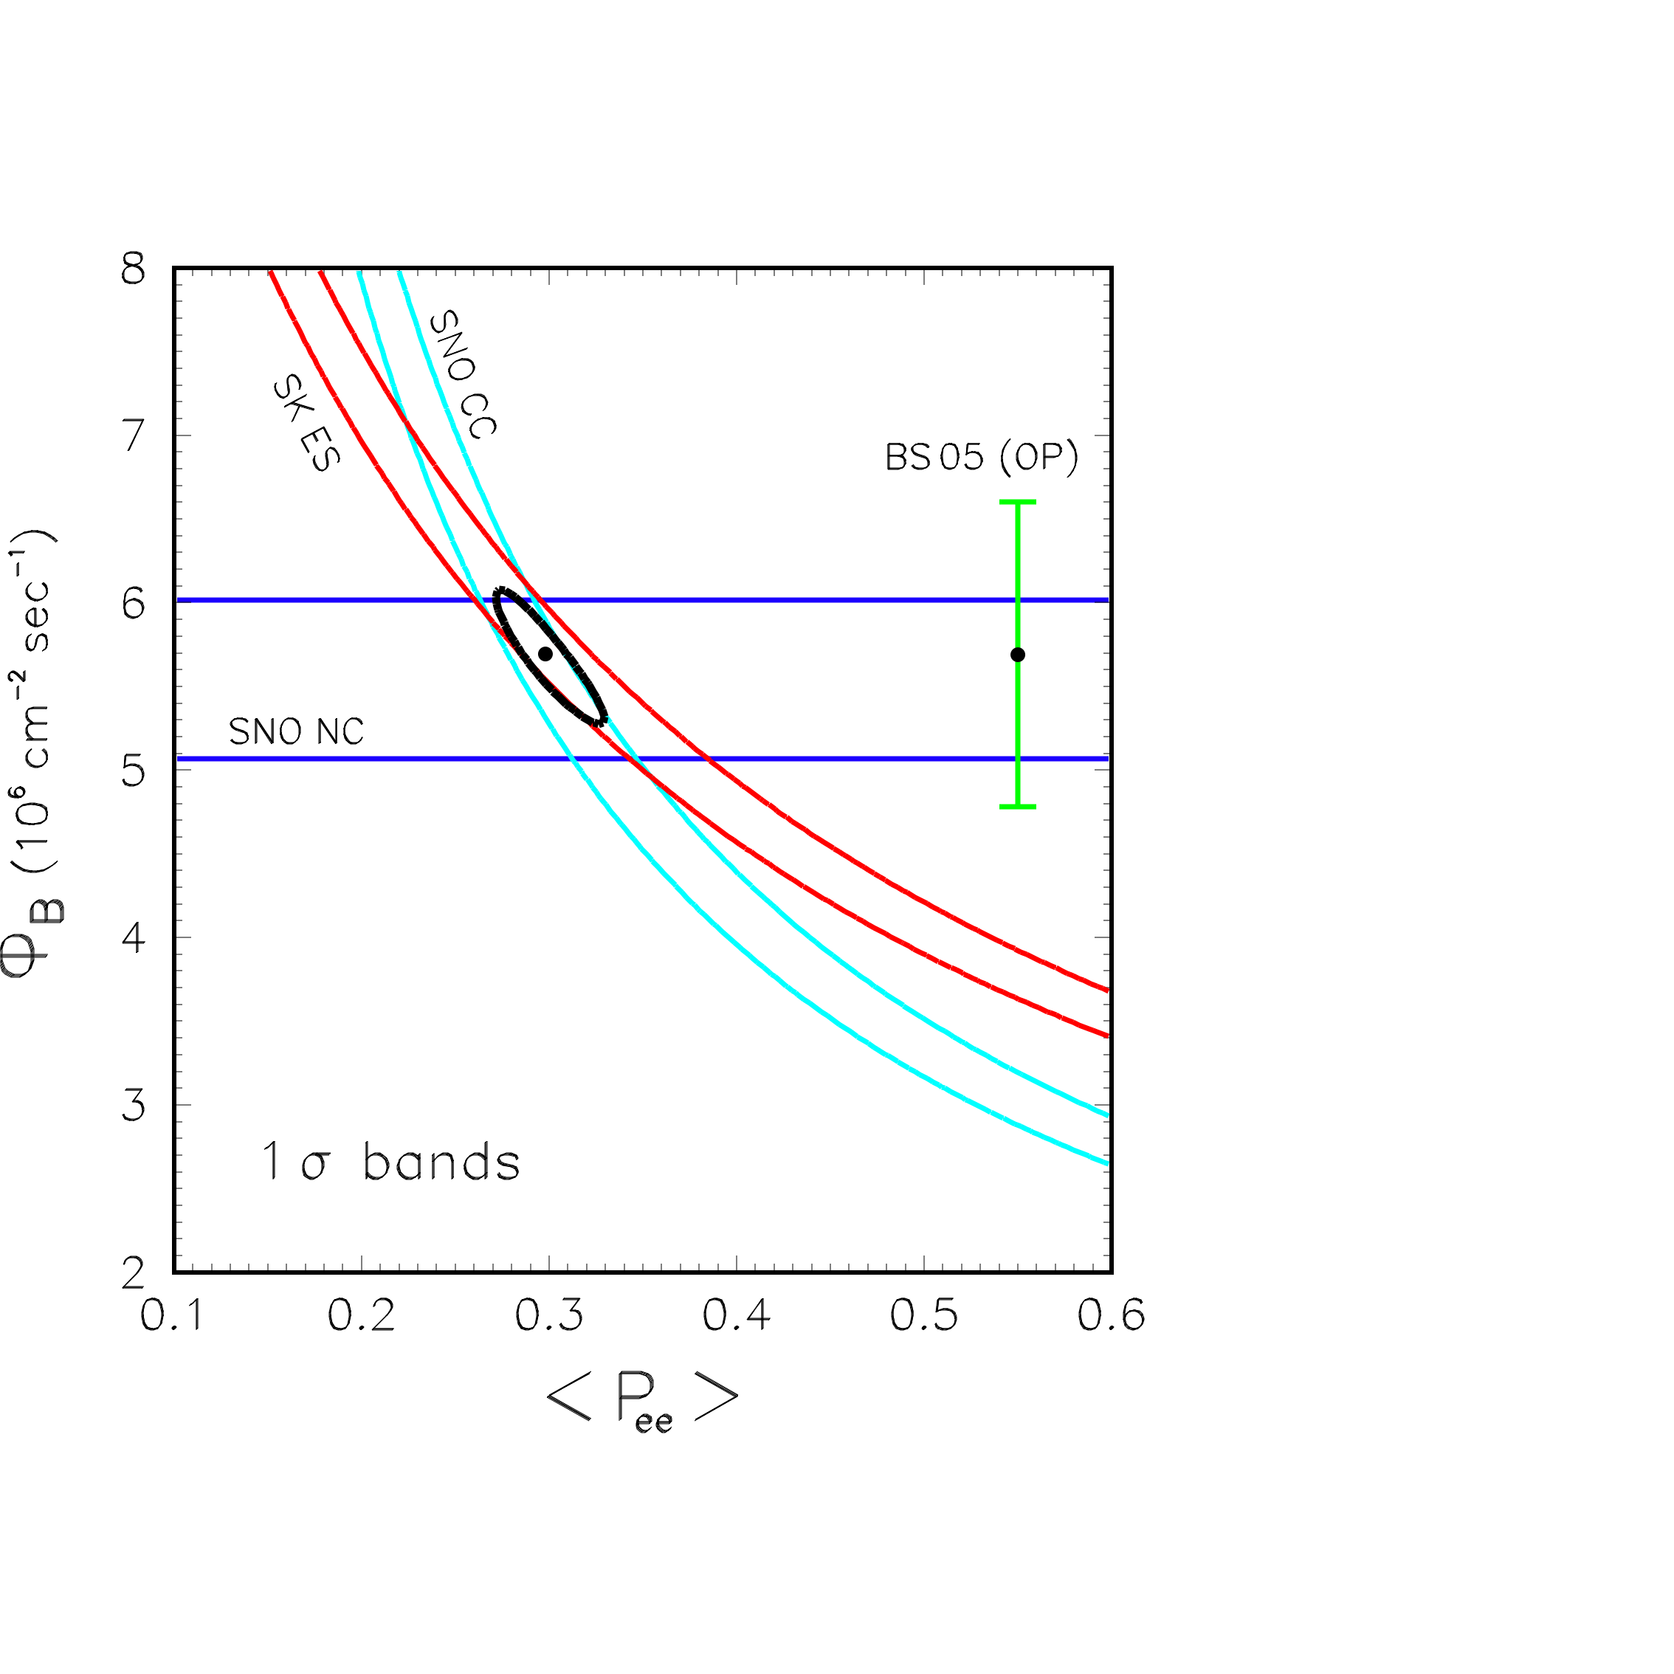
Note: new data are OK from a model-independent viewpoint
“Internal” consistency among SNO (CC, NC) and SK (ES)
Also, consistency among NC measurement and BS’05 Standard Solar Model prediction
consistencies already good in SNO-II …
… but even better in SNO-III
SNO-II (2005)
SNO-III (2008)
(Our analysis; see also talk by A. Palazzo at NOW 2008)

Slide 13
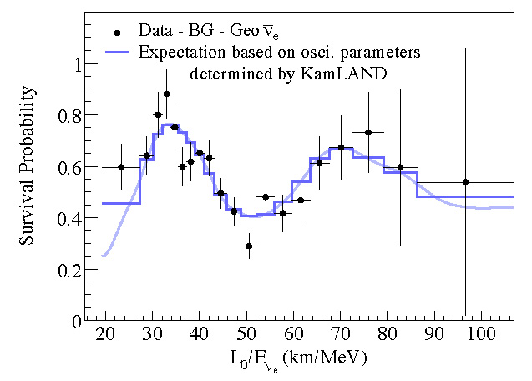
On the other hand, also KamLAND data have their own internal consistency …
… dramatically shown by the reconstruction of the oscillation pattern over one full period:

Slide 14
The fact that the solar and KamLAND datasets are separately OK, but slightly disagree on θ₁₂, unless θ₁₃ > 0, is thus intriguing.
Here an updated example with currently available data (including Borexino):
(Our analysis; see also talk by A. Palazzo at NOW 2008)

Slide 15
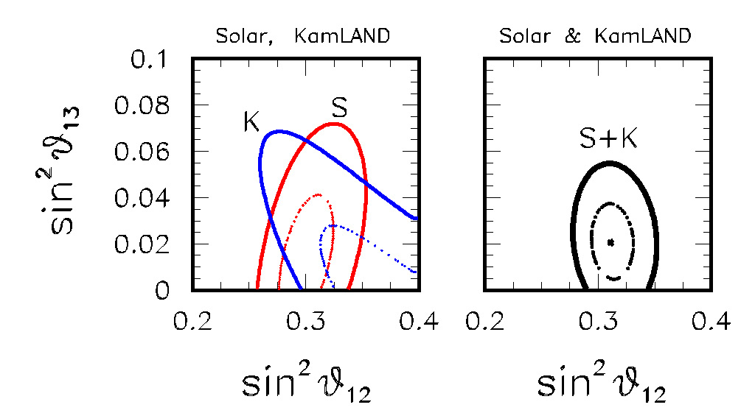
Event 3
Hints of θ₁₃ > 0 from global analysis [GLF, Lisi, Marrone, Palazzo, Rotunno arXiv:0806.2649 (PRL 101:141801 (2008)]
The solar+KamLAND hint for θ₁₃ > 0 can be plotted in the plane of the two mixing angles, where the different correlations of the datasets are more evident:
By combining the two sets of data …
Best fit more than 1 sigma away from zero
sin²θ₁₃ = 0.021 ± 0.017 (solar + KamLAND)

Slide 16
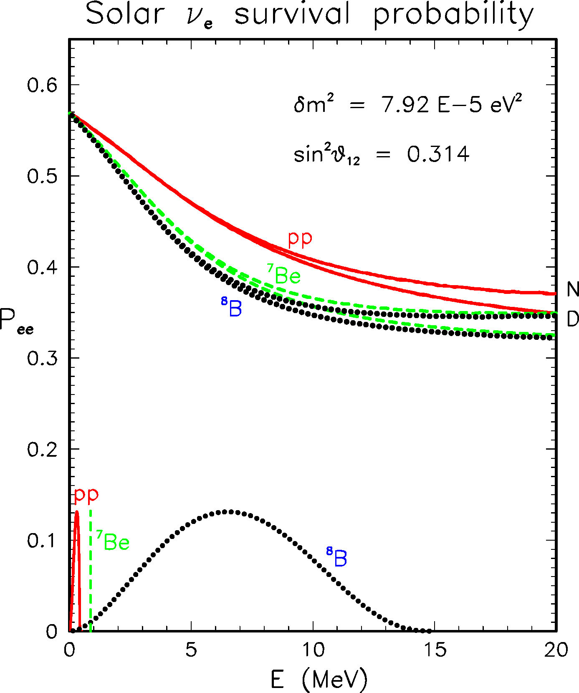
Reason of the different correlation between the two mixing angles: different relative sign of mixings in P_{ee} (the ν_{e} survival probability) of SNO vs KamLAND
Low E, vacuum
− −
High E, adiabatic MSW (SNO !)
− +
KamLAND, vacuum
_
− −
16

Slide 17
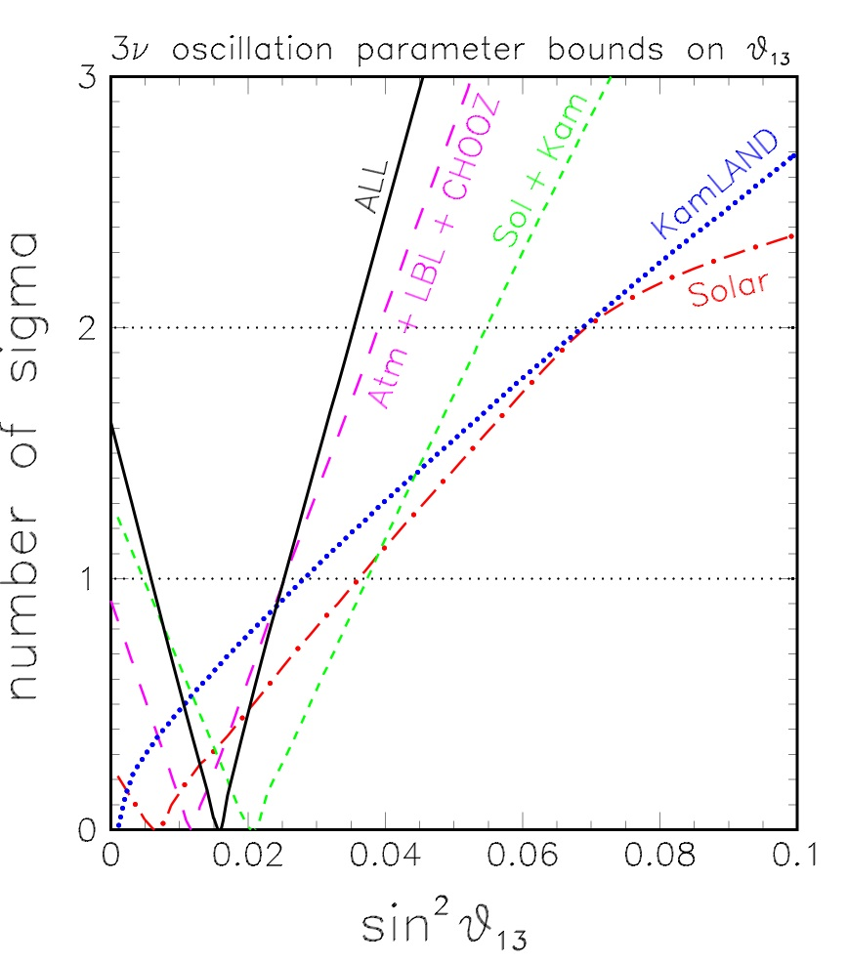
Complementarity: solar or KamLAND data, taken separately, prefer θ₁₃ ~ 0. Only their combination hints to θ₁₃ > 0 at ~ 1.2 sigma:
~ 1.2 sigma for the combination solar + KamLAND (green line):

Slide 18
Event 4
In August, Schwetz, Tortola, Valle (arXiv:0808.2016) also found a preference for θ₁₃ > 0 from the latest solar+KamLAND data, at a slightly higher CL (~ 1.5 sigma):
From Schwetz, Tortola, Valle New J.Phys.10:113011,2008 (arXiv:0808.2016)

Slide 19
In conclusion of this ACT ONE …
A weak preference for θ₁₃ > 0 from Solar + KamLAND data seems now accepted at the level of ~ 1.2-1.5 sigma.
The question now is:
Is this preference also supported by atmospheric + accelerator data?
In our paper (arXiv:0806.2649) we used, as independent support for θ₁₃ > 0, an older hint coming from our atmospheric + CHOOZ + long-baseline analysis.
We start from this hint in opening …

Slide 20
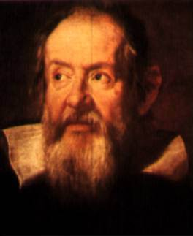
Portrait of Galileo
Justus Sustermans – Firenze, Uffizi
ACT TWO: The atmospheric (+CHOOZ+LBL) hint for θ₁₃ > 0
[where the complication usually comes out …]

Slide 21
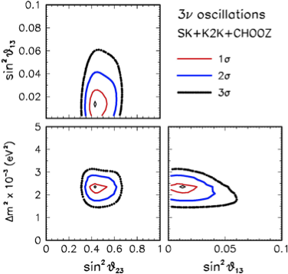
Event 5
An older (but persisting) hint for θ₁₃ > 0 comes from our 3-neutrino analysis of atmospheric + LBL + Chooz data …
GLF, Lisi, Marrone, Palazzo
Progr. Part. Nucl. Phys. 57, 742 (2006)
See also Escamilla et al., arXiv:0805.2924
… mainly due to subleading “solar term” effects which help fitting atmospheric electron event data (especially sub-GeV).
best fit ~ 1 sigma away from zero
We find also that the hint is NOT killed by adding latest MINOS disappearance data.

Slide 22
Excess of electron events induced by 3ν subleading effects
Our calculations of atmospheric ν oscillations are based on a full three-flavor numerical evolution of the Hamiltonian along the ν path in the atmosphere and (below horizon) in the known Earth layers …
… however, semi-analytical approximations can be useful to understand the behavior of the oscillation probability of some of the atmospheric neutrino observables.
A particularly important observable is the excess of expected electron events compared to the no oscillation case, i.e.
[O.L.G. Peres and A.Yu. Smirnov , Nucl. Phys. B 456, 204 (1999); ibidem 680, 479 (2004)]
with P_{ee} and P_{eμ} oscillation probabilities
ν_{μ}/ν_{e}
flux ratio
sub-GeV
r
=
multi-GeV
θ₁₃ = 0
δm² = 0
zero when both
but can have contribution from θ₁₃ ≠ 0 and/or δm² ≠ 0

Slide 23
Constant density approximation
By assuming
A(x) = 2 2 G_{F}N_{e}(x) E = const
(assumption made only in the spirit of simplifying the present example)
From an estimate of the
order of magnitude
of the potential
we see that in SK data Earth matter effects take place, Δm²-driven for multi-GeV and δm²-driven for sub-GeV events.
In the assumed constant density approximation, the electron excess can be written as the sum of three terms

Slide 24
In particular, for the case
[ν, normal hierarchy, δ=0]
“θ₁₃ term”
(~ quadratic in θ₁₃)
“δm² term”
(∼ θ₁₃-independent)
“interference term”
(~ linear in θ₁₃)
mixing angles
in matter
The corresponding expressions in the other cases are obtained by making use of the following
“swapping”
relations

Slide 25
Exact numerical examples for
SubGeV and MultiGeV events
GLF, Lisi, Marrone, Palazzo, Progr. Part. Nucl. Phys. 57, 742 (2006)
“θ₁₃ term” dominant
“δm² term” dominant
“Interference term” dominant
(only in sub-GeV)
These terms help fitting the small electron excess in SubGeV and MultiGeV data, with the interference term helping, in particular, for SubGeV data at δ=π.
25

Slide 26
More about the “subleading” solar terms
The atmospheric three-neutrino analyses in
SK Collaboration, hep-ex/0604011
Schwetz, Tortola, Valle, arXiv:0808.2016
(also based on the same SK-I data), adopt the so-called one-mass-scale-dominance, and thus do not include the two subleading solar terms.
As a consequence, their results (which prefer θ₁₃ ~ 0) cannot be directly compared with ours (while Gonzalez-Garcia & Maltoni, arXiv 0704.1800, do include all terms).

Slide 27
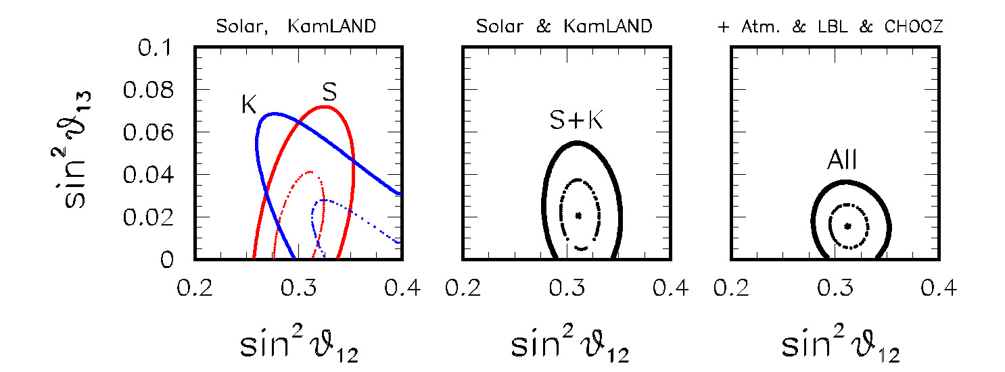
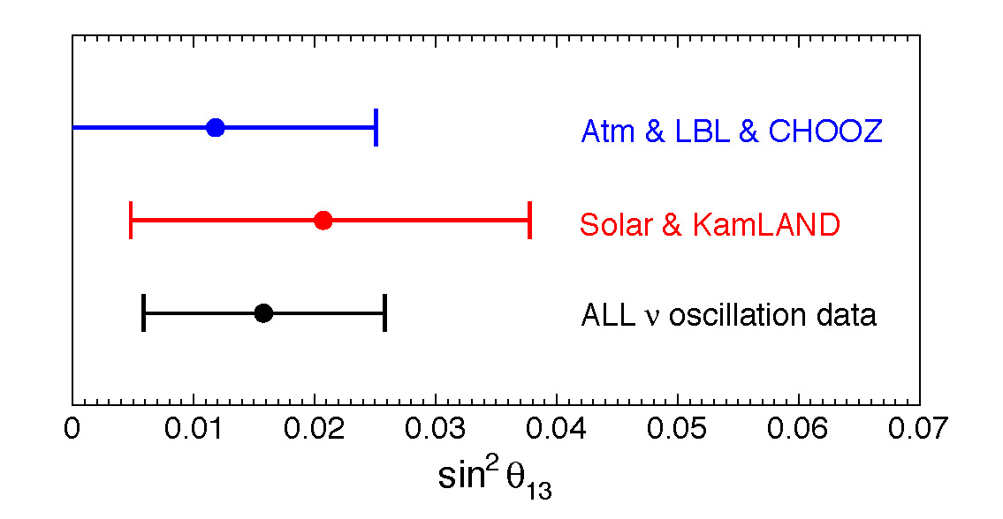
Sticking to our analysis
Taken together, the two hints (solar+KamLAND, and atmospheric+CHOOZ+LBL), provide a possible indication in favor of θ₁₃ > 0 at the level of ~ 1.6 sigma = 90% CL: not so bad!
By combining all data together …
sin²θ₁₃ = 0.016 ± 0.010 (all data)
GLF, Lisi, Marrone, Palazzo, Rotunno
PRL 101, 141801 (2008) arXiv:hep-ph/0806.2649
Notes:
27

Slide 28
Event 6
In the last December Maltoni & Schwetz (arXiv:0812.3161) study the variations of a full 3-neutrino atmospheric data analysis containing all terms (as well as preliminary SK-II data).
Their results can be summarized as follows:
Using SK-I data, they find at most a 0.5 sigma hint from atmospheric + CHOOZ analysis.
This is weaker than our 0.9 sigma, but shows similar qualitative features – e.g., the role of the interference term, and the irrelevance of K2K+MINOS disappearance data).
Varying the χ² definition, they find a possible reduction of the hint to 0.2 sigma.
Multi-GeV electron data also contribute to the likelihood of θ₁₃, and the fact that in SK-II such data show no longer an upgoing excess can suppress the hint.
The latter two points bring us to a discussion of …
Notes:
28

Slide 29
Event 7
SK-I+II (+ III + …) data and ongoing analyses (not yet published)
There exist ongoing three-flavor analyses in SK after phase I, as detailed in recent (2008) PhD theses using SK-I+II data (available at www-sk.icrr.u-tokyo.ac.jp/sk/pub/):
R.A. Wendell: allows θ₁₃ > 0, but sets δm² = 0; finds no hint for θ₁₃ > 0.
Y.Takenaga: allows δm² > 0, but sets θ₁₃ = 0.
Unfortunately, none of the above analyses allows both θ₁₃ > 0 and δm² > 0, and thus they do not include interference effects linear in θ₁₃ (which, as noted, may play some role at sub-GeV energies).
However, the trend of the data may tell us something about the expectations for θ₁₃ …
Notes:
29

Slide 30
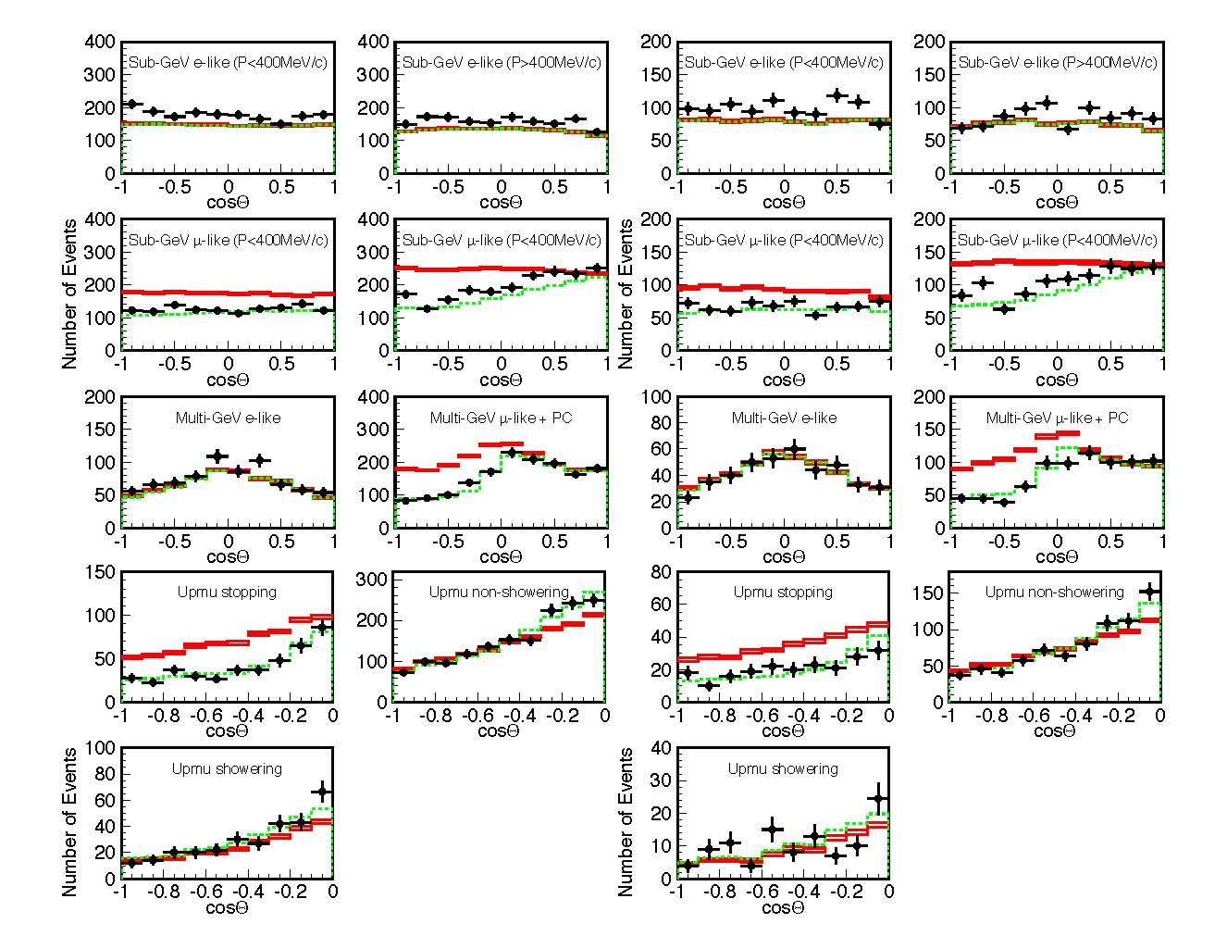
SK-I data
SK-II data
Trend from SK-I to SK-II:
Sub-GeV electron excess
persists in both phases I and II
Conversely,
slight excess of upgoing MGe present in SK-I but not in SK-II
Actually, this downward MGe fluctuation may disfavor θ₁₃ > 0 (as noted by Maltoni and Schwetz)
(zenith distributions from Takenaga thesis, 2008)
… however, going to SK-III …
Notes:
30

Slide 31
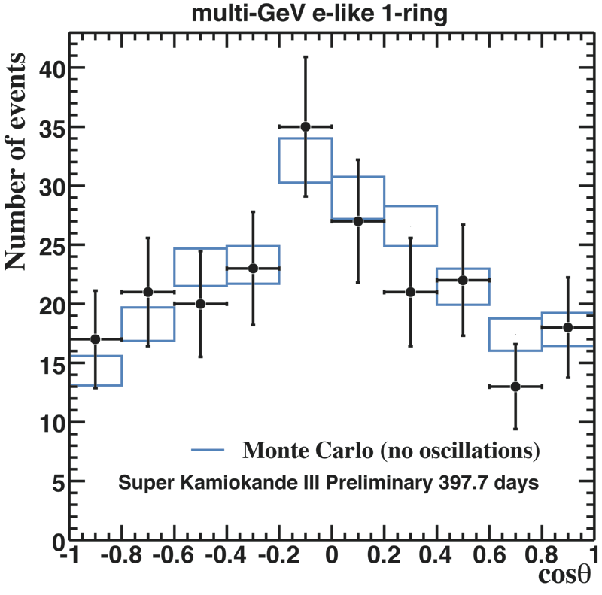
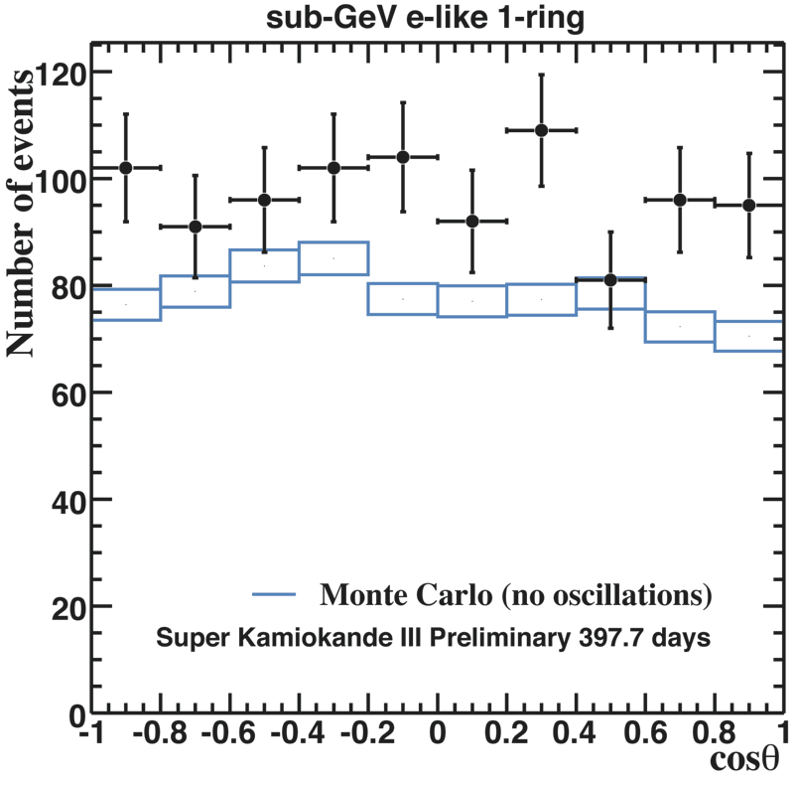
…in SK-III data, a slight excess of upgoing MGe seems to be back …
(SK-III data, from
J. Raaf at Neutrino 2008)
…together with a persisting excess of SGe data!
Question:
Can all this be interpreted away from statistical fluctuations + systematic uncertainties?
The answer requires a refined statistical analysis …
Notes:
31

Slide 32
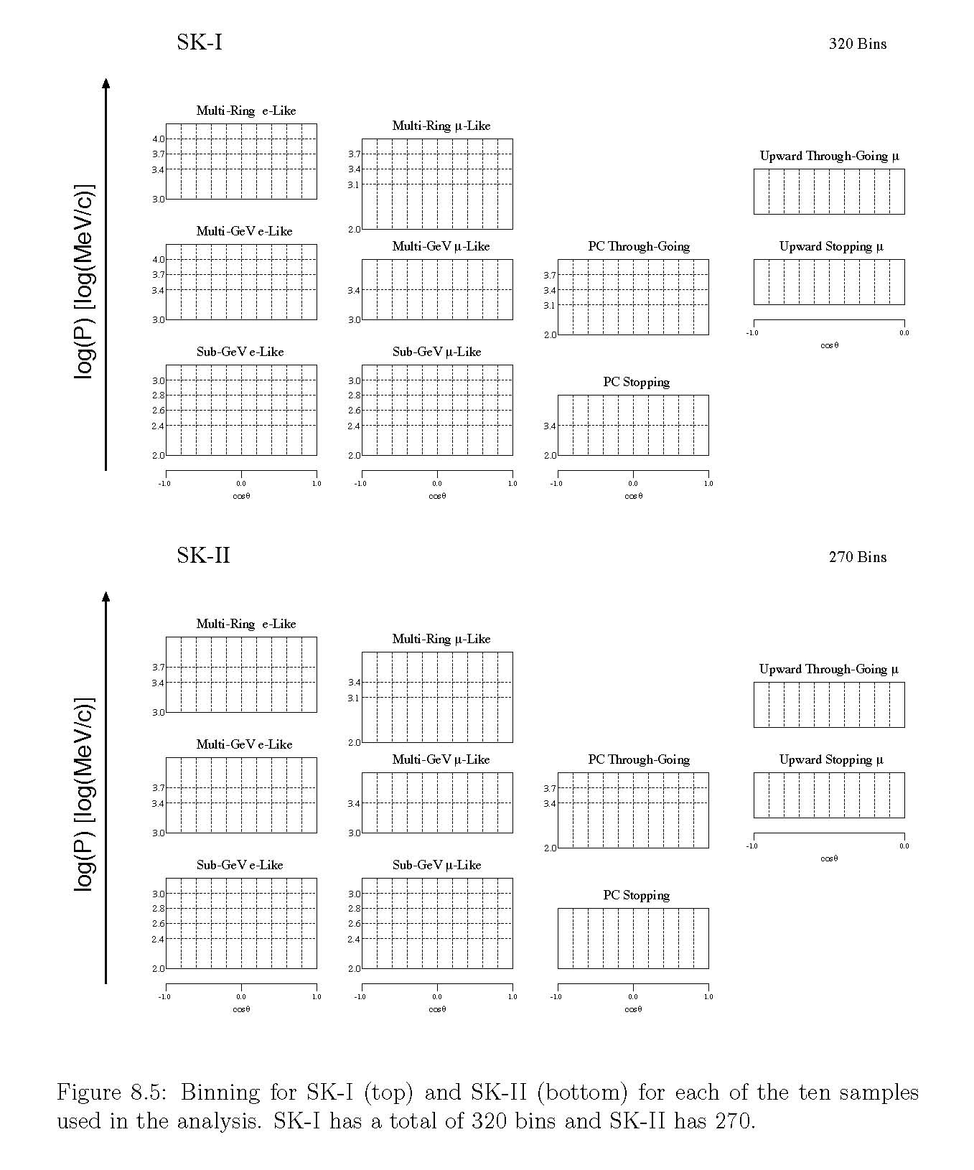
The analysis SK-I+II Collaboration currently includes:
320+270 energy-angle bins for SK-I + SK-II
20+26+20 sources of systematics for SK-I + SK-II
(26 being common to both phases)
to be handled within the so-called “pull method”
(that we advocated in hep-ph/0206162 and hep-ph/0303064)
R. Wendell thesis, 2008
Such a level of refinement, with ~ 600 bins and ~ 70 systematics, partly shared in SK-I+II, is difficult to be reproduced in detail outside the SK collaboration.
Independent analyses of atmospheric data searching for small effects (or hints) at the level of ~ 1 sigma, like ours, are thus getting harder and harder to perform.

Slide 33
Therefore …
… it will be very important to see the next official SK data release and especially the official SK oscillation analysis, hopefully including a complete treatment of three-flavor oscillations with both δm² > 0 and θ₁₃ > 0 (and possibly including also SK-III data).
In the meantime, we do not have compelling reasons to revise our 0.9 sigma hint of θ₁₃ > 0 obtained from published SK-I data, although it may have, admittedly, a more fragile status than the ~ 1.2 sigma hint from the analysis of solar + KamLAND data.
In any case, the whole discussion about θ₁₃ > 0 must be taken with a grain of salt, since we are talking about really small and indirect effects, which will never pre-empt the discovery potential of direct searches at reactors and accelerators.

Slide 34
Event 8
First MINOS results on electron neutrino appearance
These preliminary results have been released recently by the MINOS collaboration (Mayly Sanchez, talk at FNAL, Feb. 27th)
It would be unfair to anticipate results and slides that will be presumably shown by Milind Diwan later in this Workshop …
… but I can’t help noticing that MINOS’s best fit for θ₁₃ sits around the CHOOZ limit, and is away from zero at ~ 90% C.L. (although the Collaboration, conservatively, does not attach any particular relevance to this fact).
We are then ready to open …

Slide 35
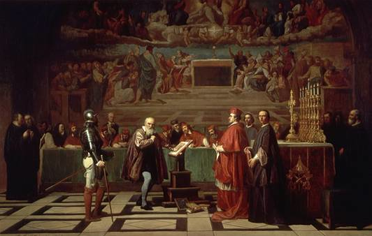
Galileo before the Holy Office, by Joseph Nicolas Robert-Fleury Luxembourg Museum
ACT THREE: Approximate update for θ₁₃
[where the resolution of the problem is given …]

Slide 36
If, optimistically, we see the glass “half full” rather then “half empty”, then we might have
two independent 90% CL hints in favor of θ ₁₃ > 0
one coming from our global analysis (2008)
sin²θ₁₃ = 0.016 ± 0.010
and one coming from MINOS (2009), that we roughly symmetrize and approximate with only one significant digit as
sin²θ₁₃ ~ 0.05 ± 0.03
[Note that being more refined about MINOS would not really matter in this context.]

Slide 37
A combination at face value gives …
sin²θ₁₃ ~ 0.02 ± 0.01
namely, an overall indication at ~ 2 sigma (95% CL)
In other words …
the odds against null θ₁₃ are now 20 to 1 !

Slide 39
BACKUP

Slide 44
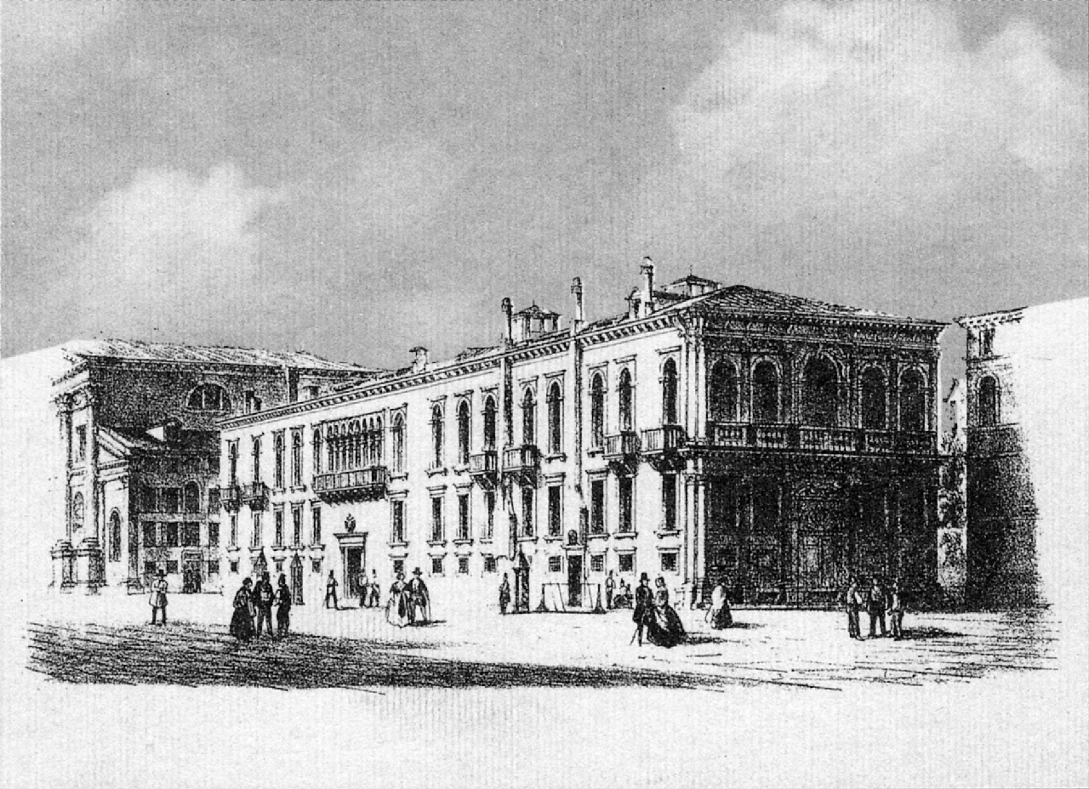
SNO, KamLAND and neutrino oscillations: θ₁₃
Venice, March 10, 2009
Gianluigi Fogli
XIII International Workshop on “Neutrino Telescopes”
17th of the series “Un altro modo di guardare il cielo”

Slide 45
SNO, KamLAND and neutrino oscillations:
Venice, March 10, 2009
θ₁₃
Gianluigi Fogli
XIII International Workshop on “Neutrino Telescopes”
17th of the series “Un altro modo di guardare il cielo”

Slide 46
Venice, March 10, 2009
Gianluigi Fogli
SNO, KamLAND and ν oscillations:
θ₁₃
XIII International Workshop on “Neutrino Telescopes”
17th of the series “Un altro modo di guardare il cielo”

Slide 47
Venice, March 10, 2009
Gianluigi Fogli
SNO, KamLAND and ν oscillations:
θ₁₃
XIII International Workshop on “Neutrino Telescopes”
17th of the series “Un altro modo di guardare il cielo”

Slide 48
SNO, KamLAND and neutrino oscillations: θ₁₃
Gianluigi Fogli
Venice, March 10, 2009
θ₁₃
XIII International Workshop on “Neutrino Telescopes”
17th of the series “Un altro modo di guardare il cielo”

Slide 49
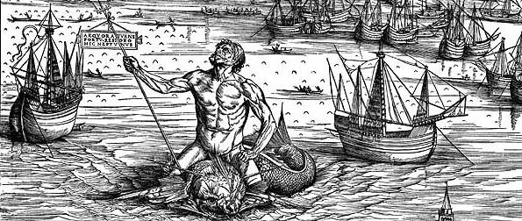
Outline
Flash-back from NO-VE 2008
The solar+KamLAND hint for θ₁₃ > 0
The atmospheric + accelerator hint for θ₁₃ > 0
Conclusions

Slide 50
SNO, KamLAND and neutrino oscillations: θ₁₃
Gianluigi Fogli
Dipartimento di Fisica dell’Università di Bari & Sezione INFN – Bari
ITALY
Based on work done in collaboration with: E. Lisi, A. Marrone, A. Palazzo, A.M. Rotunno
50

Slide 51
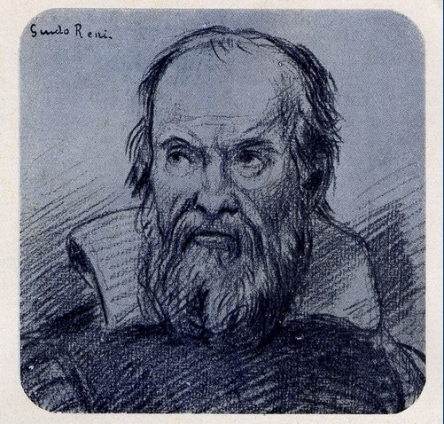
Galileo Galilei by Guido Reni (?)
Portrait of Galileo
Justus Sustermans – Firenze, Uffizi

Slide 52
Galileo before the Holy Office, by Joseph Nicolas Robert-Fleury – Luxembourg Museum

