Slide 1
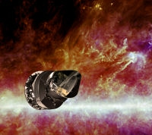
Inflazione cosmologica: cosa ci aspettiamo da Planck?
Nicola Bartolo, Dip. di Fisica ``G. Galilei’’ & INFN Padova
Padova 18th May 2011, Scuola di neutrini in Cosmologia

Slide 2
Outline
Basics of Inflation
What do we expect from Planck?
some avenues to probe physics beyond the
standard (cosmological) model

Slide 3
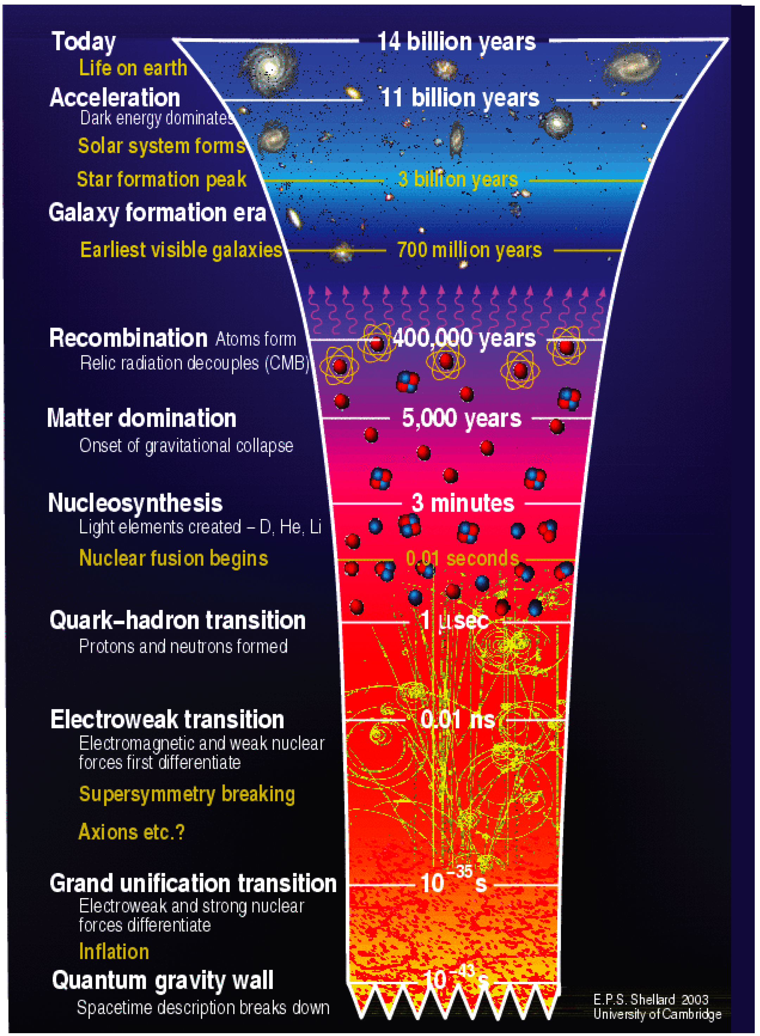
We are here
We seek information
about very early times
and very high energies
E~10¹⁶ GeV

Slide 4
INFLATION:
a period of accelerated expansion in the very early universe
In a homogeneous and isotropic universe:
cosmological scale factor ( physical length )
From Einstein+continuity equations
and
with the total energy density of the universe and pressure

Slide 5
INFLATION:
a period of accelerated expansion in the very early universe
For sure Inflation takes place before primordial nucleosythesis (T≈1MeV): for radiation and
(collisionless) matter dominated epochs p=1/3 and p=0.
A reference example: de Sitter phase
An exponential expansion sourced by an energy density that does
not dilutes away

Slide 6
INFLATION: WHY SO IMPORTANT?
Inflationary paradigm is one of the most relevant development in
modern cosmology. Introduced to solve some shortcomings of the
standard Big-Bang model (Guth ‘81)
e.g.: why the universe is so nearly spatially flat? (flatness problem)
why the temperature of CMB photons on opposite sides of the
sky is so accurately the same even if they were never in causal
contact? (horizon problem)
most importantly: inflation offers an elegant explanation for the
origin of the first density perturbations which are the seeds for
the CMB anisotropies and the Large-Scale-Structures of the Universe
we observe today (e.g. cluster of galaxies).

Slide 7
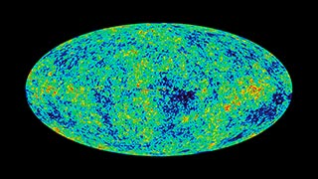
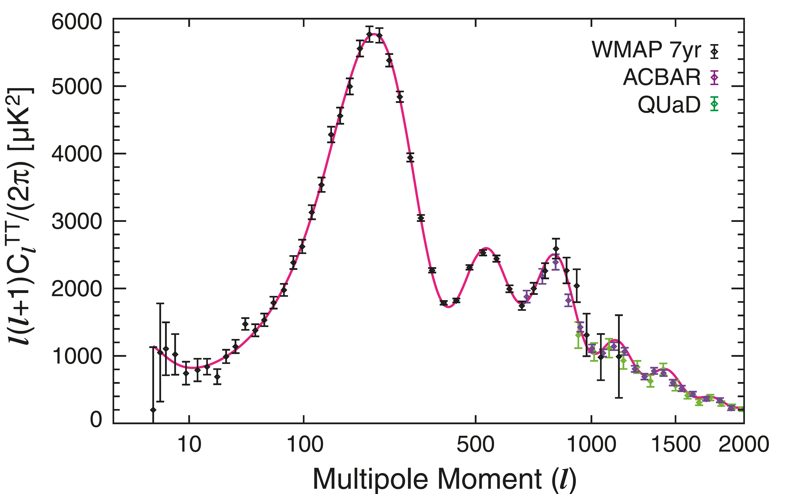
Quantum fluctuations of primordial energy density (of a scalar field, the inflaton) set the initial conditions for CMB anisotropies and Large-Scale-Structure formation
WMAP
Hinshaw et al. 2006
astro-ph/0603451

Slide 8
We are here
We seek information
about very early times
and very high energies
E~10¹⁶ GeV

Slide 9
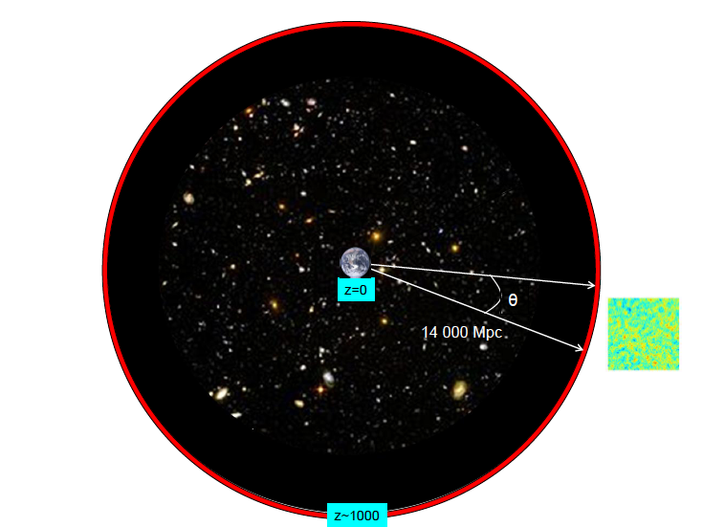
THE HORIZON PROBLEM
Last scattering surface: CMB photons decouple at
recombination epoch z~1100
(t_{r}~ 400,000 years)
Light could have travelled
L ~ c t_{r} (horizon)
Such a distance would
subtend an angle of
about 1 degree.
We actually see
CMB photons with
nearly the same
T at bigger angular
scales >7°
(e.g. COBE satellite)
>7°
2 causally
disconnected
regions at
recombination
Adapted from http://benasque.org/2011Astrophysics/talks_contr/172_Lewis.pdf

Slide 10
Example: solving the horizon problem
The (comoving) Hubble radius (a H)⁻¹ (the horizon) decreases exponentially during
inflation;
regions of size λ > (a H)⁻¹ are causally disconnected;
they are causally connected for λ <(a H)⁻¹
Subhorizon
Superhorizon
(comoving) lengths
Hubble radius: (a H)⁻¹
λ~ 2 π/k
Log a(t)
INFLATION
End inflation -> radiation epoch
t₀: today
N.B.: Inflation must last enough to solve the horizon (flatness) problems

Slide 11
A huge expansion
Take a region of size at the beginning of inflation:
Since , it gets inflated by !!!!

Slide 12
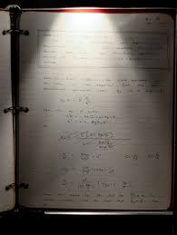
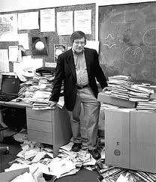
What is inflation?
``spectacular realization “
(Alan Guth’s diary 1979)

Slide 13
INFLATION and THE INFLATON
Who is a candidate to get ?
Consider a simple real scalar field:
Equation of motion:
Energy-momentum tensor:
for a homogeneous and isotropic field

Slide 14
INFLATION and THE INFLATON
Inflation is attained if the energy density of the universe is dominated by the potential
energy of a scalar field (the inflaton)
If the inflaton is slowly rolling its potential:
Slow-roll conditions: the potential V(ϕ)
must be flat
and
(effective cosmological constant:
inflation is driven by the vacuum energy
of the scalar field)

Slide 15
Generating the primordial density perturbations
first step: take a scalar field during an inflationary (de-Sitter) phase
split the scalar field into a ``classical’’ background expextation value (on the vacuum state)
and quantum fluctuations around the mean value

Slide 16
Quantum fluctuations of a scalar field during inflation
A massless or light scalar field: m²=V’’ << H² for slow-roll
when the perturbation modes are within the horizon:
λ << (comoving) Hubble radius = (a H)⁻¹
k>> (aH)
when the perturbation modes are superhorizon scales:
(k<<aH)
Remember: H≈const.

Slide 17
Subhorizon:
Superhorizon:
(comoving) lenghts
Hubble radius: (a H)⁻¹
λ~ 2 π/k
Log a(τ)
End inflation -> radiation epoch
δφ_{k}
ON SUPERHORIZON SCALES THE FLUCTUATIONS
GETS FROZEN IN
?
τ
Horizon crossing

Slide 18
Quantum fluctuations of a scalar field during inflation
Guess the value of the quantum fluctuations ………
(during inflation) the only relevant scale is the Hubble radius H⁻¹
Yes, you are not so wrong……..

Slide 19
The power spectrum of cosmological perturbations:
a quick definiton
Consider a random field f(t,x):
Power-spectrum
Essentially
f(t,x) can be the fractional energy density perturbation, or the scalar field perturbation, in which case the brackest denots the expectation value on the vacuum state and it can be computed using creation and annhiliation operators.
Inflaton fluctuations

Slide 20
Quantum fluctuations of a scalar field during inflation
A massless or light scalar field: m²=V’’ << H² for slow-roll
when the perturbation modes are within the horizon:
λ << (comoving) Hubble radius = (a H)⁻¹
k>> (aH)
when the perturbation modes are superhorizon scales:
(k<<aH)
Remember: H≈const.

Slide 21
A massless or light scalar field: m²=V’’ << H² for slow-roll
Exact solution:
On subhprizon scales: -k τ=k /(aH)>>1
ON SUPERHOPRIZON SCALES: -k τ=k /(aH)<<1

Slide 22
Subhorizon:
Superhorizon:
(comoving) lenghts
Hubble radius: (a H)⁻¹
λ~ 2 π/k
Log a(τ)
End inflation -> radiation epoch
δφ_{k}
ON SUPERHORIZON SCALES THE FLUCTUATIONS
GETS FROZEN IN
τ
Horizon crossing

Slide 23
Primordial gravitational waves
All light fields get excited on superhorizon scales in the same way by
the accelerated expansion
Graviton field (intrinsic quantum fluctuations of the transverse
trace-free part of the metric tensor perturbations)
or the two polarization state.
Energy scale of inflation!

Slide 24
Generating the primordial density perturbations
The inflaton field is special: it dominates the energy density of the universe during inflation
Fluctuations in the inflaton produce fluctuations in the universe expansion from place to place,
so that each region in the universe goes through the same expansion history but at slightly
different times:

Slide 25
Generating the primordial density perturbations
N.B: on superhorizon scales ζ=constant,
so one can easily relate density fluctuations after inflation with the quantum fluctuations of the inflaton field δϕ~H/2π
t(k): time when fluctuation
of mode k exit horizon
(comoving) lenghts
Horizon re-entry
Hubble radius: (a H)⁻¹
λ~ 2 π/k
density fluctuations
Log a(t)
INFLATION
End inflation -> radiation epoch
t₀: today

Slide 26
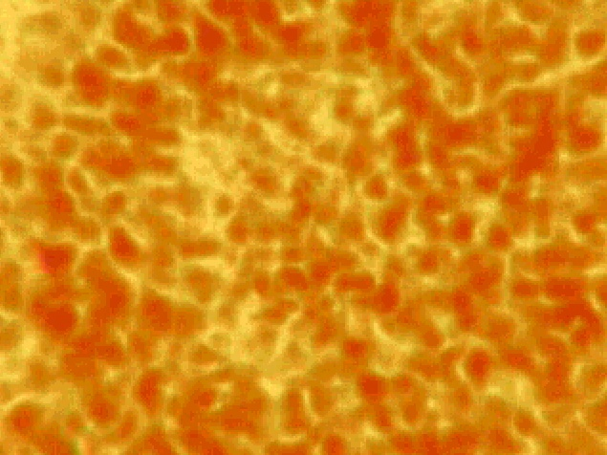
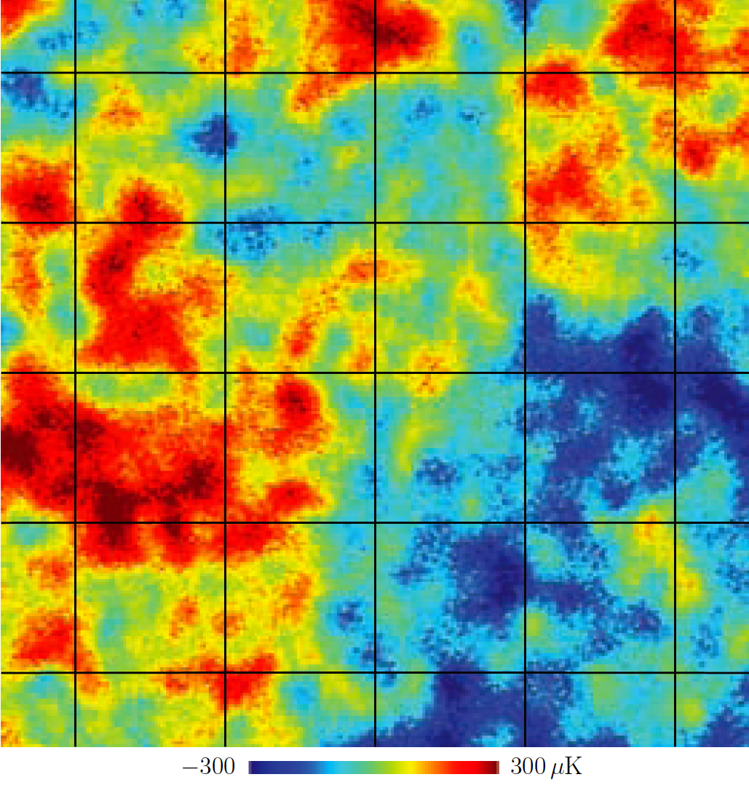
Structure formation within the inflationary scenario
Quantum fluctuations are streched from microscopic to cosmological scales
(comoving) lenghts
ζ
1-3000 Mpc
Hubble radius: (a H)⁻¹
λ~ 2 π/k:
fluctuation
mode
Log a(t)
End inflation -> radiation epoch
t₀: today
δϕ ⇒ ζ
quantum fluctuations
⇒ δρ
CMB fluctuations & structure formation
sub-atomic scales
cosmological scales

Slide 27
On superhorizon scales at recombination
Friedmann-Roberston-Walker perturbed metric (dη=dt/a(t): comformal time)
Gravitational potential
Gravitational potential
Contain tensor
Perturbations
(gravity waves)

Slide 28
Harrison-Zel’ dovich spectrum
But we know that H and ϕ vary in time very slowly: the level of density
fluctuations does not depend on the cosmological scale λ~ 2 π/k
(exact scale-invariance: Harrison-Zel’ dovich spectrum).
In fact H and ϕ vary a little bit: you expect a spectrum of density
perturbations which is nearly scale-invariant.

Slide 29
Observational predictions (I)
Primordial density (scalar) perturbations
spectral index:
(or ``tilt’’)
amplitude
N.B: both depend on the dynamics of the scalar field during inflation and hence on the potential
Recall:
Primordial (tensor) gravitational waves
Tensor spectral index:

Slide 30
Varying the Spectral index
If n=1: Harrison-Zel’ dovich spectrum (exact scale-invariance)
n>1: blue tilt: perturbtions have more power on
smaller scales
P(k)
n=1
n<1: blue tilt: less power on smaller scales
k
parametrizes deviation from scale-invariance:
n=1 would signal some underlying symmetry;
measuring n ≠ 1 would signal a dynamical process for generating the initial density fluctuations

Slide 31
Observational predictions (II)
Another relevant observable quantity related to the power spectra is the running of the
scalar spectral index:
Consistency relation (valid for all single field of slow-roll inflation):
Consider the tensor-to scalar perturbation ratio
then

Slide 32
Observational predictions: summary
Two amplitudes:
(density perturbations) (gravitational waves)
but overall normalization just leaves the tensor-to-scalar ratio
two spectral index: n and n_{T}
bur consistency relation just leaves the scalar spectral index
running of the scalar spectral index

Slide 33
Let’s pause for a moment
A few order of magnitudes:
On large scales
: observed amplitude of density pert.
: number of e-folds for succesfull inflation

Slide 34
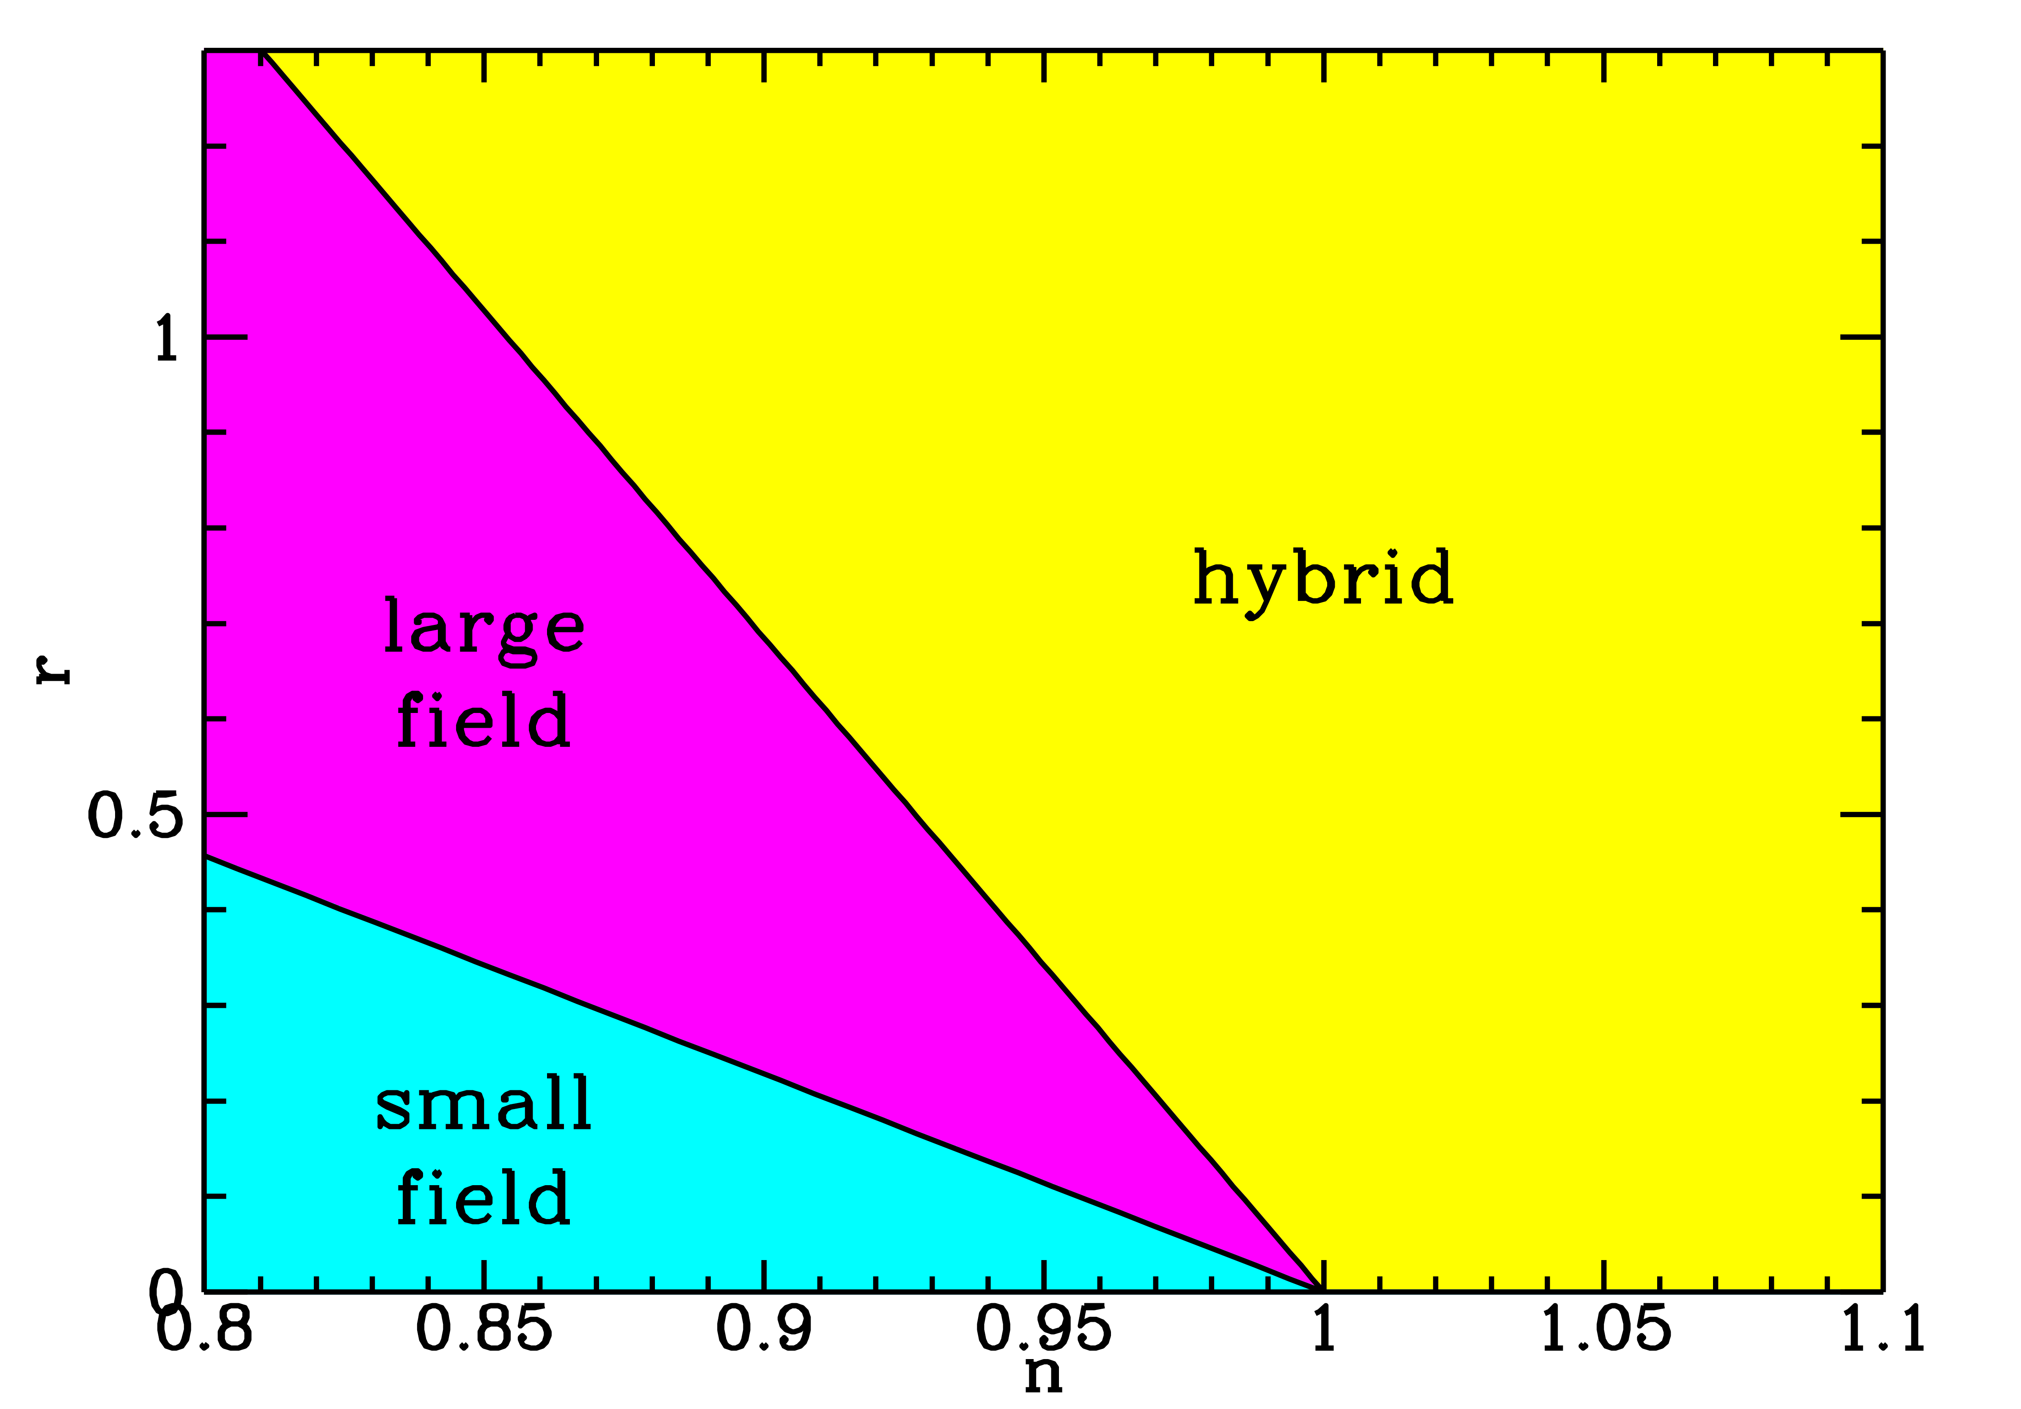
Zoology of inflationary models
η>2 ε
0<η<2 ε
η<0
See,e.g., Kinney et al.
astro-ph/0007375

Slide 35
Zoology of inflationary models
``Large-field’’ models 0<η<2ε:
typical of ``caothic inflation scenario’’ (Linde `83)
``power law inflation’’ (Lucchin, Matarrese ‘85)
``small-field models’’: η<0
from spontaneous symmetry breaking or Goldstone,
axion modes (Linde; Albrecht, Steinhardt `82; Freese
et al ‘90)
hybrid models η>2 ε:
supersimmetry; typically involve a second field to end
inflation (Linde ’91; ‘94)

Slide 36
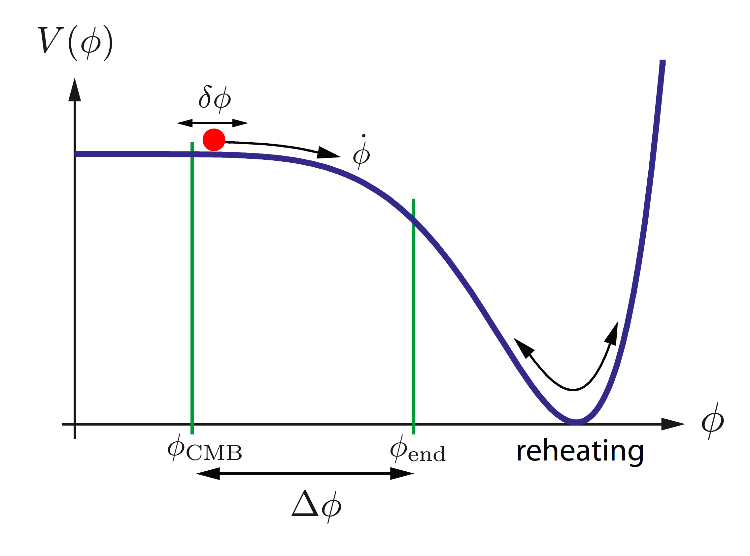
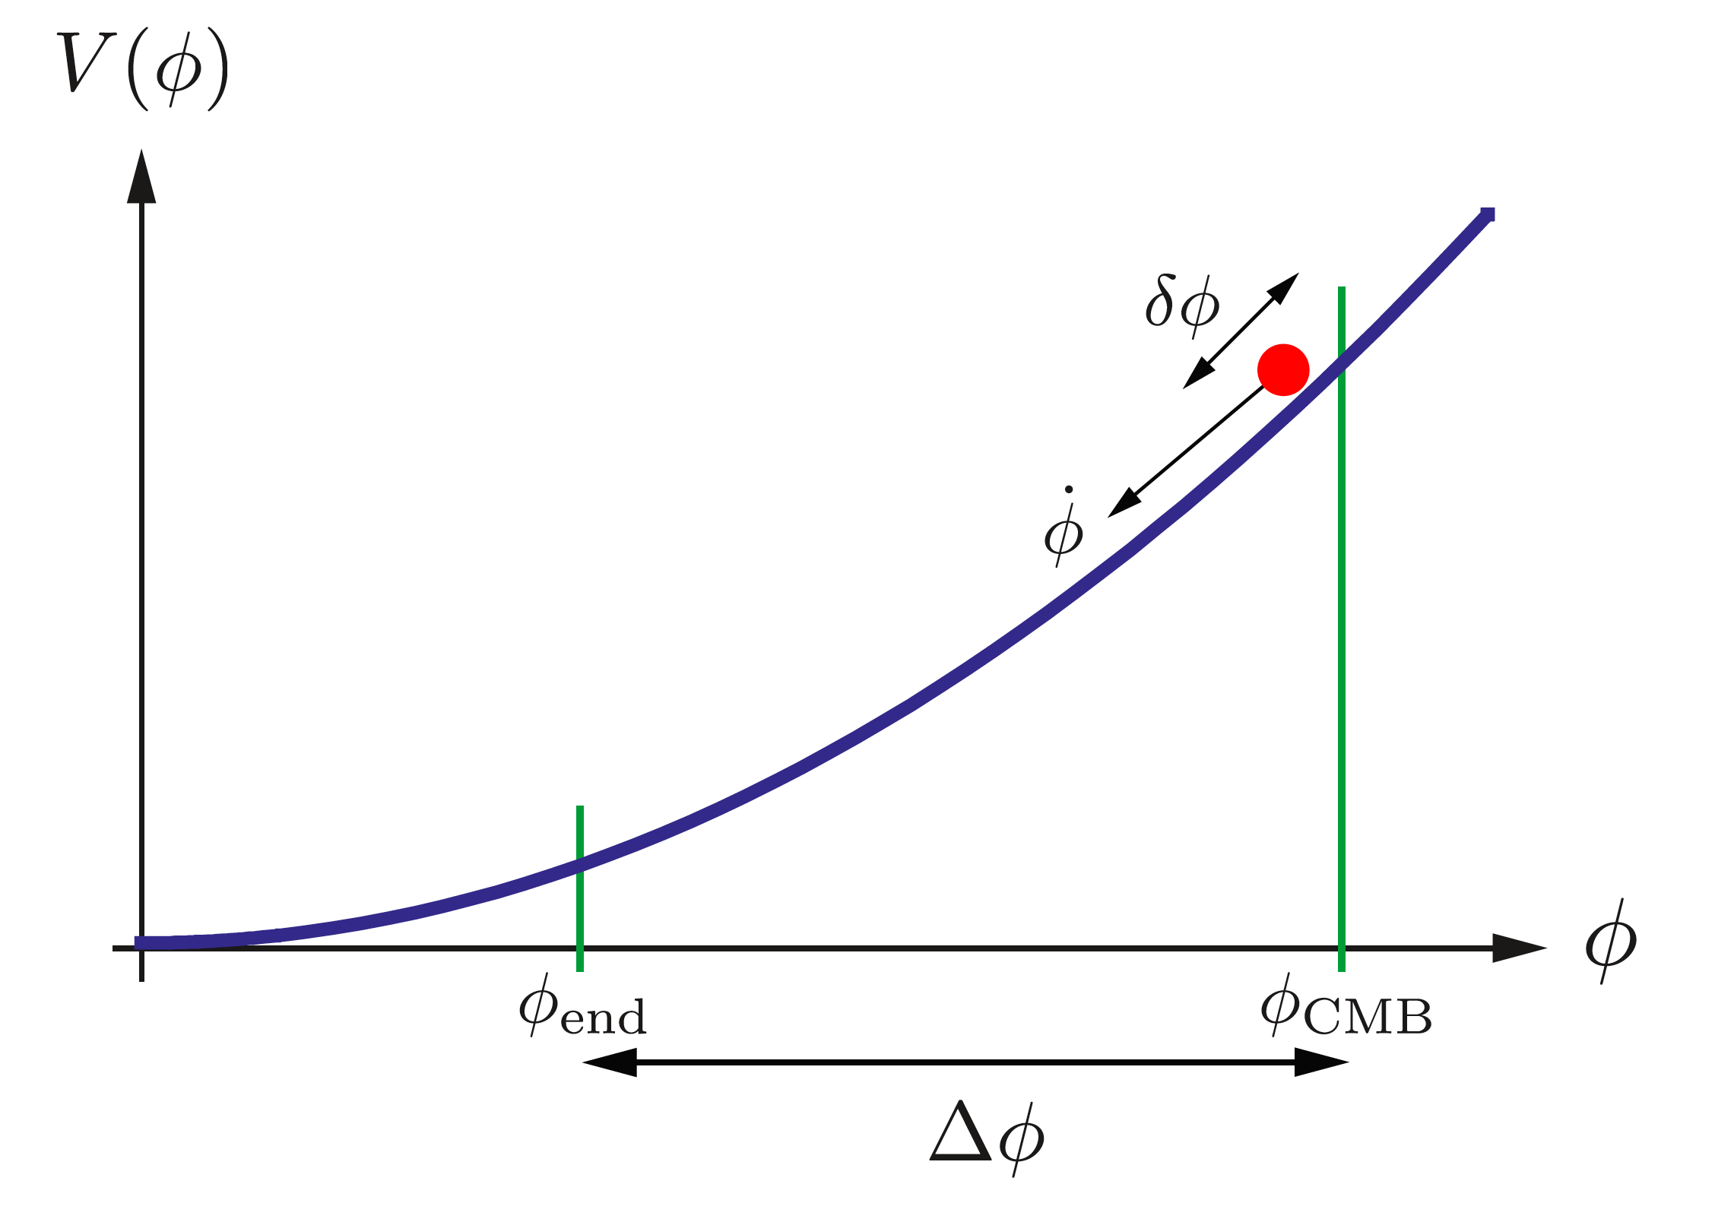
Zoology of inflationary models
``Small field’’ like potential
``Large field’’ like potential

Slide 37
Zoology of inflationary models: a warning
Up to now we have considered the simpest minimal inflationary models:
slow-roll single-field
Single weakly-coupled real scalr field
Canonical kinetic term
Slowly-rolling on a (featureless) potential
Initial Bunch-Davies vacuum state
However……….violating each of these conditions can bring much richer
models both for the observational signatures (e.g. non-gaussianity of
the primordial perturbations, isocurvature perturbations – i.e relative
perturbations between different scalar-fields,……) and for particle physics
theories motivating them

Slide 38
Zoology of inflationary models: a warning (II)
A couple of examples:
Multi-field models of inflation
non-standard kinetic terms: inflaton lagrangian is an arbitrary function of the
inflaton field and the kinetic term (Chen, Huang, Kachru, Shiu hep-th/0605045)
e.g. i) kinetic inflation: inflation driven by kinetic terms (A.Picon, Damour, Mukhanov hep-th/9904075)
ii) DBI (Dirac-Born-Infield) models (brane/string inspired models)
Alishahiha, Silverstein, Tong hep-th/0404084
rmendarizass
N.B.: In these models inflaton perturbations propagate with a sound speed c_{s}<1 and inflation
can happen with steep potentials

Slide 39
Why gravity waves of inflation are important?
A smoking gun of a period of inflation in the early universe
The amplitude of the inflationary gravity waves probes the
energy scale of inflation
a detection would provide a firm observational link to physics of
the early universe, characterized by energies never acheivable in labs.
inflationary gravity waves generate a unique imprint into the CMB
polarization pattern

Slide 40
Observational constraints
Constraints on r, n, dn/dlnk can be translated into constraints on
the slow-roll parameters allowing to constraint/rule out inflationary
models

Slide 41
CMB anisotropies:
how they tell us about early universe physics?
•
Gravity+
pressure
(+ diffusion)
•
•
•
•
•
•
•
•
•
•
•
•
•
•
•
•
•
•
•
•
Initial conditions from inflationary perturbations

Slide 42
CMB anisotropies: how they tell us about early universe physics?
Last scattering surface:
primary anisotropies=
disomogenieties+
doppler effects.
Primordial fluctuations
imprinted
Intervening matter:
secondary anisotropies:
e.g. blueshift-redshift of
CMB photons (ISW effect)

Slide 43
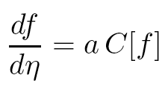
CMB anisotropies: basics
Actors:
Photons-baryons glued together in a single fluid by Compton scattering until last-scattering epoch z~1100.
dark matter+ neutrinos+cosmological constant
Forces:
gravity (mainly due to Dark Matter)+pressure = acoustic oscillations
Boltzmann eq. for photons distribution function f:
Collision term: pressure and diffusion
Gravity effects
+Boltzmann eqs. For Dark matter particles, neutrinos and Einstein equations

Slide 44
CMB anisotropies: basics
One is essentially perturbing around a Black-body distribution with
mean temperature
Observed CMB anisotropies at the level 10⁻⁵:
CMB Angular power spectrum:

Slide 45
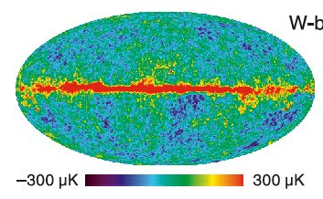
Observed Temperature power spectrum
WMAP coll. ApJ 2011
Observations
Constrain models of early universe
+ evolution parameters and geometry
Adapted from http://benasque.org/2011Astrophysics/talks_contr/172_Lewis.pdf

Slide 46
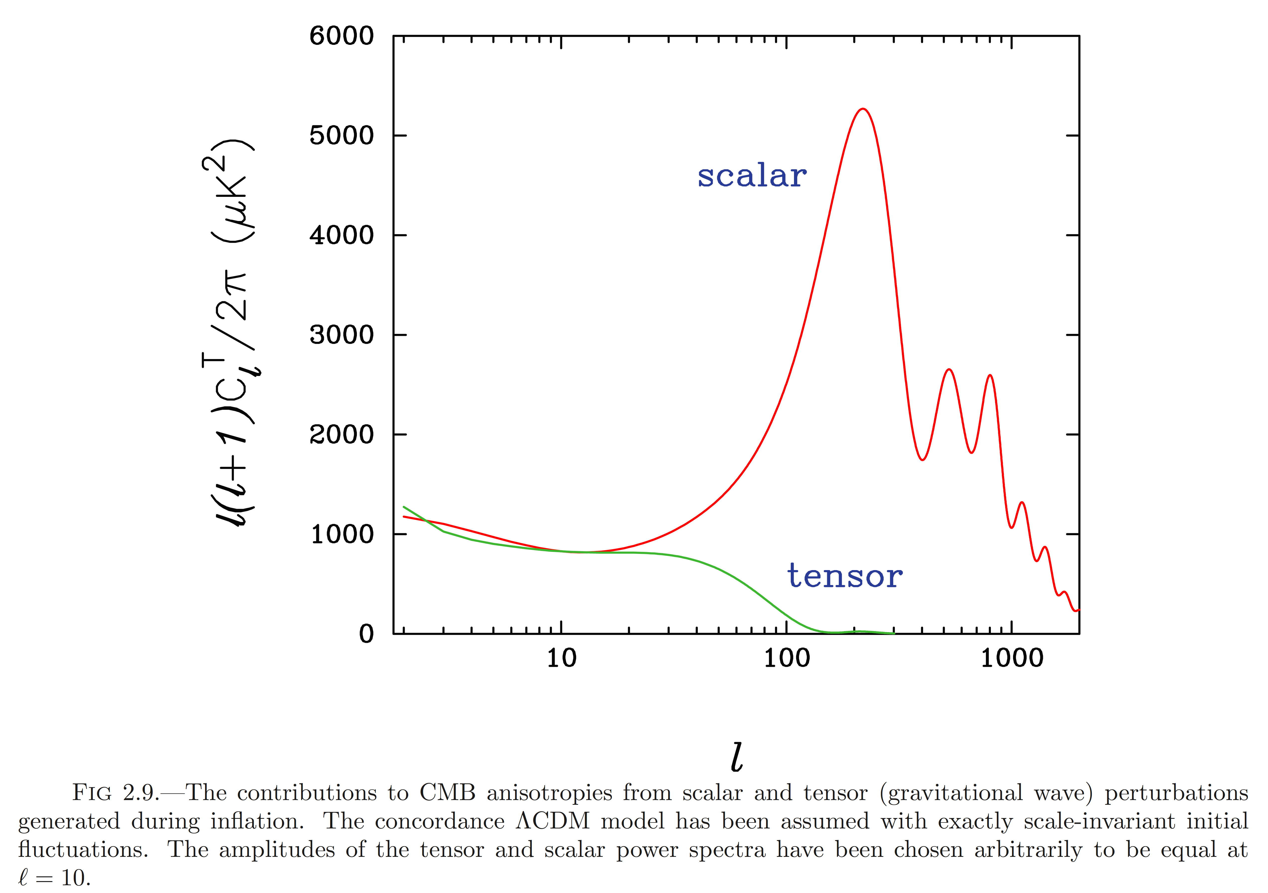
Effects of ``primordial’’ cosmological paramters
Normalization C₁₀: simply moves the
spectrum up and down
spectral index n:
e.g.: if n<1 anisotropies smaller wr.t.
n=1 model on small scales
gravity waves: die out when they enter
the horizon at last scattering epoch
correponding to l>100
tilt
C₁₀

Slide 47
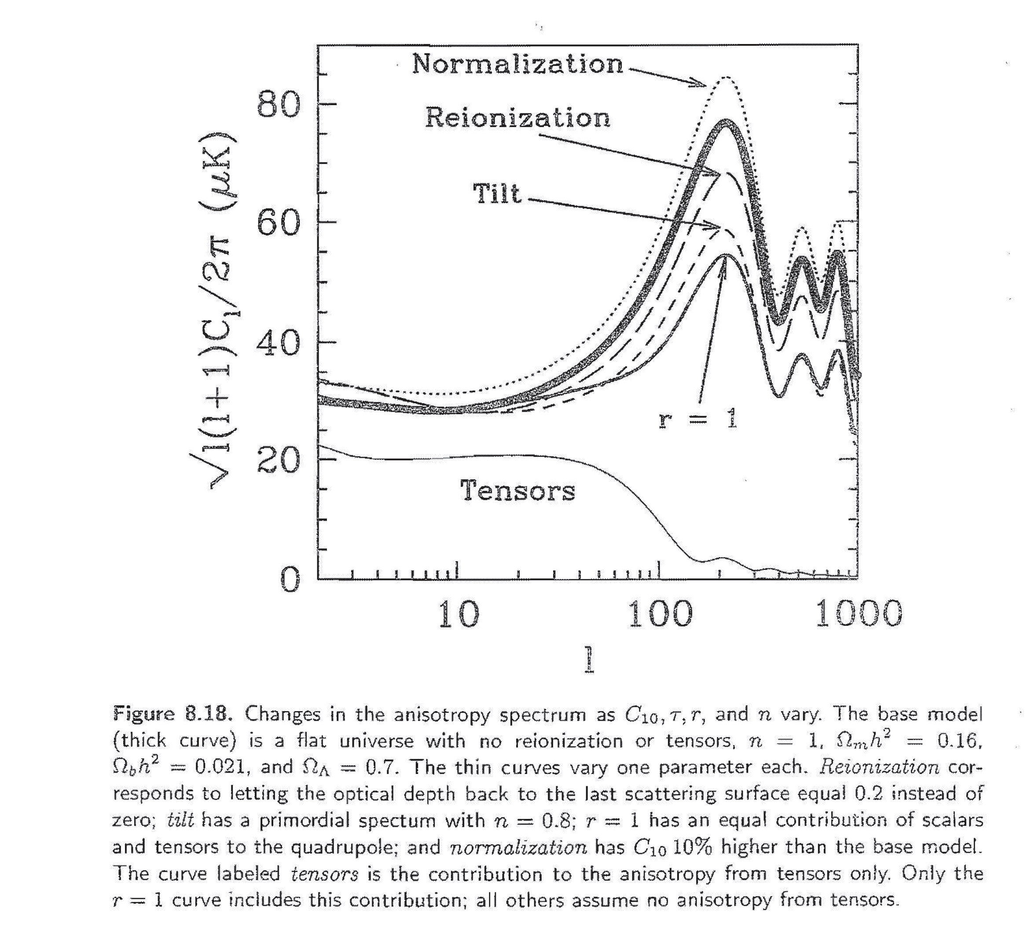
Effects of ``primordial’’ cosmological parameters
flat ΛCDM model with
n=1; Ω_{m} h²= 0.16; Ω_{b} h²= 0.021
Ω_{Λ}=0.7, no tensors, no reionization
Normalization C₁₀: simply moves the
spectrum up and down
spectral index n:
e.g.: if n<1 anisotropies smaller wr.t.
n=1 model on small scales
gravity waves: die out when they
enter the horizon at last scattering
epoch correponding to l>100
(n=0.8)

Slide 48
CMB anisotropies theory: basics
Within linear perturbation theory
Sachs-Wolfe effect
at last scattering surface
Doppler effect
at last scattering surface
Integrated SW effect
Friedmann-Roberston-Walker perturbed metric (dη=dt/a(t): conformal time)
Gravitational potential
Gravitational potential
Contain tensor
Perturbations
(gravity waves)

Slide 49
CMB anisotropies theory: basics
but the effective temperature we see is
On large scales (large than the horizon at recombination)
(overdensity Φ<0: see cold spot
underdensity Φ>0: see hot spot)
On smaller scales acoustic oscillations of the photon baryon fluid:
: sound speed
: signals presence of baryons

Slide 50
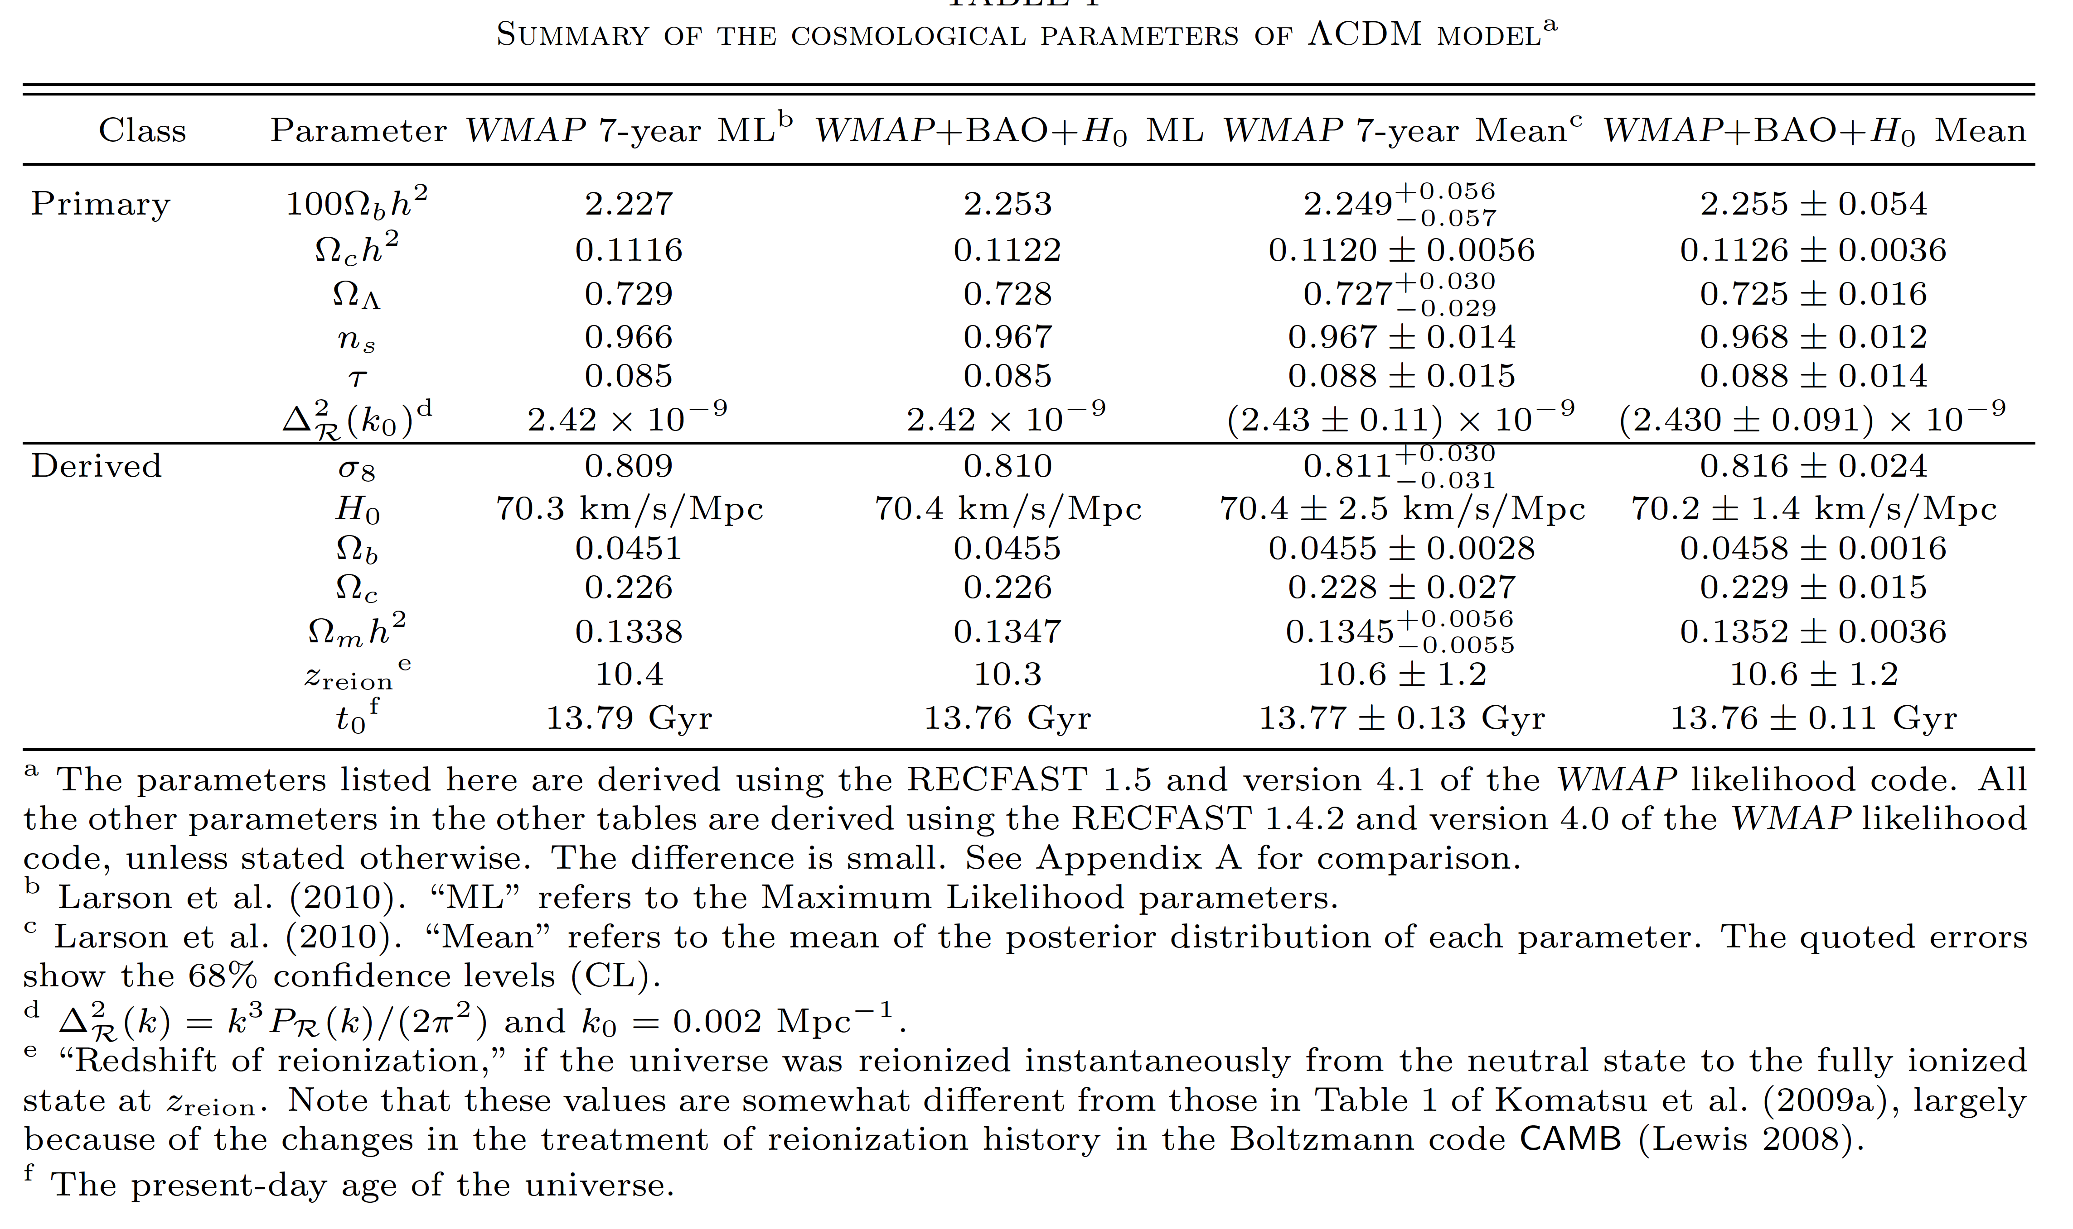
Observational constraints: WMAP 7-year
n=1 excluded at 99.5%
(from Komatsu et al., Astrophys.J.Suppl.192, 2011)
Remember that inflation predicts that Ω₀ is very close to unity today

Slide 51
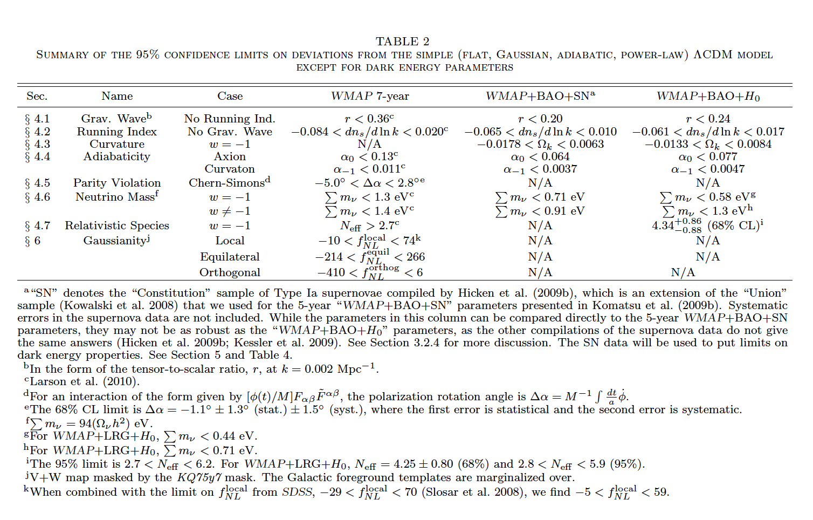
The amplitude of primordial gravity waves
probe the energy scael of inflation

Slide 52
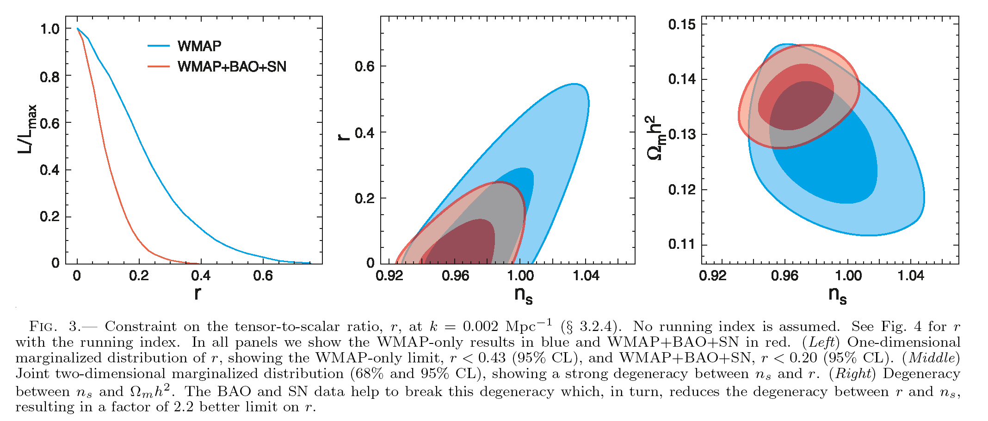
(from Komatsu et al. Astrophys.J.Suppl.180, 2009, WMAP 5-year data)

Slide 53
What are the implications for inflationary models ?

Slide 54
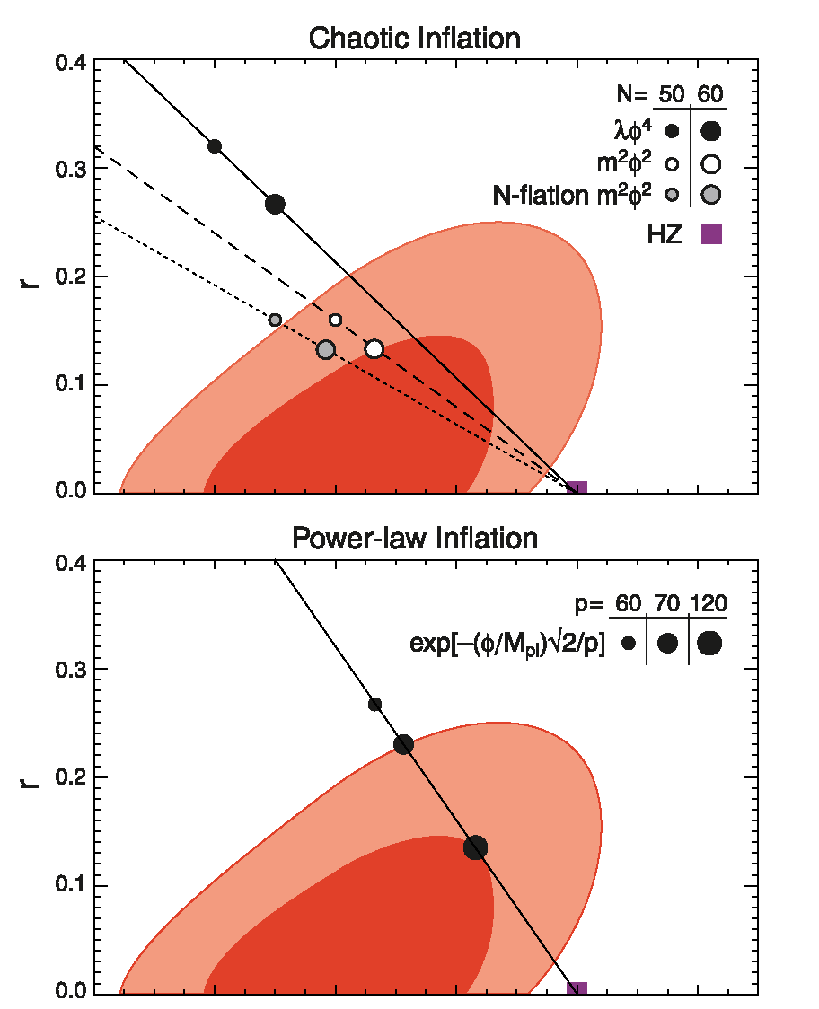
0.94
0.96
0.98
1
n
(from Komatsu et al. Astrophys.J.Suppl. 180,
2009, WMAP 5-year data)
0.94
0.96
0.98
1
n

Slide 55
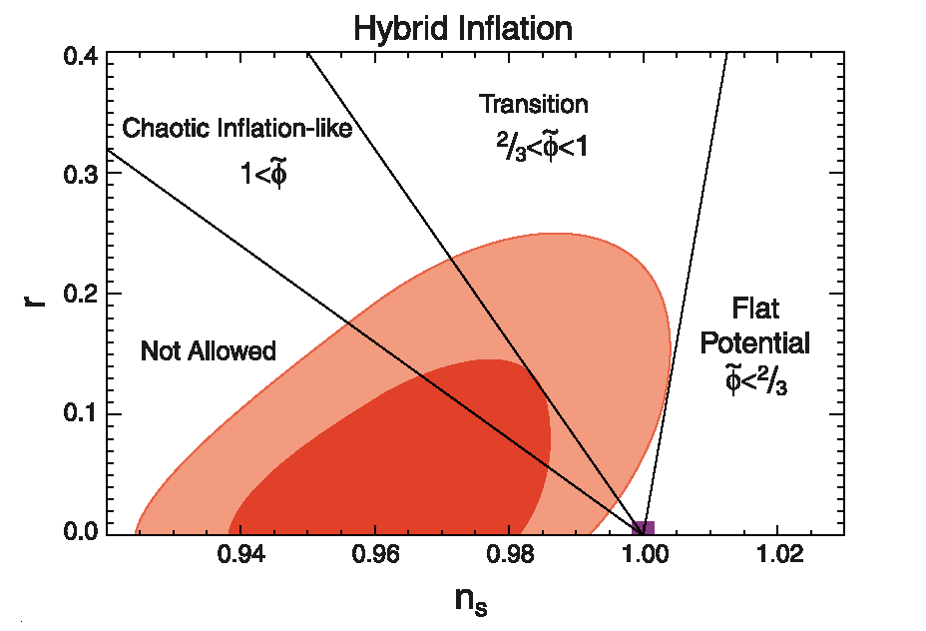
n

Slide 56
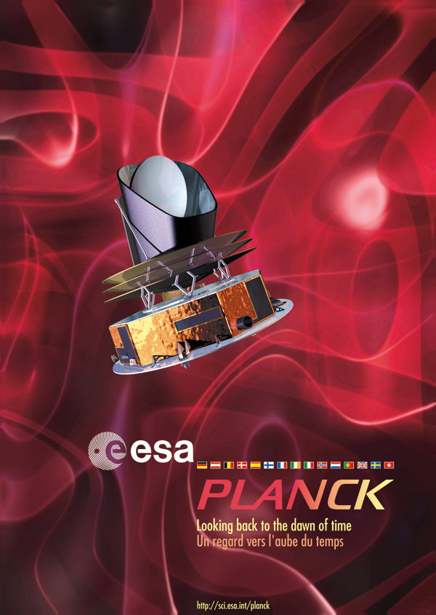
What do we
expect from
Planck?

Slide 57
Some crucial aspects of the Planck satellite
Planck has 3 times the angular resolution of WMAP (Planck angular resolution ~ 7’)
an order of magnitude lower noise (at the optimal frequency of 100GHz)
much wider frequency coverage (from 30 GHz to 857 GHz)
A net improvement in the CMB polarization measurements
Dramatic benefits include
Much better determination of temperature and polarization CMB power spectra
Temperature power spectrum can be measured to almost cosmic variance
accuracy over the full range of multipoles 2 < l <∼2500
(measurement of polarization signal dominated up to l~1500)
wider frequency coverage will allow to separate CMB from astrophysical
foregrounds as required by its low noise level and to check against systematics
goal: determine cosmologial parameters to unprecedente precision of better
than a percent

Slide 58
COBE satellite 1992
Angular resolution ~ 7°
WMAP satellite
Angular resolution ~
several arcminutes
Hinshaw et al. astro-ph/0603451

Slide 59
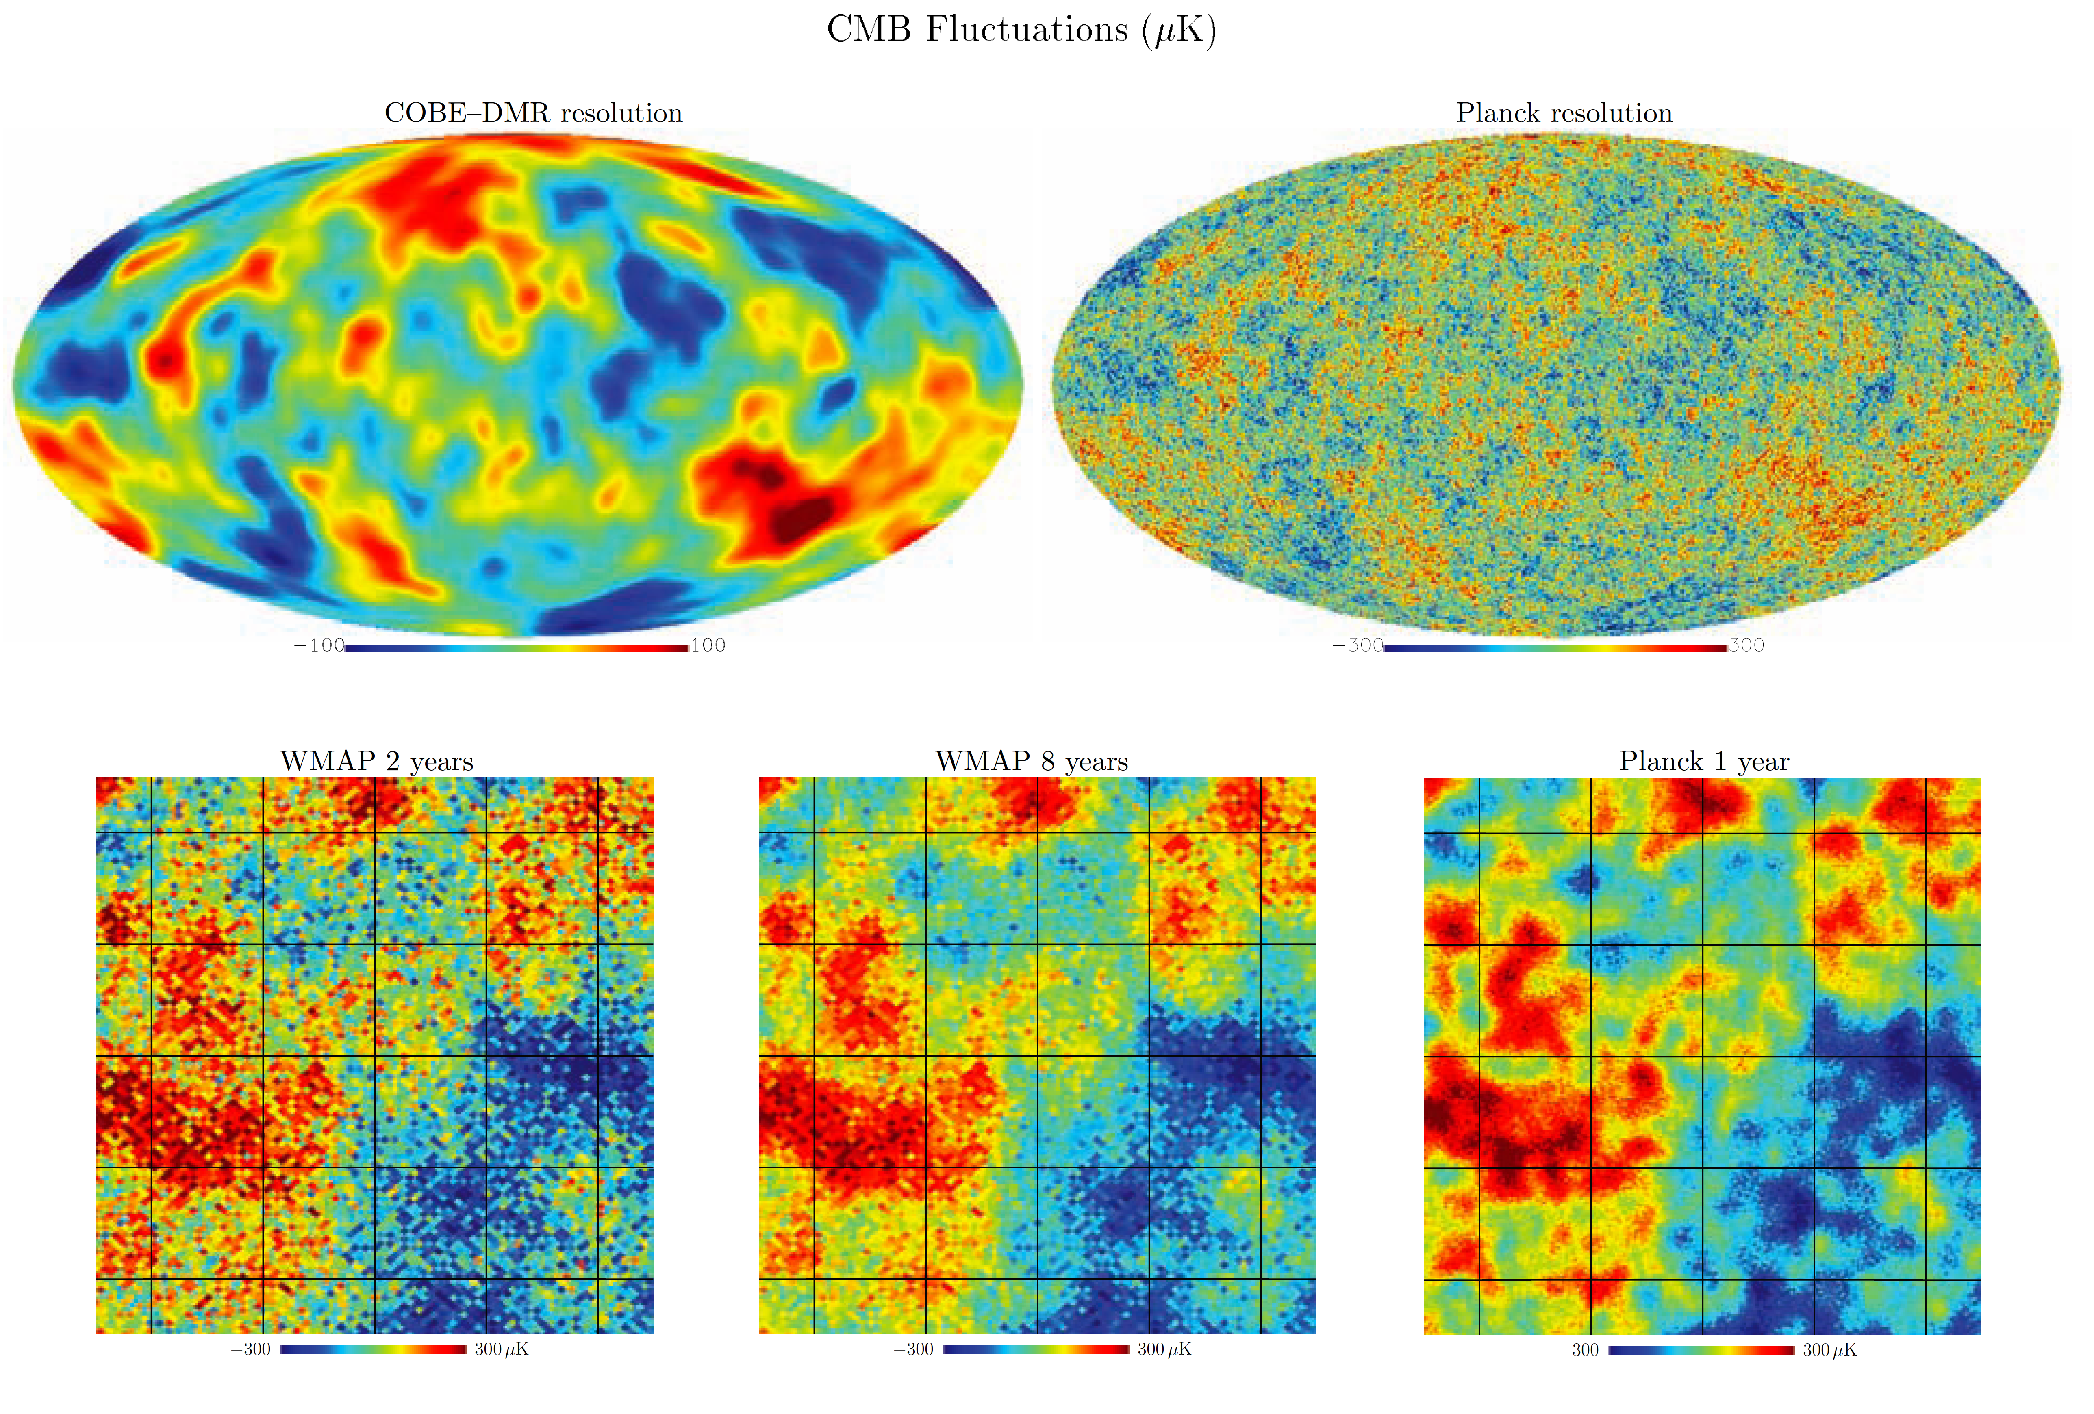
5° ×5° (WMAP 94 GHz vs Planck 217 GHz channels: simulated CMB maps for inflationary
CDM (Cold Dark Matter) models

Slide 60
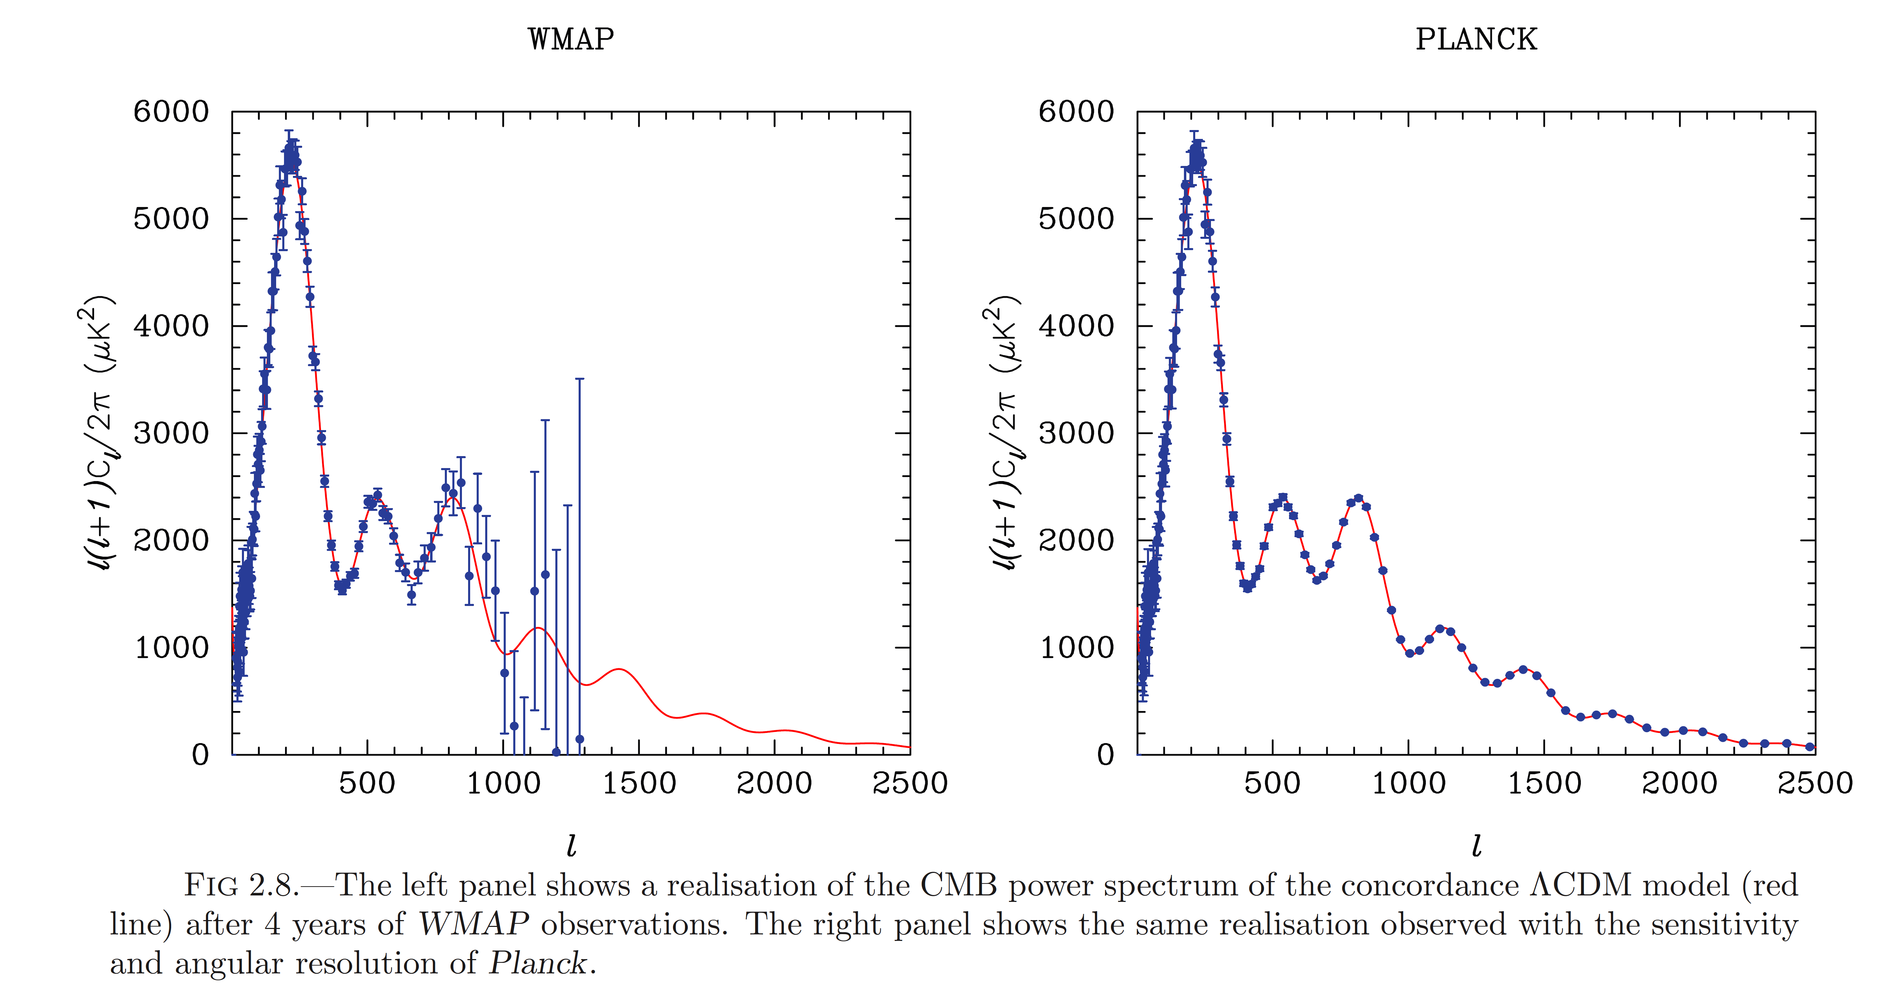
visit http://www.rssd.esa.int/index.php?project=Planck
and look for the Planck Blue-Book

Slide 61
Constraining Cosmology with Planck
Improved tests of inflationary models: Planck has the potentiality to
easily detect small deviations from a scale-invariant power spectrum
(n=1) and constrain/detect a running of the spectral index
Improved determination of cosmological parameters
e.g.: better determination of acoustic peaks at higher multipoles in the CMB power
spectra and hence better determination of Ω_{m} and of Ω_{b}
Measuring CMB polarization: brings crucial additional information on
nature of primordial perturbations (e.g. initial adiabatic vs entropic
fluctuations), on reionization of the universe. If r ≥ (some × 0.01)
Planck may detect inflationary gravity waves.
Secondary CMB anisotropies: a whole series of effects involving CMB
photons while travelling across the structures of the universe
e.g.: Integrated Sachs-Wolfe, CMB lensing → dark energy information

Slide 62
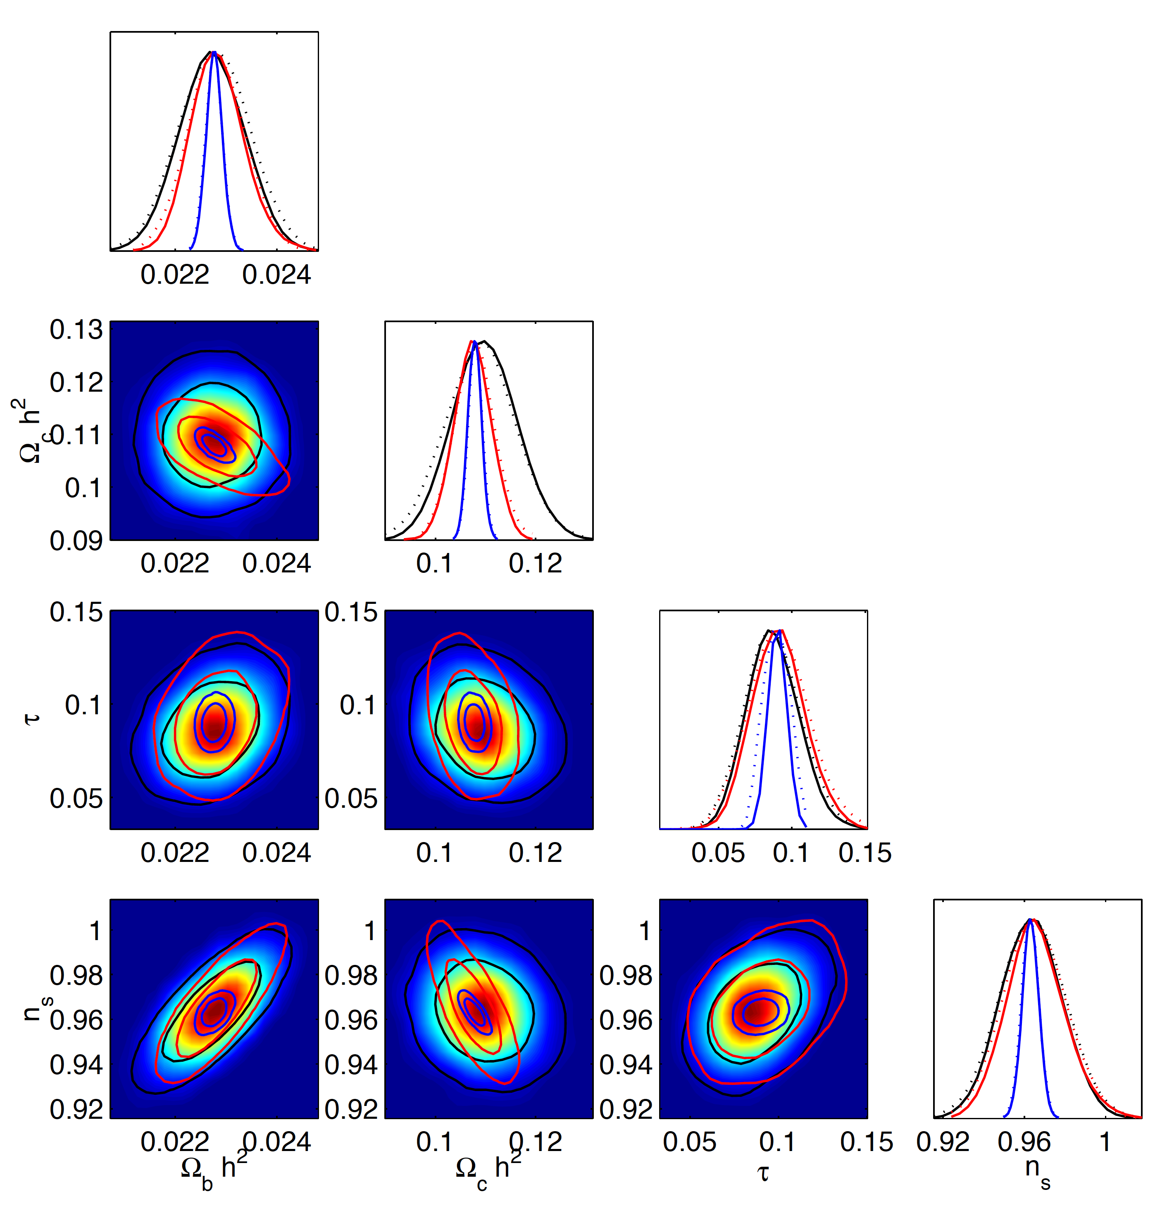
PLANCK forecasts vs WMAP 5 year data
Forecasts for 4 cosmological parameters of the WMAP
5 year best-fit ΛCDM model:
primordial spectral index n
baryon density Ω_{b}
matter density Ω_{c;}
optical depth τ
PLANCK (70+100+143 GHz 14th months)
PLANCK (LFI 70GHz 14th months)
WMAP observations (5 year data)
From Mandolesi, Bersanelli
et al. 1001.2657

Slide 63
Planck and Inflation: what do we expect, what can we gain?

Slide 64
Spectral index of inflationary perturbations
Simulated WMAP data for
n=0.95
theoretical inflationary ΛCDM
model scale invariant n=1

Slide 65
Running of the spectral index
theoretical model
with no running

Slide 66
A couple of lessons from these two examples
PLANCK will be able to distinguish easily between a ΛCDM
model with an exact scale-invariant power spectrum n=1
and one with n=0.95
PLANCK has both the lever-arm and sensitivity to probe
a running of the primordial spectral index (WMAP needs
to rely on other data sets to investigate accurately this
issue)
PS: However notice that in the two examples shown all the other parameters fixed……..
but in general degeneracies between cosmological parameters

Slide 67
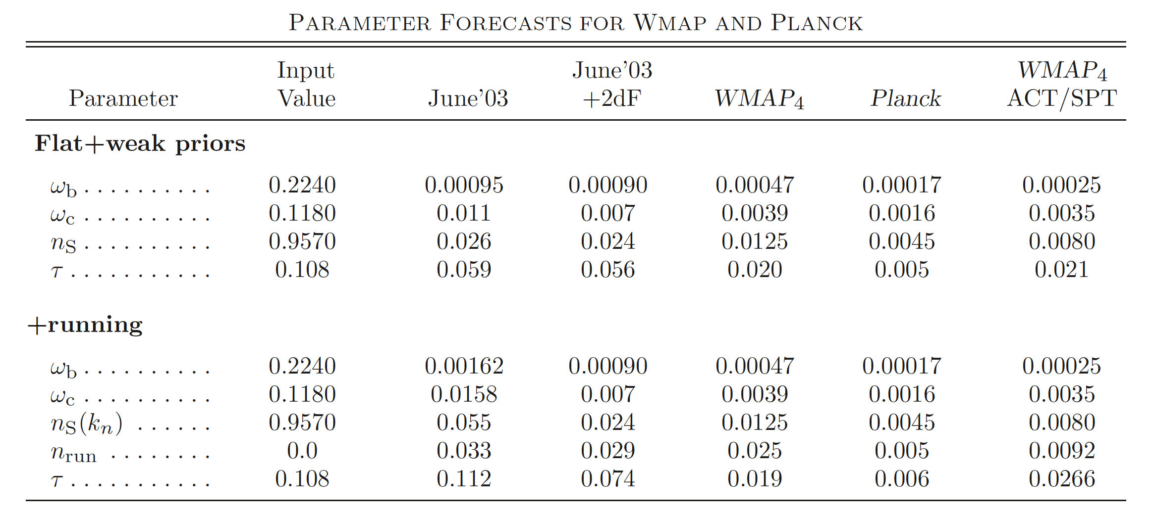
A more realistic situation
N.B.: Present WAMP 7-year data constraints: n=0.968±0.012 (68% C.L.; WMAP+BAO+H₀)
-0.084< dn/dlnk < 0.020 (95% C.L.)

Slide 68
PLANCK breaking degeneracies
Forecasts for 4 cosmological parameters of the WMAP
5 year best-fit ΛCDM model:
primordial spectral index n
baryon density Ω_{b}
matter density Ω_{c;}
optical depth τ
PLANCK (70+100+143 GHz 14th months)
PLANCK (LFI 70GHz 14th months)
WMAP observations (5 year data)
From Mandolesi, Bersanelli
et al. 1001.2657
Notes:
- Improvement massimizzato per Omega_c e per n_s

Slide 69
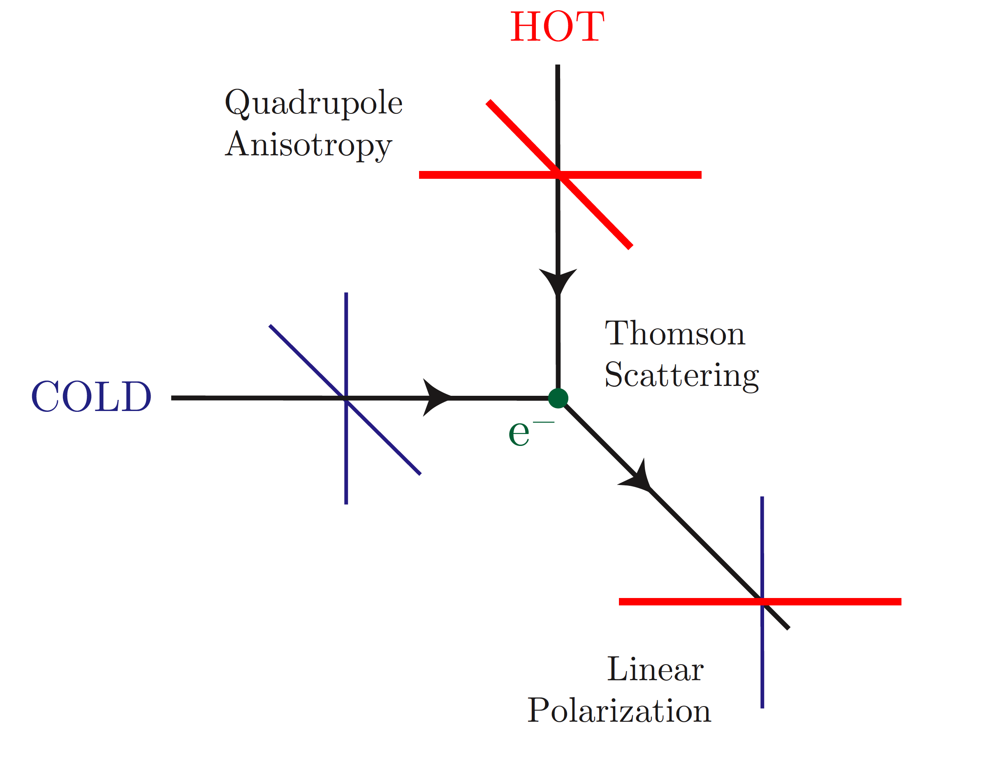
CMB Polarization
Quadrupole anisotropies + scattering Thomson
=
linear polarization of CMB generated at recombination
A tiny effect because quadrupoles are suppressed by tight coupling of photons and baryons;
gets enhanced when universe reionizes but still small

Slide 70
CMB Polarization
Decomposition E-B modes
Temperature anisotropies/E-mode cross-correlation
Importance for primordial (inflationary) gravitational waves

Slide 71
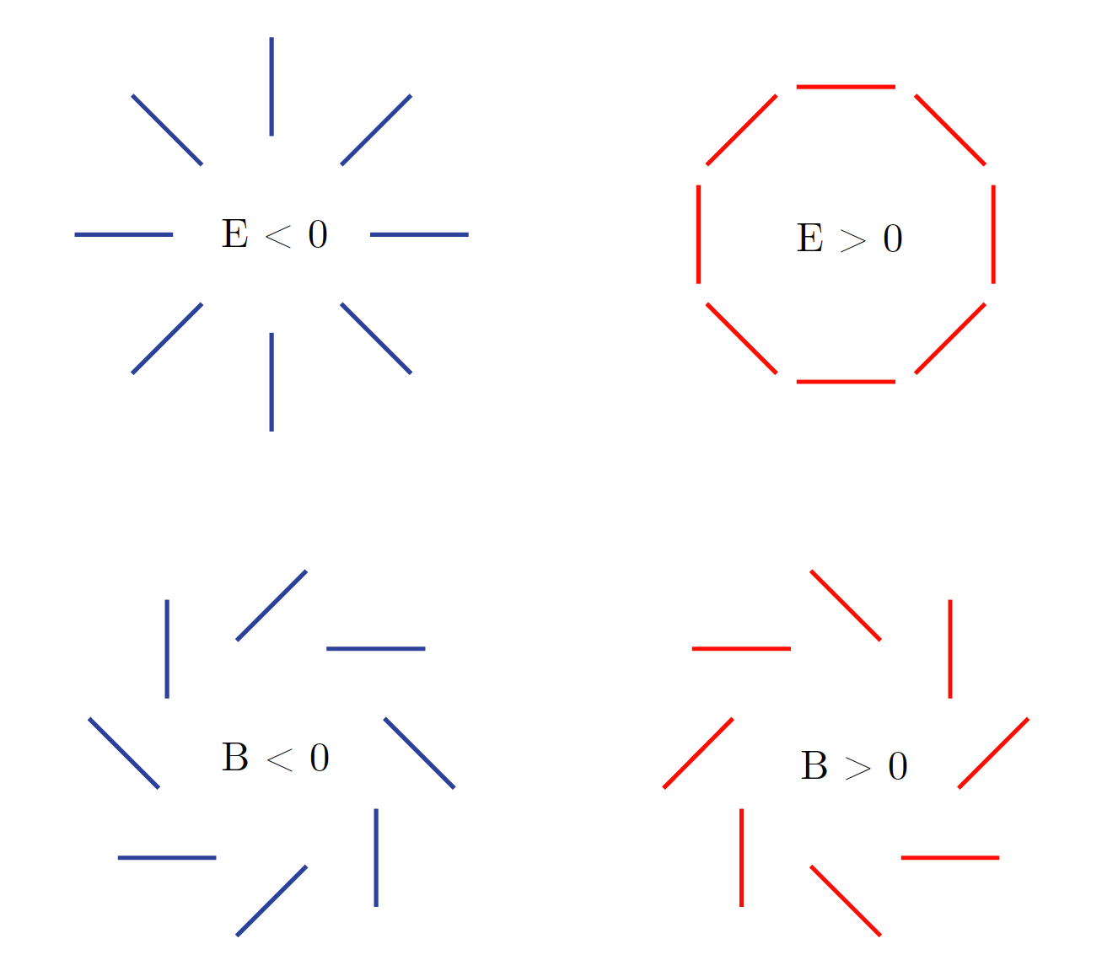
CMB Polarization
Curl-free E-modes polarization:
generated by density perturbations
and by gravitational waves
Curl B-modes polarization:
Can be produced only by
gravitational waves
Primordial B-modes is a smoking gun for inflation

Slide 72
Why gravity waves of inflation are important?
A smoking gun of a period of inflation in the early universe
The amplitude of the inflationary gravity waves probes the
energy scale of inflation
a detection would provide a firm observational link to physics of
the early universe, characterized by energies never achievable in labs.
inflationary gravity waves generate a unique imprint into the CMB
polarization pattern

Slide 73
CMB Polarization
You can define still some mutlipoles coefficients and
for the CMB polarization in addition to those for the temperature
(even tough techically more involved)
Try to measure the correlations
Actually TB and EB correlation are predicted to vanish for symmetry
reasons in standard scenarios (where parity violation is preserved)

Slide 74
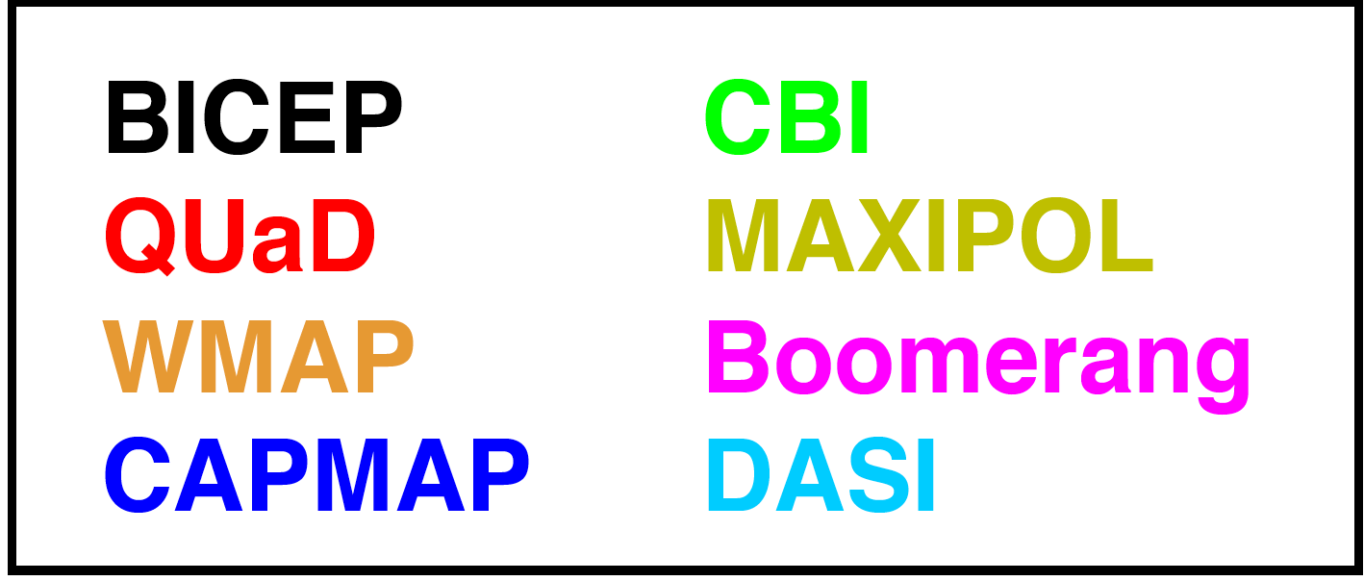
EE-power spectrum
E-polarization detected first in 2002 by DASI
Chiang et al. arXiv:0906.1181

Slide 75
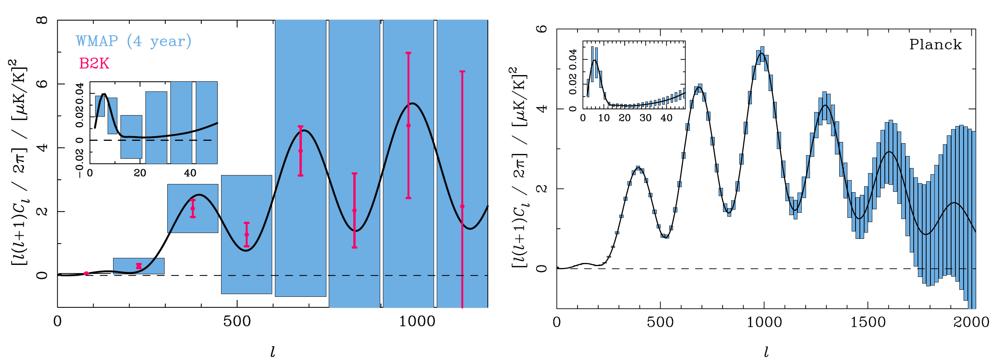
EE-power spectrum and Planck
Large-angle reionzation
Bump at l~5
Main peak at l~1000

Slide 76
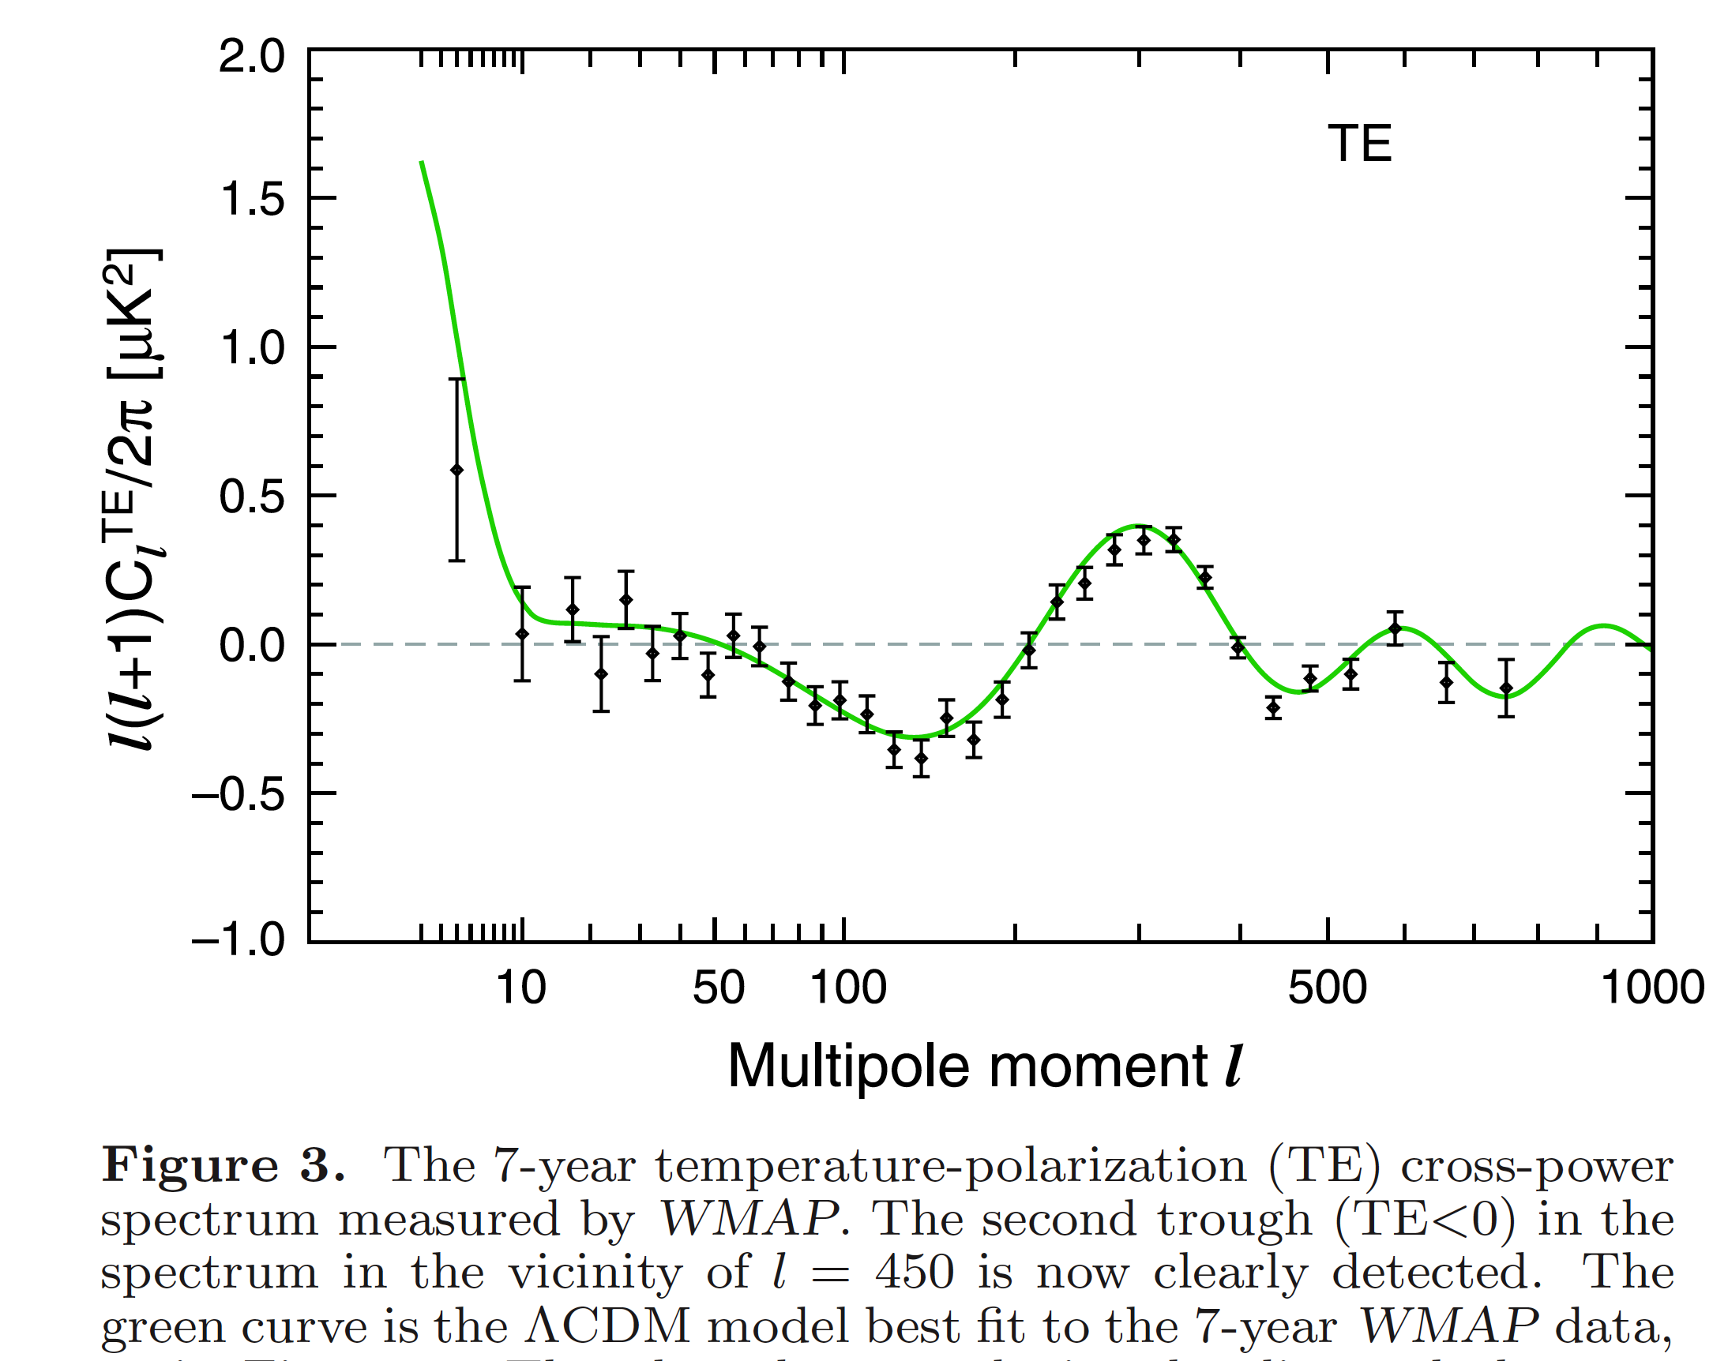
Cross-correlation T-E
You expect a cross-correlation because bioth T and E-modes are sourced by
density perturbations
The anticorrelation between
T and E for 50 <l <200 is a
distinctive signature of adiabatic
superhorizon fluctuation at last
scattering, which is a distinctive
signature of inflation:
Inflation produces fluctuations which
are coherent on superhorizon scales
at last scattering
Larson & WAMP team 1001.4635

Slide 77
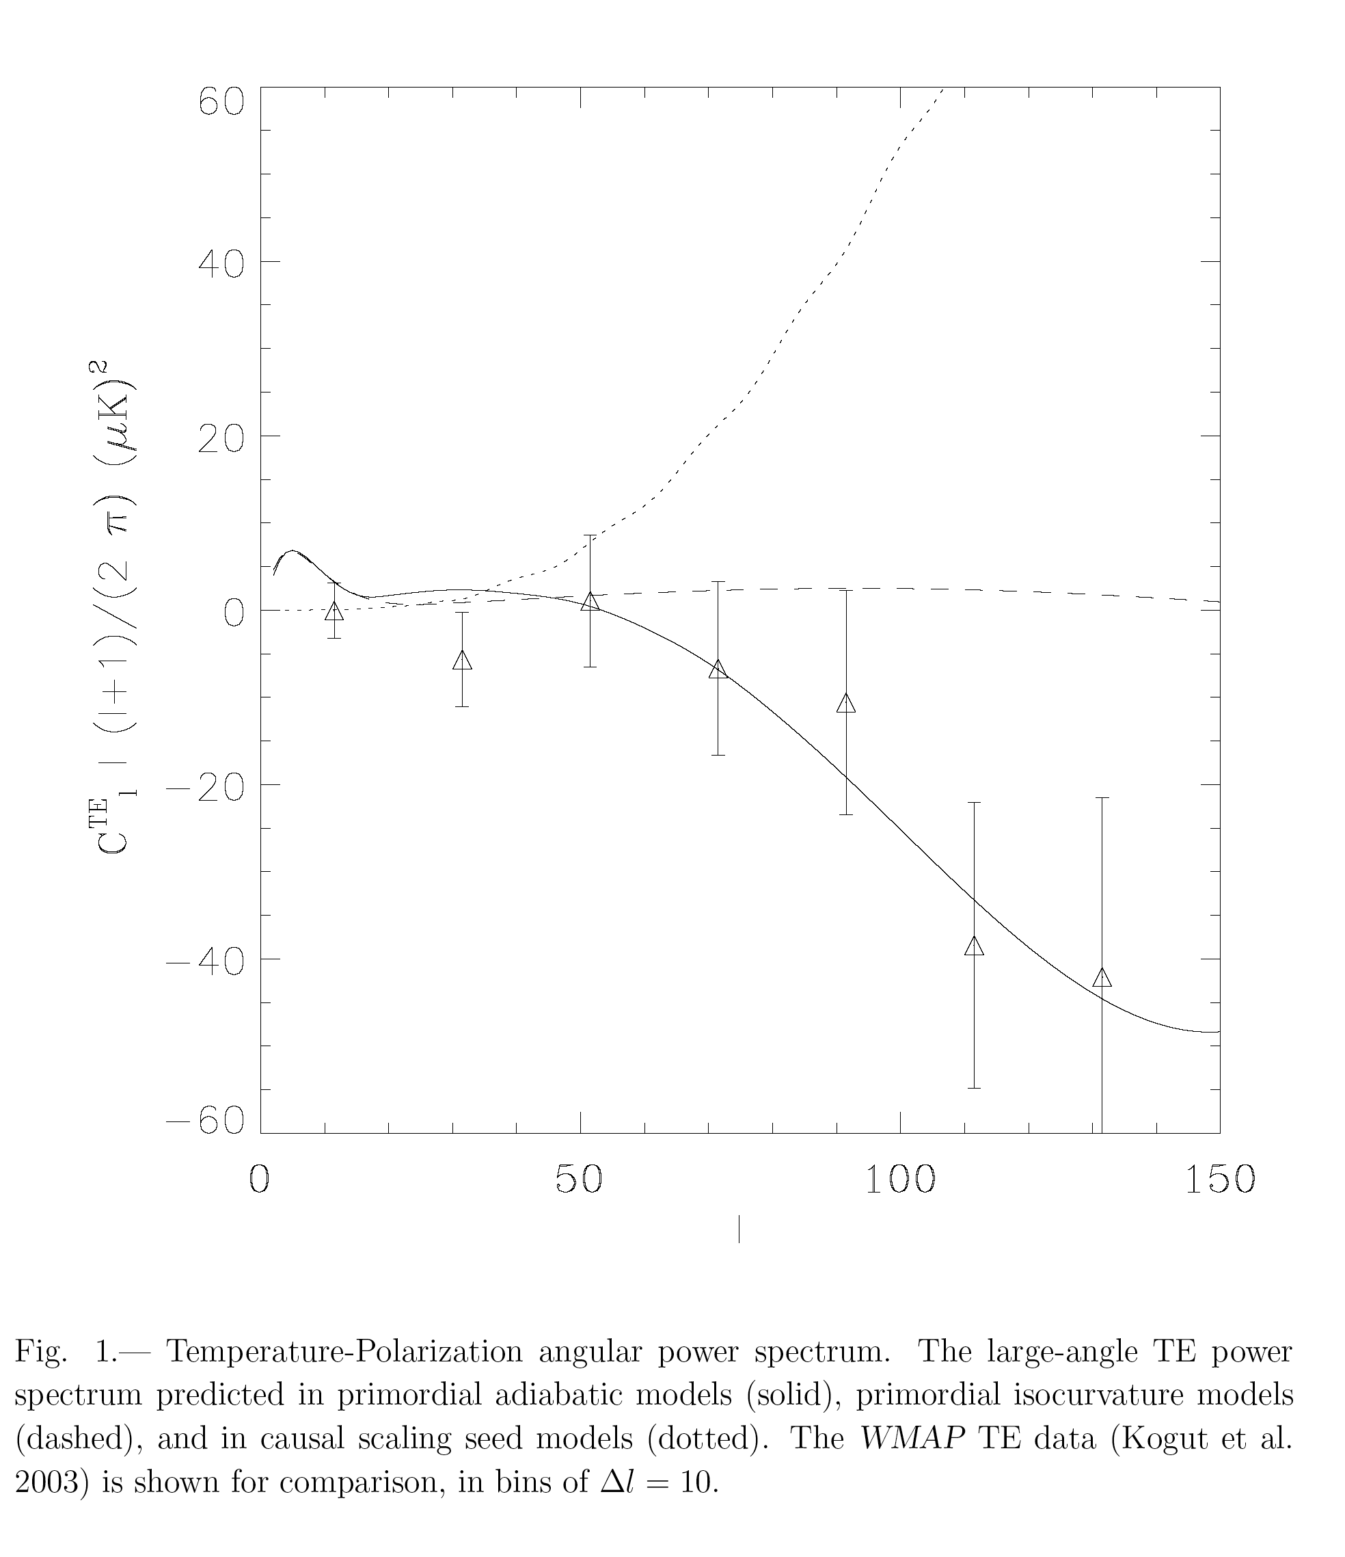
Peiris & WMAP
Team 1st year,
Astrophys. J. Suppl.
148, 213 (2003)
anticorrelation between
T and E for 50 <l <200

Slide 78
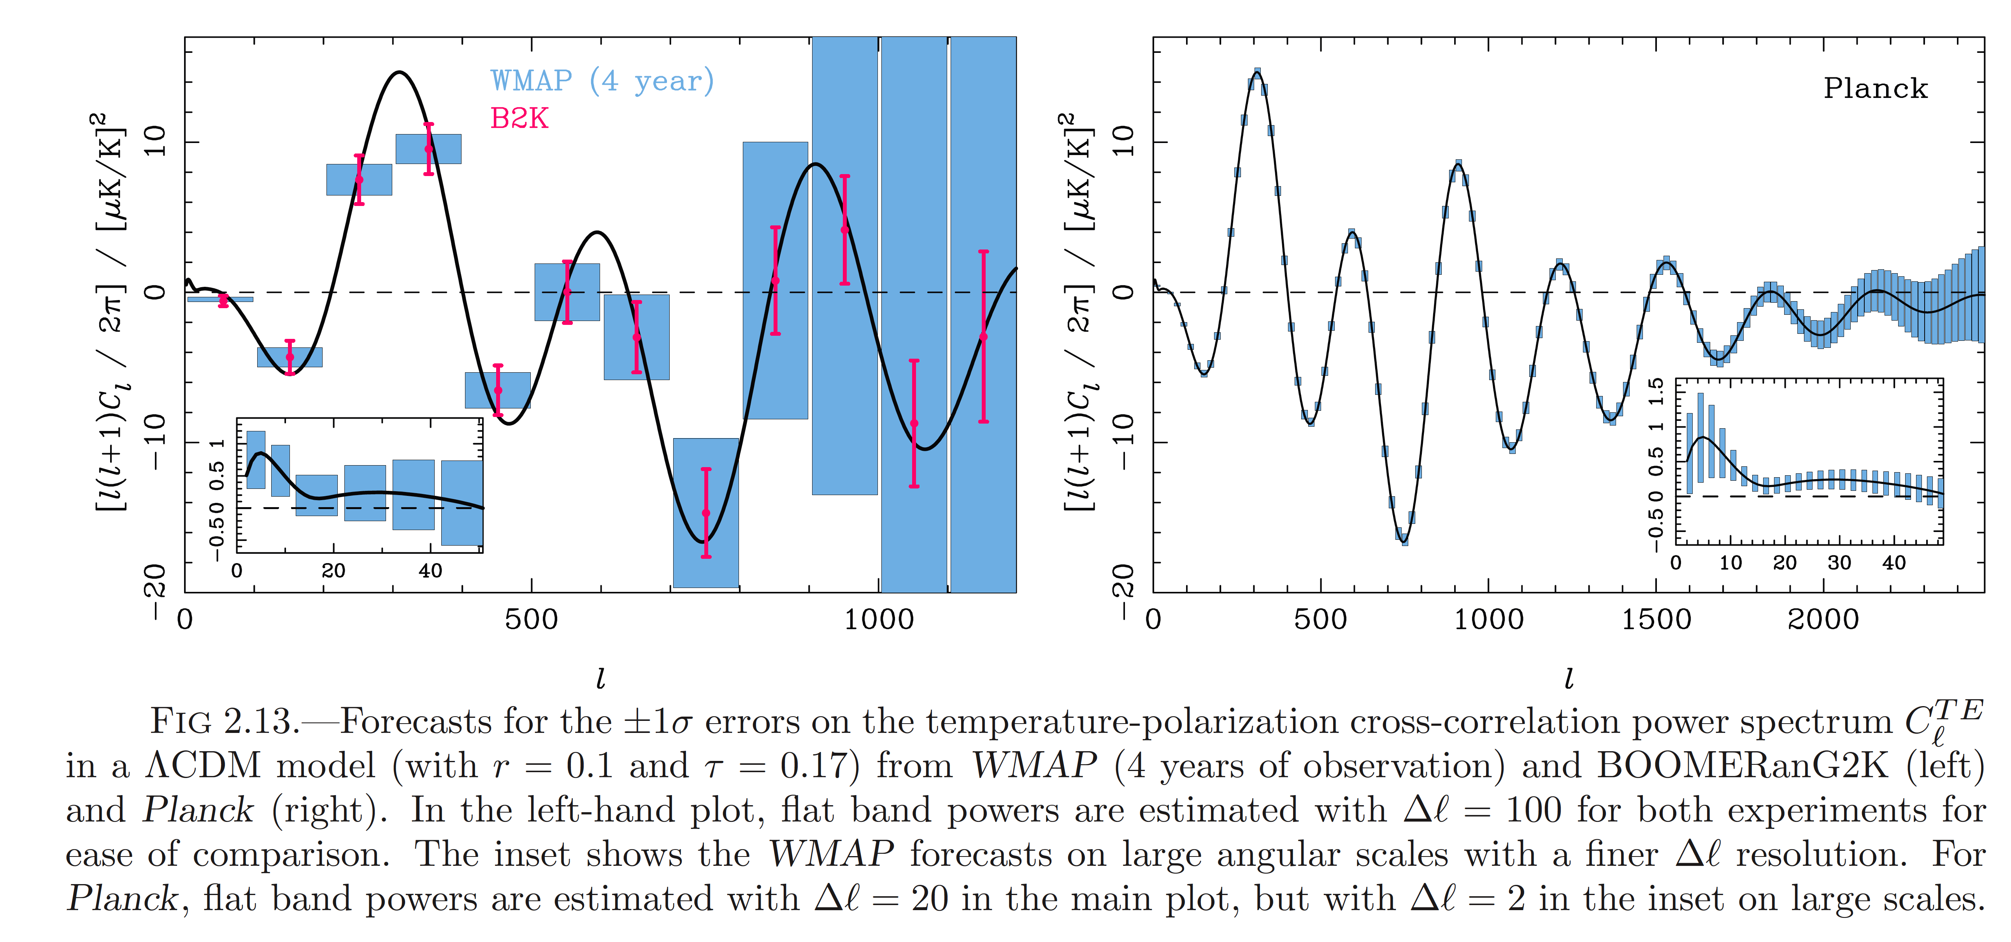
TE-power spectrum and Planck
Large-angle reionzation
Bump at l~5

Slide 79
Why CMB polarization important?
In some way polarization signal depends more directly than the temperature signal
on the fluctuations at the last scattering surface
helps in lifting several degeneracies between cosmological parameters
should carry clear imprints from the primordial gravitational waves produced during
inflation
But very important as well:
probes ionization history of the universe
probes effect of gravitational lensing that distorts on small scales the CMB
polarization

Slide 80
Why CMB polarization is important specifically for inflation?
Breaking these degeneracies is crucial to discriminate between different inflationary scenarios:
Accurate measurements of E-mode polarization can improve constraints in the (r-n) plane
Helps in lifting degeneracy between the spectral index n of inflationary fluctuations and
the optical depth parameter τ
Helps in lifting degeneracy between n, τ and the amplitude of primordial density
perturbations
Moreover:
The decomposition of CMB polarization into E- and B-modes is essential for detecting
gravitational waves produced during inflation: scalar (density perturbations)
do not contribute to B-mode.

Slide 81
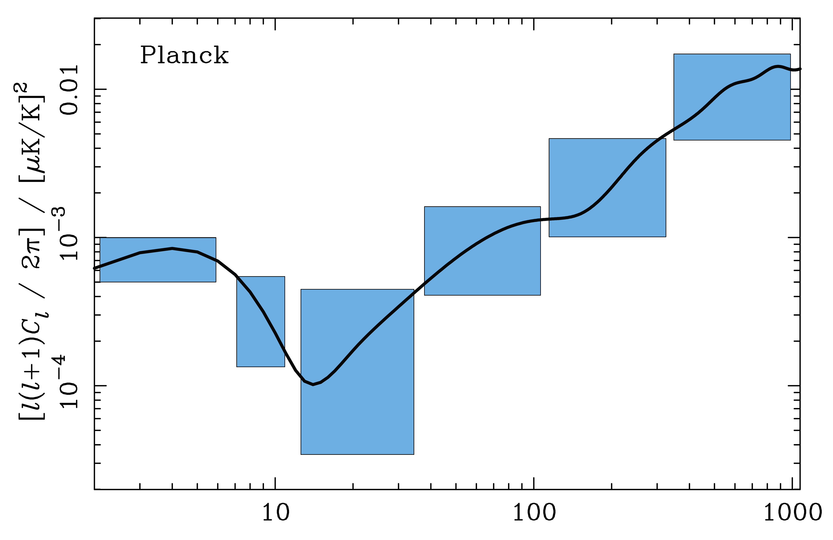
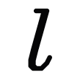
PLANCK AND INFLATIONARY GRAVITY WAVES
Potentiality of Planck
to measure r≥ (some)×0.01
Spectrum dominated by lensing signal

Slide 82
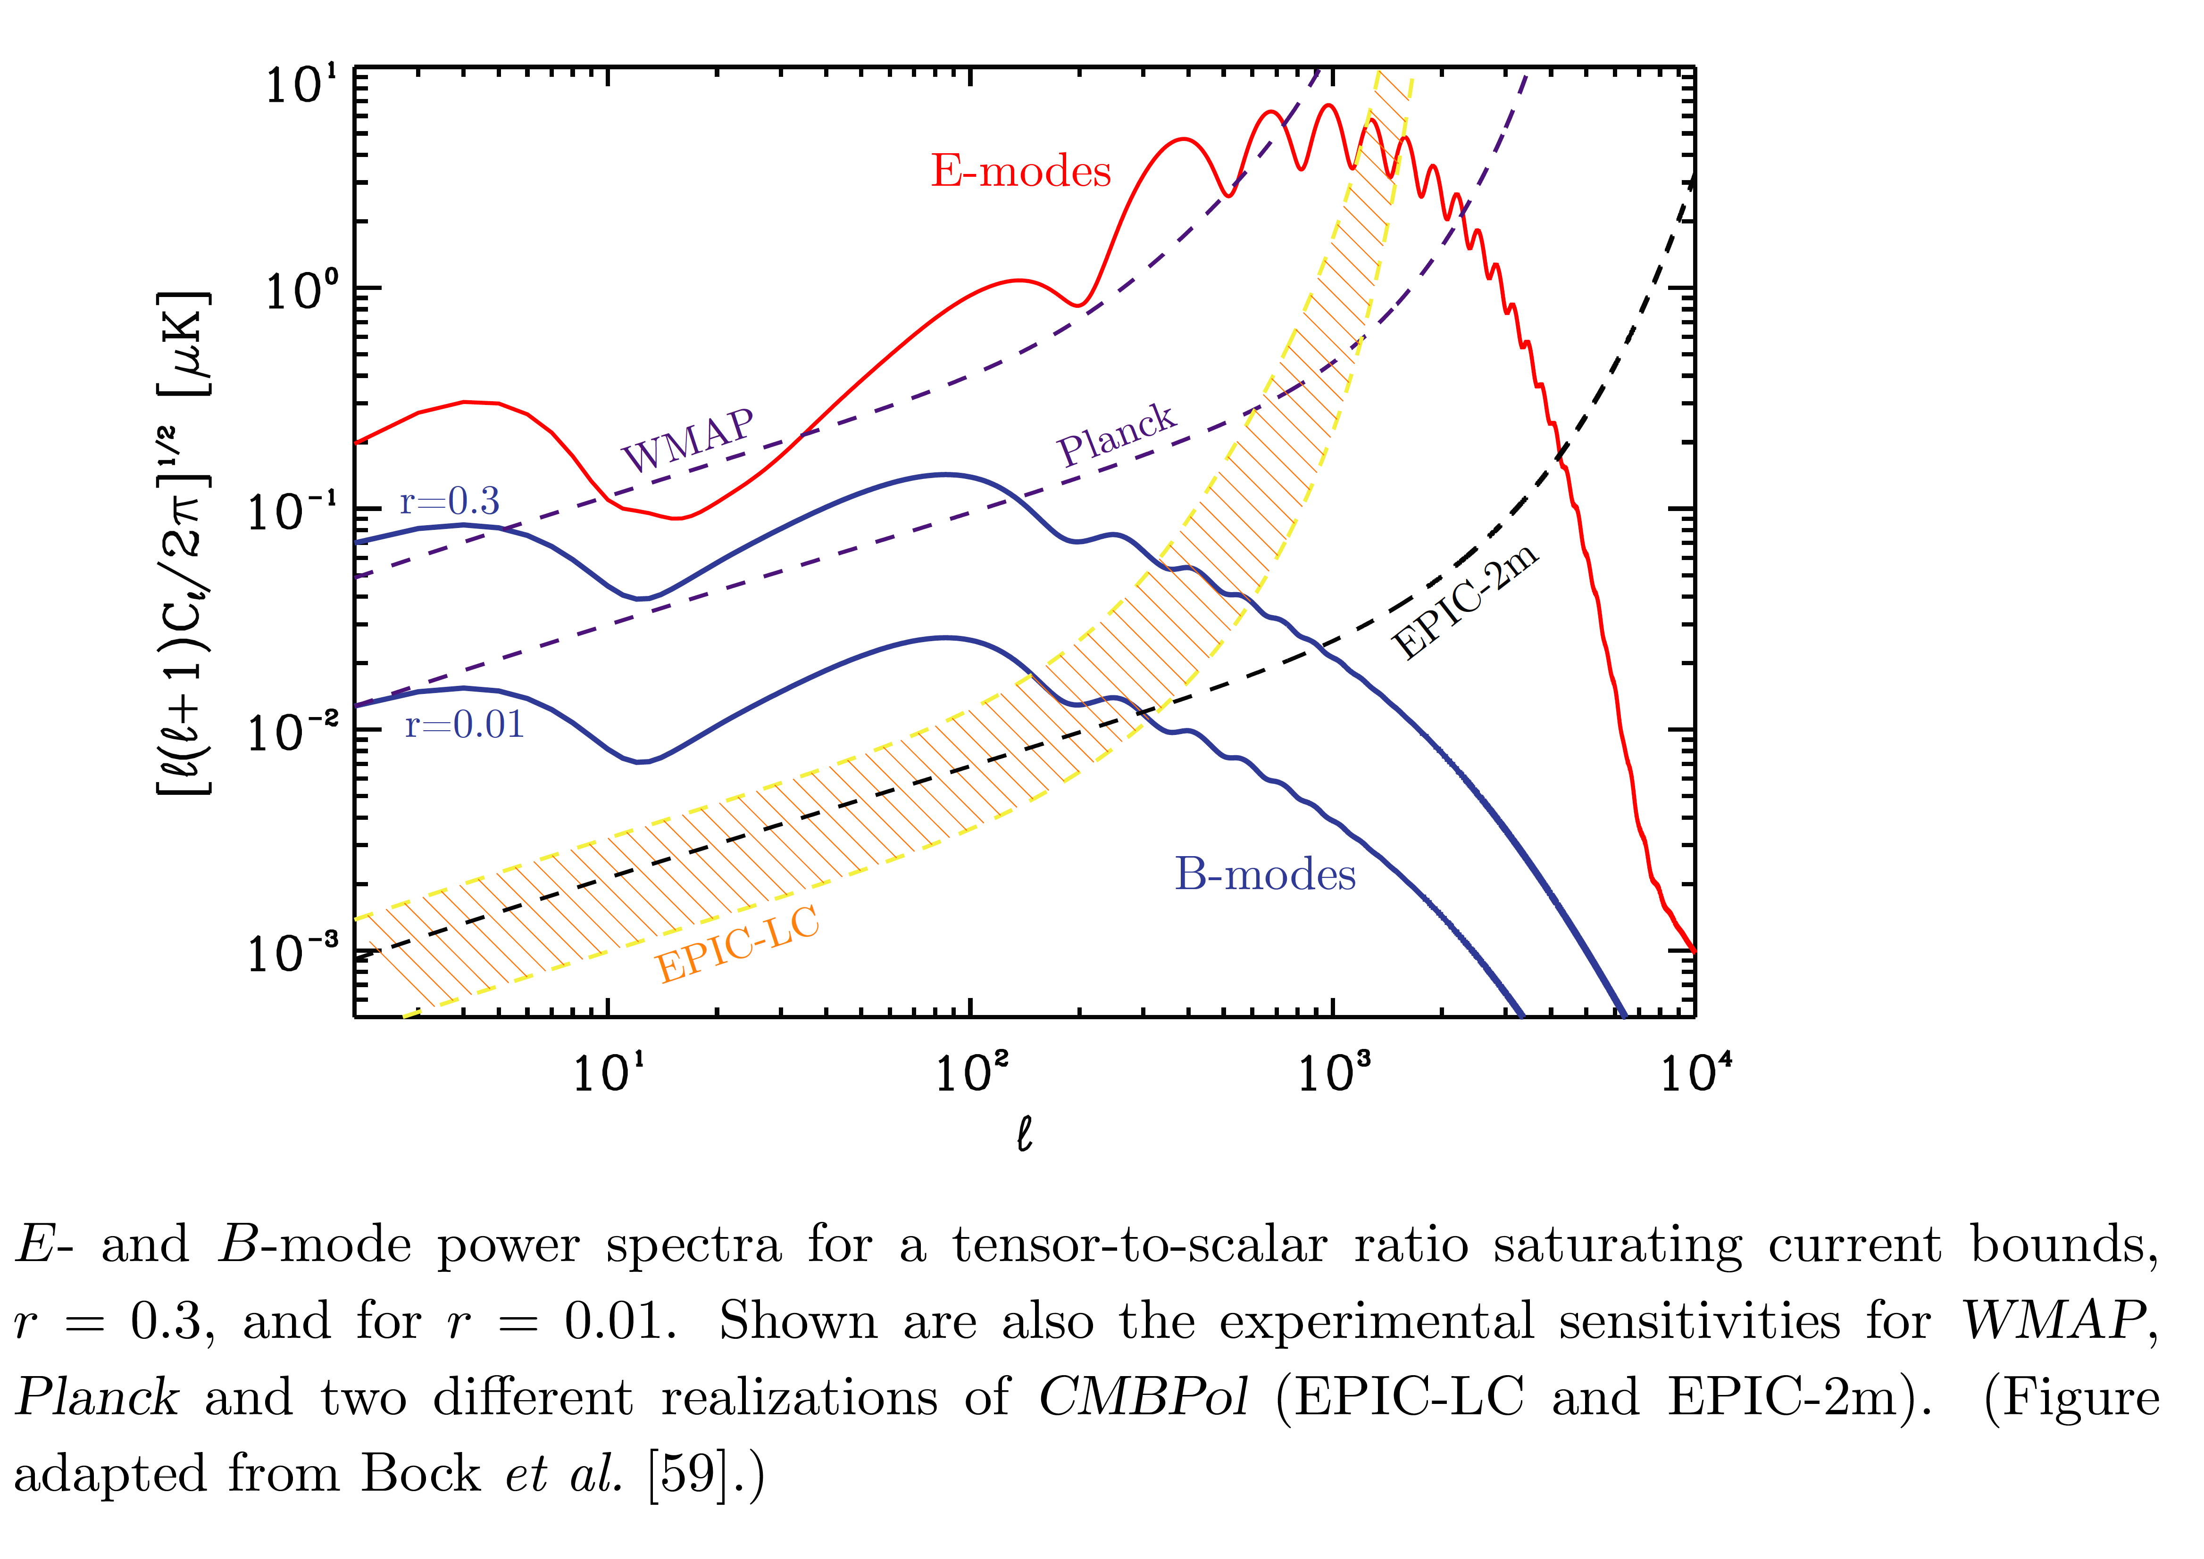
PLANCK AND INFLATIONARY GRAVITY WAVES
Baumann et al. 0811.3919

Slide 83
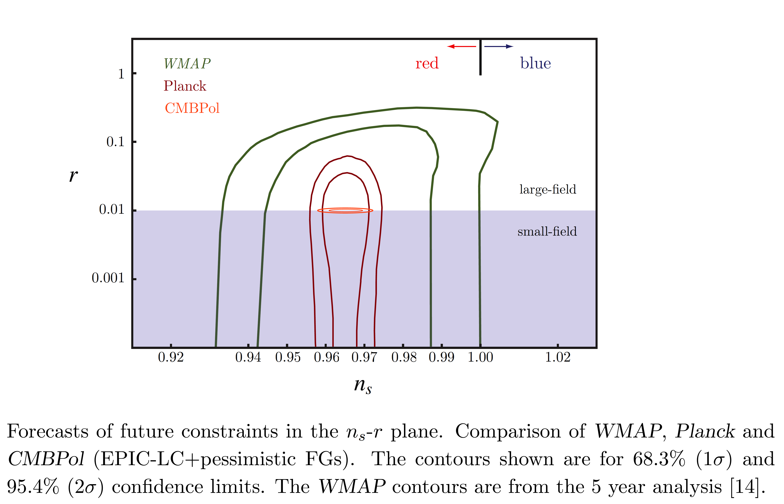
PLANCK AND INFLATIONARY GRAVITY WAVES
Baumann et al. 0811.3919

Slide 84
On the way beyond the standard models
Primordial (inflationary) non-Gaussianity
violation of statistical isotropy

Slide 85
A reminder……
Simpest minimal inflationary models: slow-roll single-field
Single weakly-coupled real scalar field
Canonical kinetic term
Slowly-rolling on a (featureless) potential
Initial Bunch-Davies vacuum state
It’s a predictive theory:
they can be tested and eventually falsified
almost spatially flat universe
density perturbations from the inflaton quantum fluctuations which are:
- adiabatic
- with slight departures from scale-invariance: P(k)=A k^{n-1}, |n-1| <<1
- (almost) gaussian distributed
primordial gravitational waves
rotational and translation invariance

Slide 86
Primordial NG
ζ(x): primordial perturbations
If the fluctuations are Gaussian distributed then their statistical properties are completely characterized by the two-point correlation function, <ζ(x₁)ζ(x₂)>
or its Fourier transform, the power-spectrum.
Thus a non-vanishing three point function, or its Fourier transform, the bispectrum
is an indicator of non-Gaussianity
Amplitude
Shape

Slide 87
Bispectrum vs power spectrum information
10⁶ pixels compressed into ~ 1000 numbers: O.K. only if gaussian
If not we could miss precious information
WMAP coll. ApJ 2011
Measure 3 point-function
and higher-order

Slide 88
Primordial NG
free (i.e. non-interacting)
field, linear theory
Gaussian
Collection of independent harmonic oscillators
(no mode-mode coupling)
Physical origin of primordial NG:
self-interactions of the inflaton field, e.g. λ ϕ³,
interactions between different fields,
non-linear evolution of the fields during inflation,
gravity itself is non linear…..

Slide 89
Why primordial NG is important?

Slide 90
One good reason:
f_{NL} and shape are model dependent:
e.g.: standard single-field models of inflation predict
f_{NL}~O(ε,η) <<1
(Acquaviva, Bartolo, Riotto, Matarrese 2002;
Maldacena 2002)
A detection of a primordial |f_{NL}|~10 would rule out
the standard single-field models of inflation

Slide 91
A second good reason
In the last 8 years there has been an explosion of a new wave
of physically well motivated inflationary models
beyond the simplest ones capable of generating a large and
detectable amount of NG (spurred by the present and future
high precision data)
|f_{NL}| >>1
See N. Bartolo, E. Komatsu, S. Matarrese, A. Riotto, astro-ph/0406398
X. Chen, arXiv:1002.1416
N. Bartolo, S. Matarrese, A.Riotto arXiv:1001.3957

Slide 92
A couple of examples
A couple of examples:
Multi-field models of inflation
non-standard kinetic terms: inflaton lagrangian is an arbitrary function of the
inflaton field and the kinetic term (Chen, Huang, Kachru, Shiu 08)
e.g. i) kinetic inflation: inflation driven by kinetic terms (A.Picon, Damour, Mukhanov 99)
ii) DBI (Dirac-Born-Infield) models (brane/string inspired models)
Alishahiha, Silverstein, Tong 04
rmendarizass
N.B.: In these models inflaton perturbations propagate with a sound speed c_{s}<1 and inflation
can happen with steep potentials

Slide 93
A third good reason
For all single-field models of inflation, independently of the specific
model (Lagrangian), the bispectrum in the squeezed limit (k₁<<k₂~k₃) is
where n is the spectral index very close to one
(e.g. Maldacena 2002)
A convincing detection of primordial NG of the squeezed configuration
can rule out all single-field models of inflation

Slide 94
On the contrary
The power spectrum of inflationary models, characterized by the
primordial tilt n and running dn/dlnk, the existence or absence of
primordial gravitational waves would provide important constraints
on large classes of inflationary models, they will lead in the next years
to rule out various classes of inflationary models, but they would never
be able to rule out single-field inflation.

Slide 95
Many other reasons
Primordial NG contains a much more wealth of information
than the power spectra:
The power spectra of primordial density perturbation is
dictated by H² α ρ, which does not tell much about the
interaction of the field(s):
Inflation models with different field interactions can lead to
very similar predictions of the power spectrum.
NG can help breaking this degeneracy

Slide 96
Constraints on f_{NL} and the shape of primordial
non-Gaussianity translate into constraints of the
coefficients of the interactions of the inflaton Lagrangian:
quadratic Lagrangian=
linear evolution
Cubic Lagrangian=interactions -> non-gaussianity
We can dream of reconstructing the inflaton Lagrangian!

Slide 97
Making some order in NG models
Simpest minimal inflationary models: slow-roll single-field
Single weakly-coupled real scalar field
Canonical kinetic term
Slowly-rolling on a (featureless) potential
Initial Bunch-Davies vacuum state
A large detectable level of NG can be generated if any of the above
conditions is violated;
violation of any of the above conditions results in specific NG shapes
corresponding broadly to well-motivated classes of non-standard
inflationary models

Slide 98
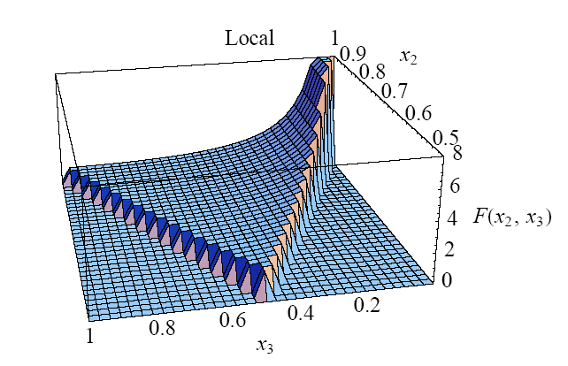
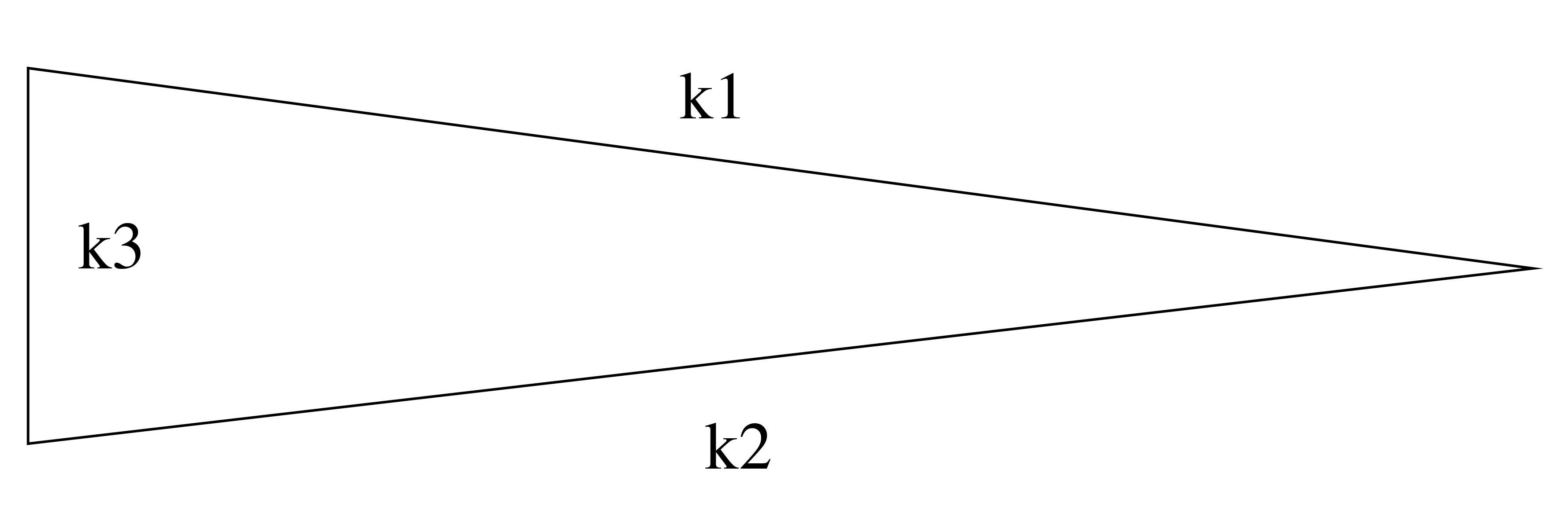
SHAPES OF NG:LOCAL NG
Bispectrum peaks for squeezed triangles k₁<<k₂~k₃
Babich et al. astro-ph/0405356
Non-linearities develop outside the horizon during or immediately after inflation
(e.g. multifield models of inflation)

Slide 99
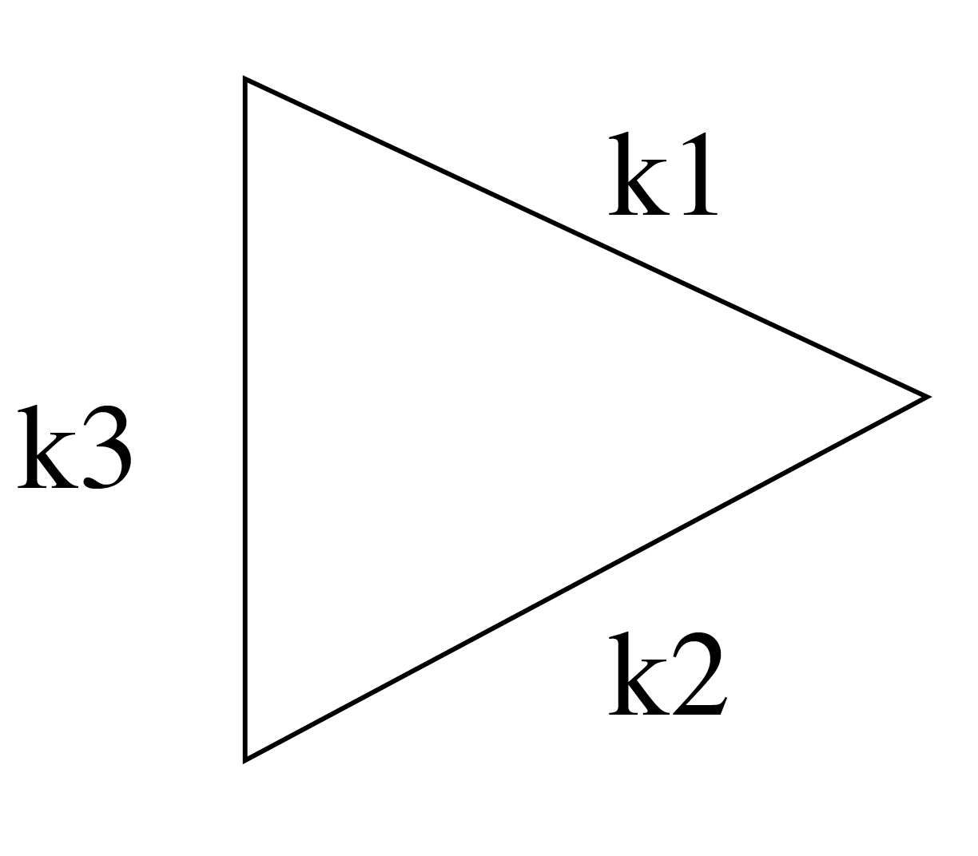
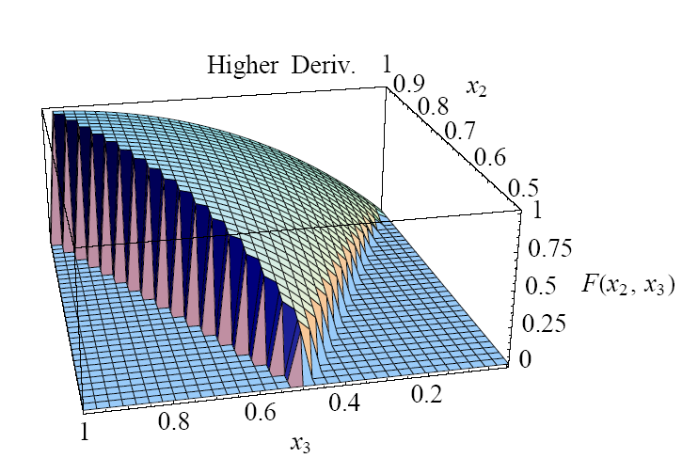
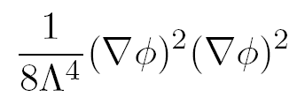
EQUILATERAL NG
Bispectrum peaks for equilateral triangles: k₁=k₂=k₃
Babich et al. (2004)
Single field models of inflation with non-canonical kinetic term L=P(, X) where X=(∂ )² (DBI or K-inflation) where NG comes from higher derivative interactions of the inflaton field

Slide 100
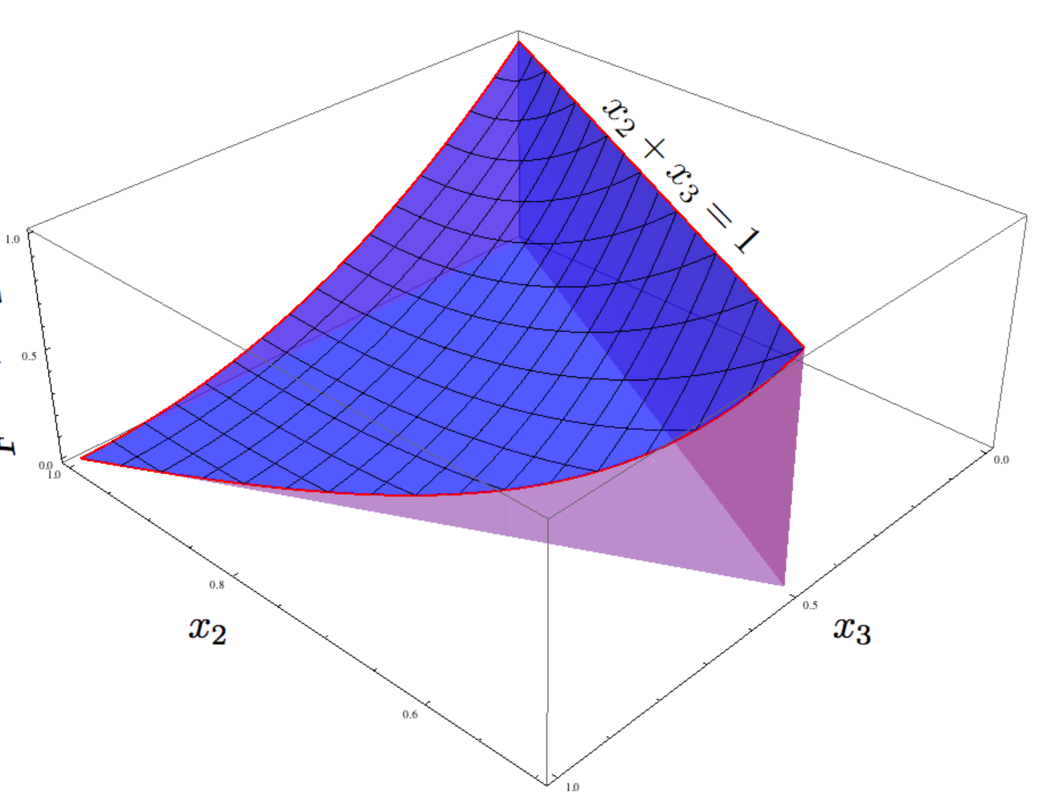
Flattened NG
Bispectrum peaks for flattened triangles k₂ = k₁+k₃
(typical of NG from excited initial states, see Meerburg et al. arXiv:0901.4044;
Chen et al. hep-th/0605045; Holman & Tolley arXiv:0710.1302;
or from higher derivative interactions, Fasiello, Bartolo, Matarrese, Riotto arXiv:1004.0893)

Slide 101
NG …..IT’S NOT JUST A NUMBER
Measuring the amplitude and shape of non-Gaussianities,
with their huge amount of information associated to triangular
configurations is analogous to measuring a cross section as a function
of the angle of the outgoing particles in particle and collider physics
Constraints on f_{NL} translates into constraints of the coefficients of the
interactions of the inflaton Lagrangian (e.g. Senatore et al. 0905.37462)

Slide 102
Observational constraints on NG
-10 < f_{NL} (local) < 74 (95% C.L>)
-214 < f_{NL} (equilateral) < 266
-410 < f_{NL} (orthogonal) < 6
Komatsu & WAMP team 1001.4538

Slide 103
What do we expect from PLANCK?

Slide 104
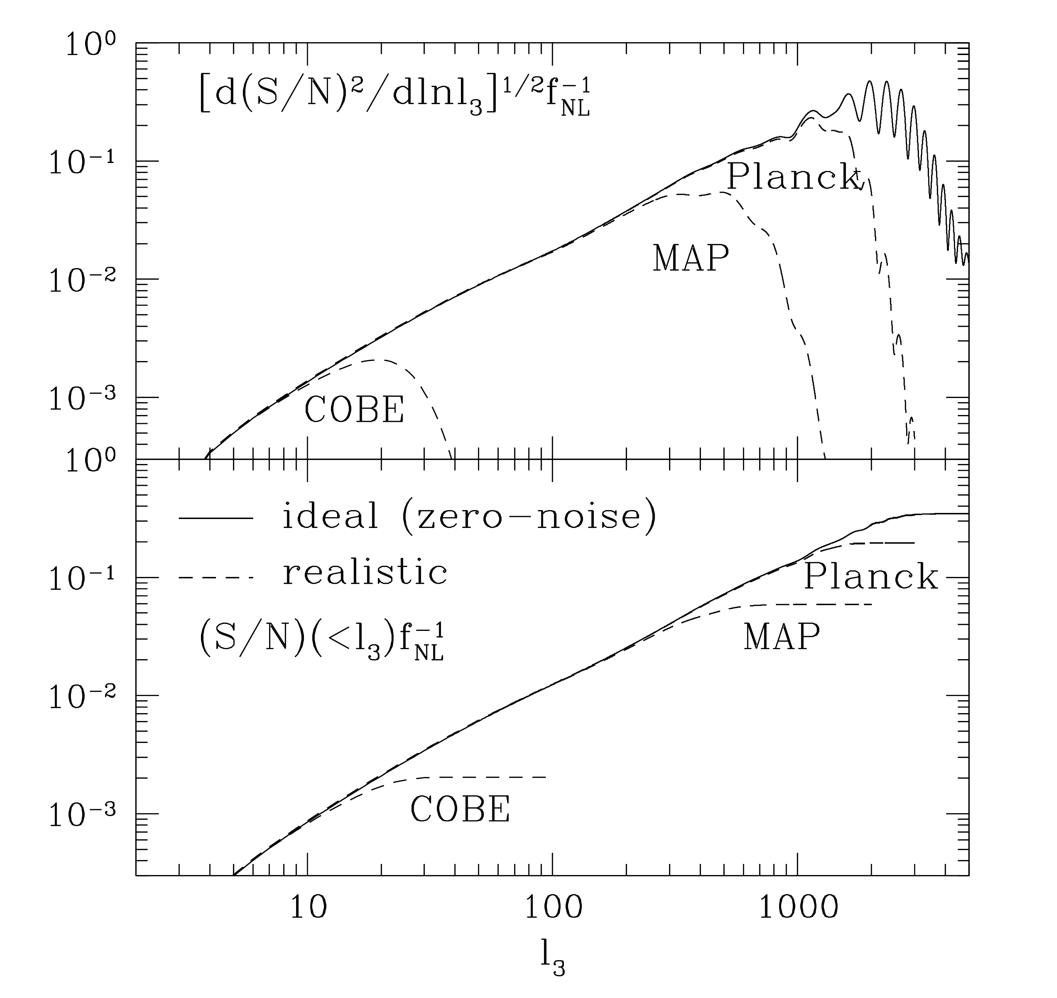
Forecasts for PLANCK
Komatsu & Spergel astro-ph/0005036
Minimum value
detectable by Planck
is f_{NL}~2
(WAMP is 20):
1 order magnitude
better!

Slide 105
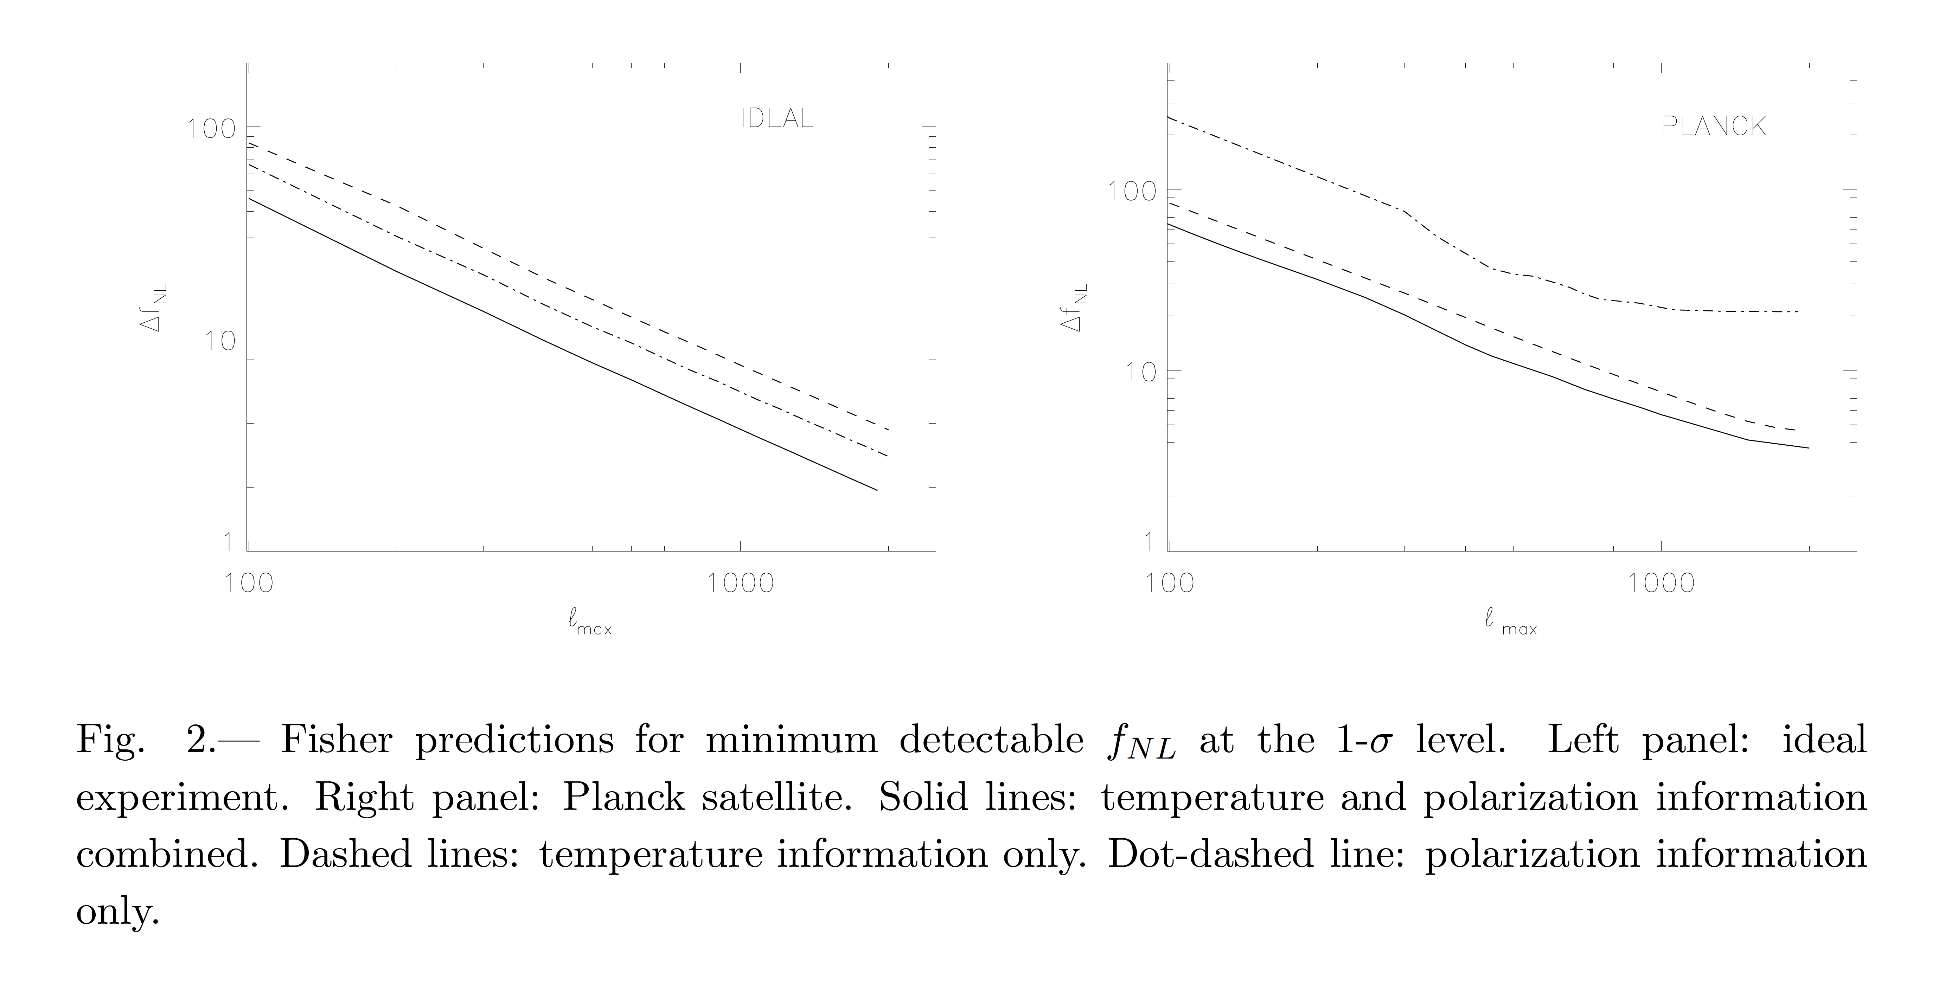
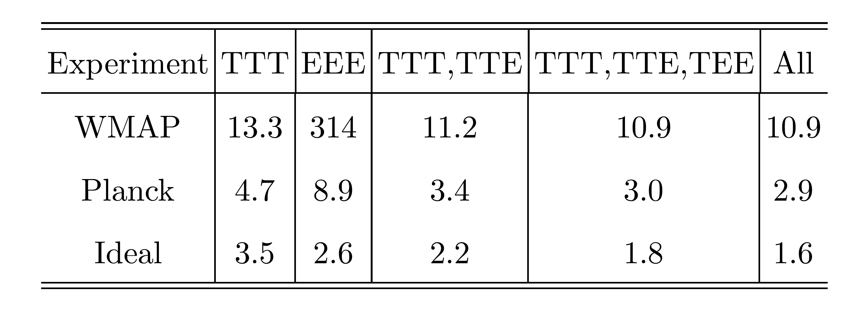
Forecasts for PLANCK
Yadav et al.
astro-ph/0701921
Babich, Zaldarriaga
astro-ph/0408455;
Liguori et al.
0708.3786
Minimum detectable value of f_{NL} :
With polarization information a factor 2 better

Slide 106
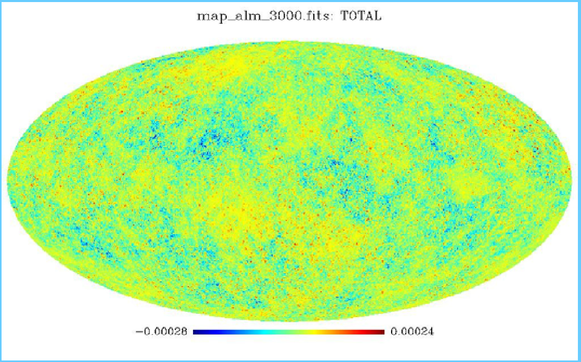
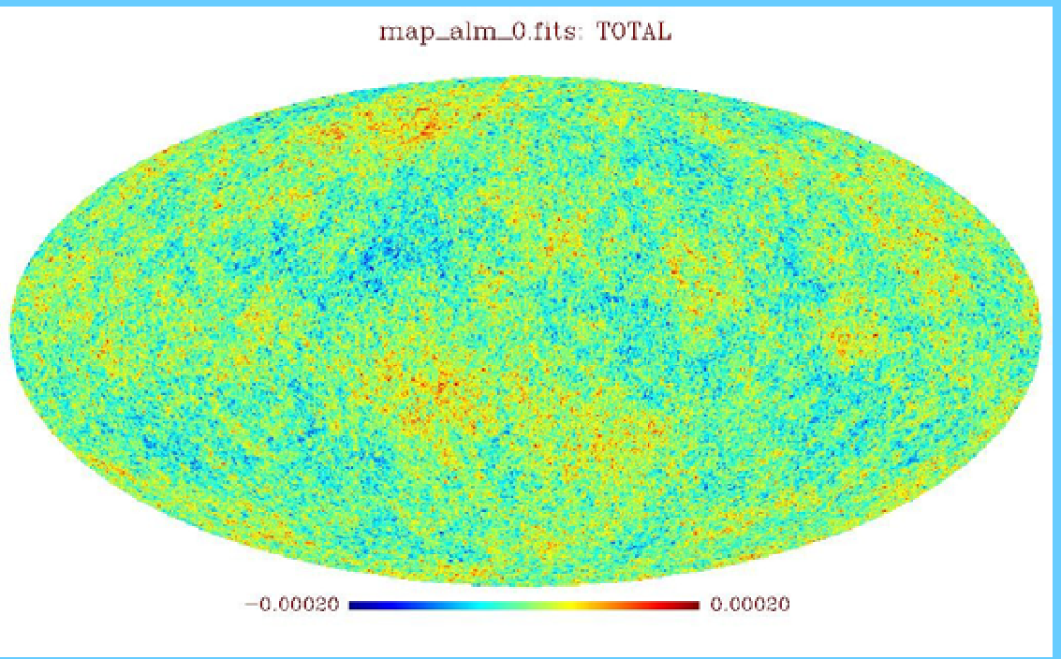
Non-Gaussian maps
f_{NL}=+3000
Planck resolution 5’
l_{max=}=3000
Liguori, Matarrese, Moscardini, 2003
f_{NL}~5 is really a tiny effect!!
Planck will be sensitive to deviation
from gaussianity of 1 part in 10⁴!!
f_{NL}=0

Slide 107
Conclusions
Planck will measure with exquisite accuracy and precision many cosmological
parameters including those characterizing the primordial (inflationary)
density perturbations
(cold dark matterd density, baryon density, optical depth, comsological constant,
primordial fluctiuation amplitude, primordial spectral index)
This will allow to rule out/confirm various inflationary models
But……main message: with Planck (and other future CMB and LSS experiments)
we will begin to look for more!!!
We can start to pass from a description of what the universe is made of to
``why’’ it has the form we observe
(nature and origin of various components, fundamental physics driving inflation)
e.g. non-Gaussianity: probing the interactions of the fields driving inflation
at extremely high energies:
learn about the fundamental physics operative during inflation.

Slide 108
We are ready for even more spectacular things!
``spectacular realization “
(Alan Guth’s diary 1979)

Slide 109
References
Reviews on inflation:
Riotto, hep-ph/9807278; arXiv:1010.2642
Baumann et al. 0811.3919, CMBPol Mission Concept Study
-Review on Inflation and non-Gaussianity:
N. Bartolo, E. Komatsu, S. Matarrese, A. Riotto, astro-ph/0406398
X. Chen, arXiv:1002.1416
Bartolo, Matarrese, Riotto, arXiv:1001.3957
Komatsu, 1003.6097; 0902.4759 (white paper to NASA decadal survey)
Yadav, Wandelt, arXiv:1006.0275
Inflation and Gravitational waves:
C. Armitage-Caplan et al. 1102.2181, COrE, a white paper
Baumann et al. 0811.3919, CMBPol Mission Concept Study
- Planck satellite: visit http://www.rssd.esa.int/index.php?project=Planck
and look for the Planck Blue-Book
- textbooks: e.g. Modern Cosmology, Scott Dodelson, 2003 Academic Press
Textbooks:

