Slide 1
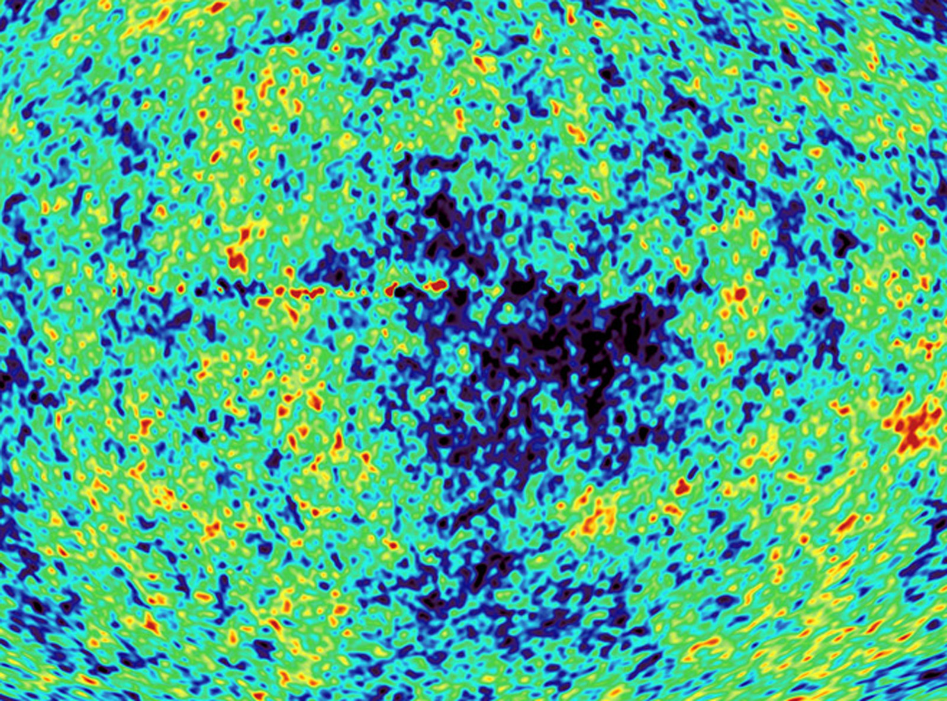
I Neutrini in Cosmologia
Scuola di Formazione Professionale INFN
Padova, 16 Maggio 2011
Alessandro Melchiorri
Universita’ di Roma, “La Sapienza”
INFN, Roma-1

Slide 2
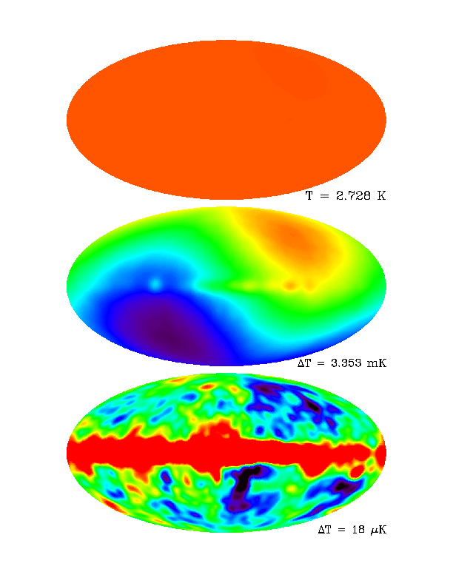
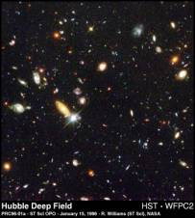
The Microwave Sky
COBE
Uniform...
Dipole...
Imprint left by primordial
tiny density inhomogeneities
(z~1000)..
Galaxy (z=0)

Slide 3
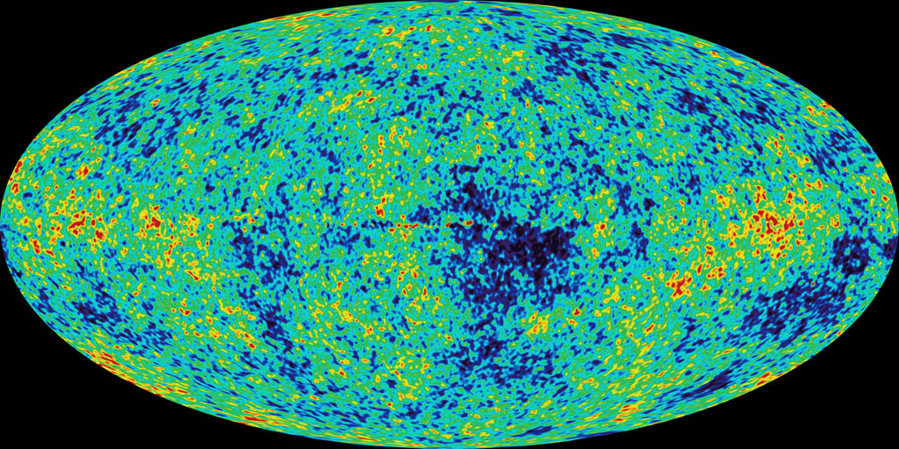

Slide 4
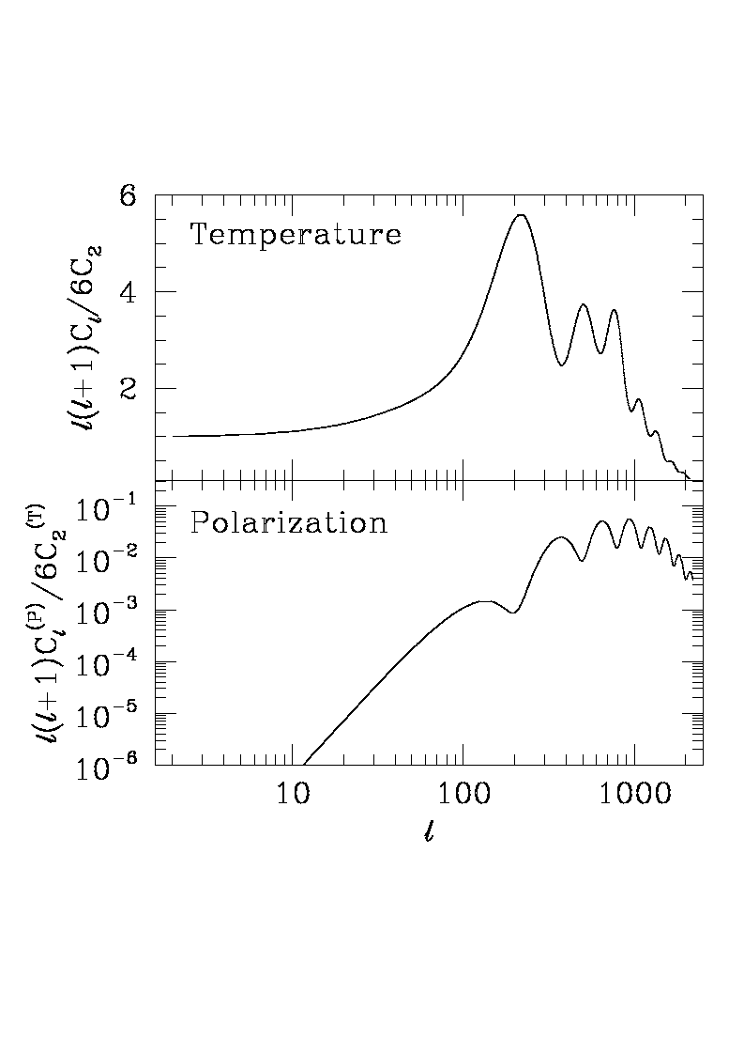

Slide 5
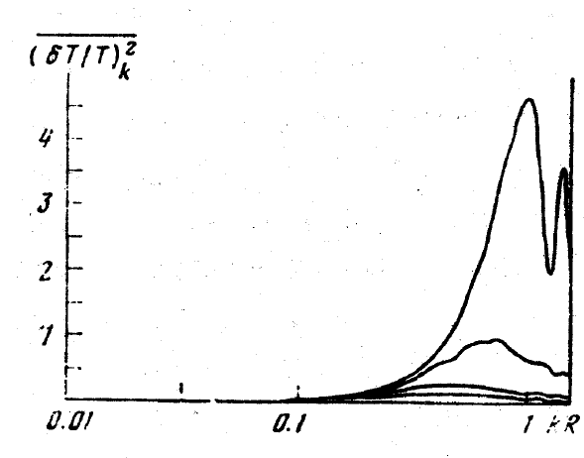
Doroshkevich, A. G.; Zel'Dovich, Ya. B.; Syunyaev, R. A.
Soviet Astronomy, Vol. 22, p.523, 1978

Slide 6
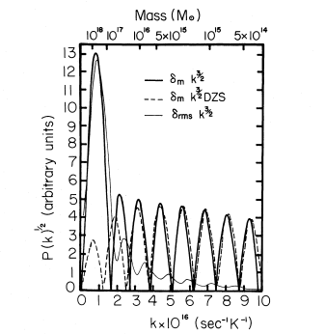
Wilson, M. L.; Silk, J., Astrophysical Journal, Part 1, vol. 243, Jan. 1, 1981, p. 14-25.
1981

Slide 7
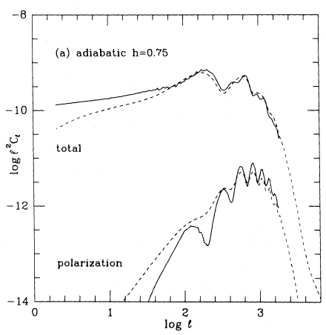
Bond, J. R.; Efstathiou, G.; Royal Astronomical Society, Monthly Notices (ISSN 0035-8711), vol. 226, June 1, 1987, p. 655-687, 1987

Slide 8
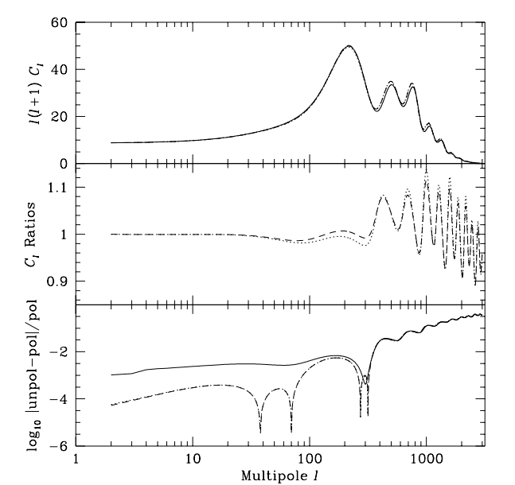
Chung-Pei Ma, Edmund Bertschinger, Astrophys.J. 455 (1995) 7-25

Slide 9
Hu, Wayne; Scott, Douglas; Sugiyama, Naoshi; White, Martin. Physical Review D, Volume 52, Issue 10, 15 November 1995, pp.5498-5515

Slide 10
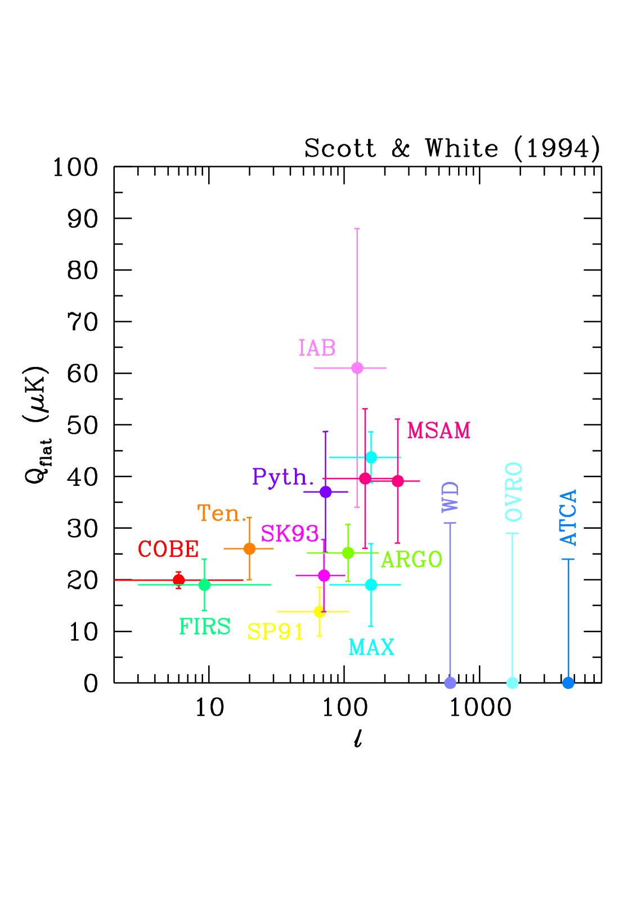

Slide 11
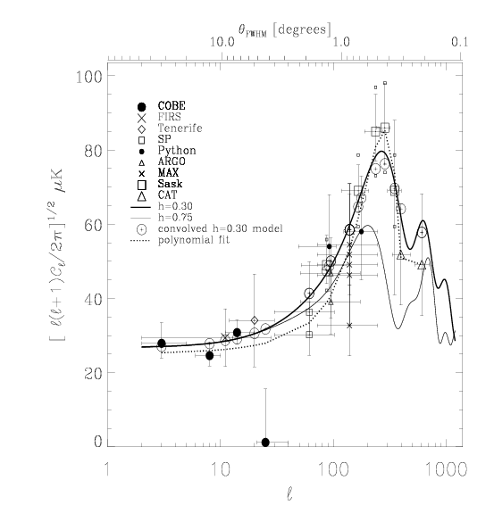
CMB anisotropies, C. Lineweaver et al., 1996 A.D.

Slide 12
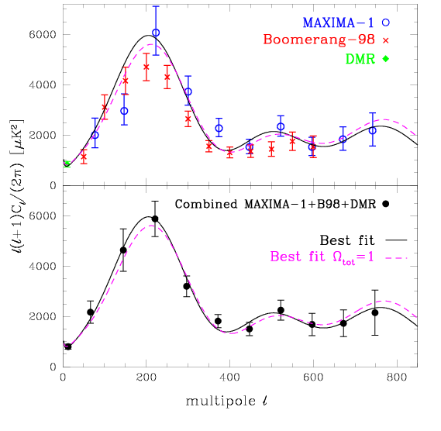
CMB anisotropies, A. Jaffe et al., 2001

Slide 13
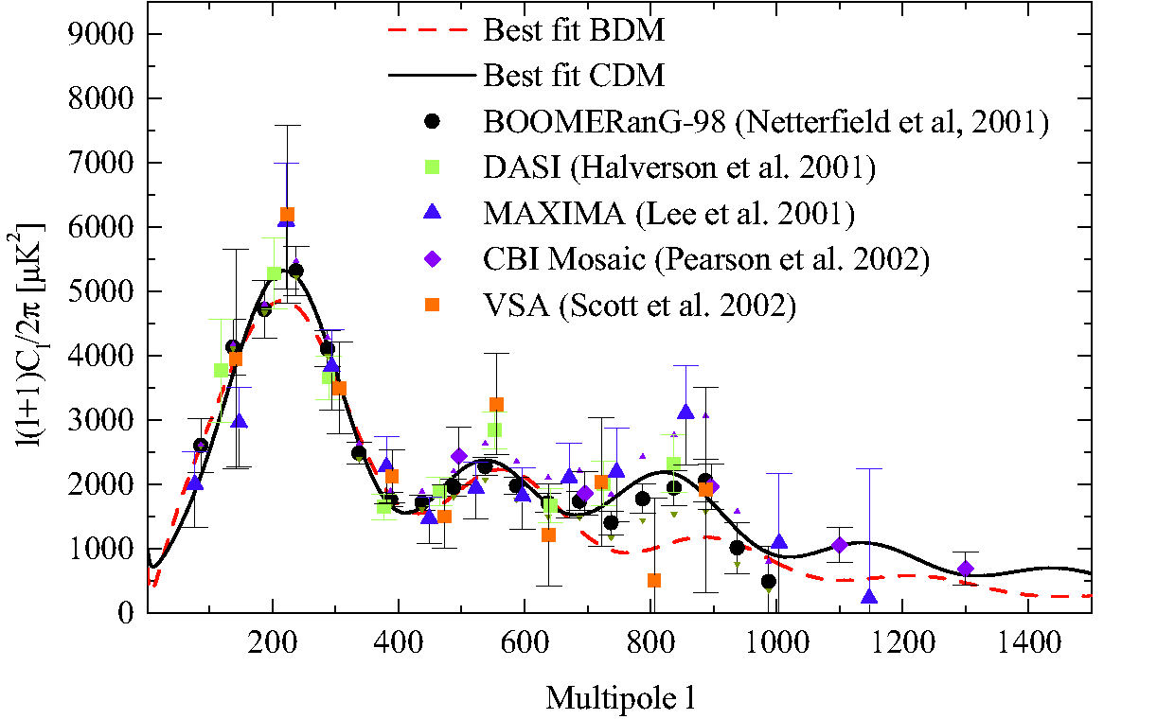
CMB anisotropies pre-WMAP (January 2003)

Slide 14
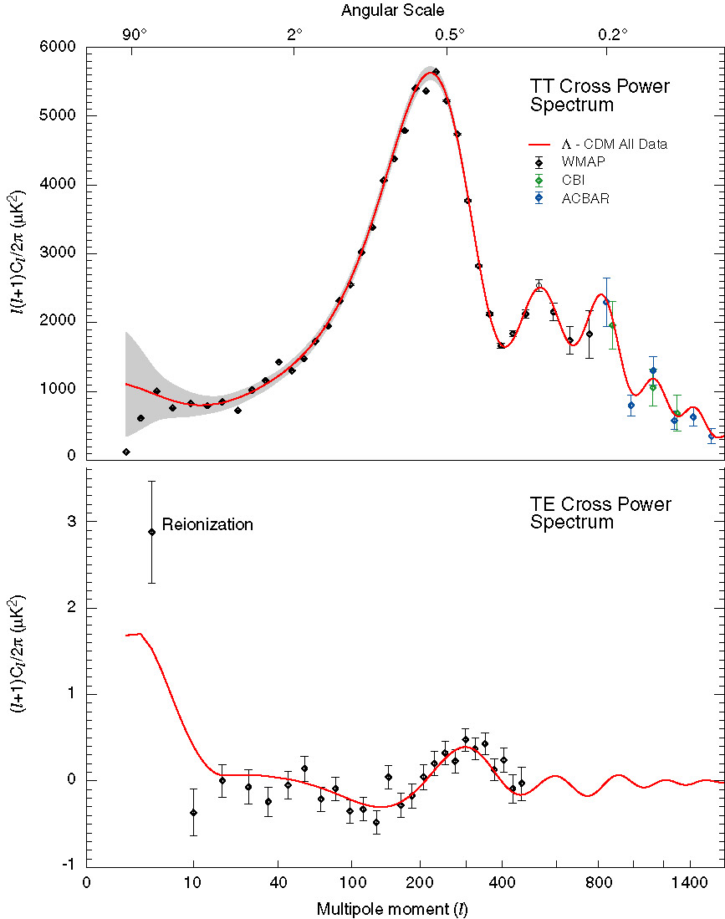
WMAP
2003
Notes:
TT Run through the regimes..
Sachs Wolfe plateau
Acoustic peaks region
Damping tail
How much do Acbar and CBI tell us?
Polarization: Two effects one comes from the decoupling surface.
One comes from the reionization of the universe.

Slide 15
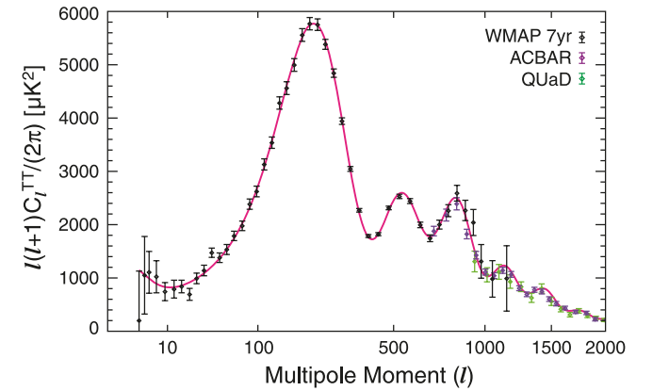

Slide 16
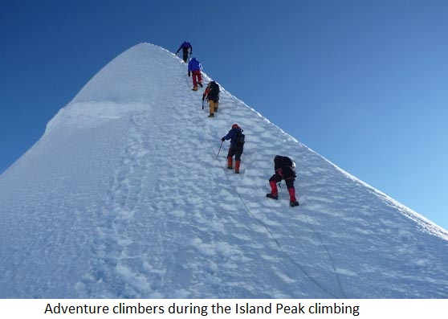
Next: Climbing to the Peak...

Slide 17
Interpreting the Temperature angular power spectrum.
Some recent/old reviews:
Ted Bunn, arXiv:astro-ph/9607088
Arthur Kosowsky, arXiv:astro-ph/9904102
Hannu Kurki-Suonio, http://arxiv.org/abs/1012.5204
Challinor and Peiris, AIP Conf.Proc.1132:86-140, 2009, arXiv:0903.5158

Slide 18

CMB Anisotropy: BASICS
Friedmann Flat Universe with 5 components: Baryons, Cold Dark Matter (w=0, always), Photons, Massless Neutrinos, Cosmological Constant.
Linear Perturbation. Newtonian Gauge. Scalar modes only.

Slide 19
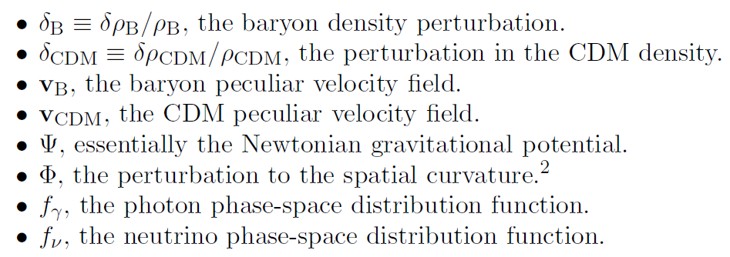

CMB Anisotropy: BASICS
Perturbation Variables:
Key point: we work in Fourier space :

Slide 20

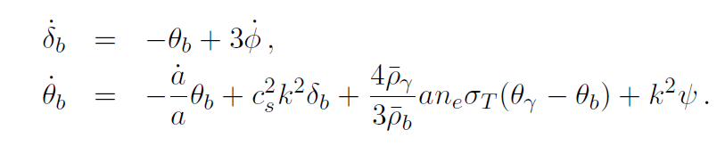
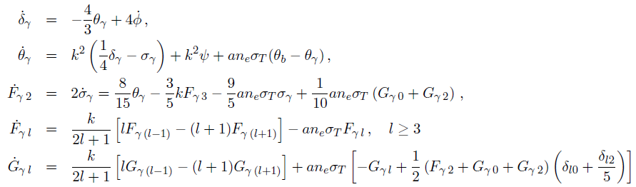
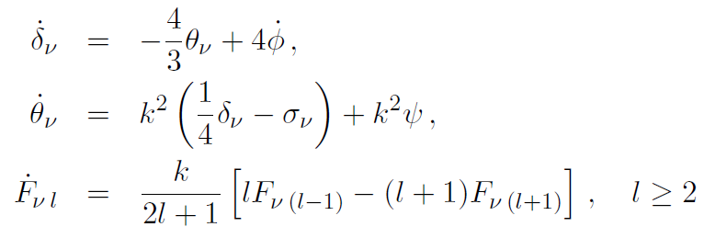
CMB Anisotropy: BASICS
Their evolution is governed by a nasty set of coupled partial differential equations:
CDM:
Baryons:
Photons:
Neutrinos:

Slide 21
Numerical Integration
Early Codes (1995) integrate the full set of equations (about 2000 for each k mode, approx, 2 hours CPU time for obtaining one single spectrum).
COSMICS first public Boltzmann code http://arxiv.org/abs/astro-ph/9506070.
Major breakthrough with line of sight integration method with CMBFAST (Seljak&Zaldarriaga, 1996, http://arxiv.org/abs/astro-ph/9603033). (5 minutes of CPU time)
Most supported and updated code at the moment CAMB (Challinor, Lasenby, Lewis), http://arxiv.org/abs/astro-ph/9911177 (Faster than CMBFAST).
Both on-line versions of CAMB and CMBFAST available on LAMBDA website.
Suggested homework: read Seljak and Zaldarriga paper for the line of sight integration.

Slide 22
CMB Anisotropy: BASICS
Their evolution is governed by a nasty set of coupled partial differential equations:
CDM:
Baryons:
Photons:
Neutrinos:

Slide 23
First Pilar of the standard model of structure formation:
Linear differential
operator
Perturbation
Variables
Standard model: Evolution of perturbations is passive and coherent.
Active and decoherent models of structure formation
(i.e. topological defects see Albrecht et al, http://arxiv.org/abs/astro-ph/9505030):

Slide 24
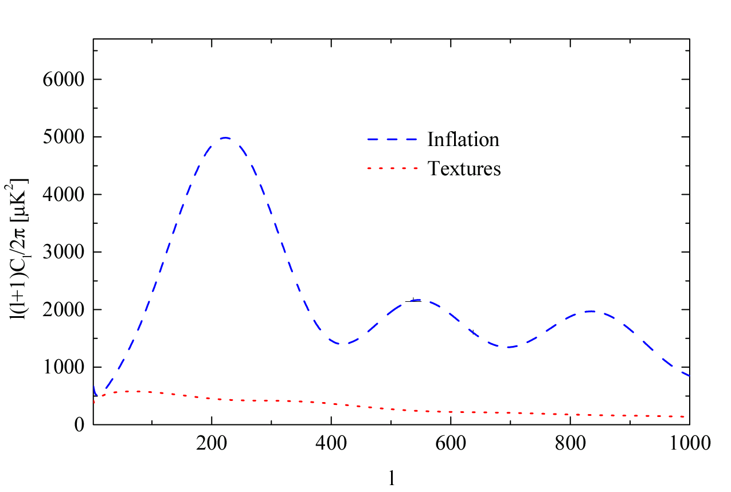
Oscillations
supporting evidence for passive and coherent
scheme.

Slide 25
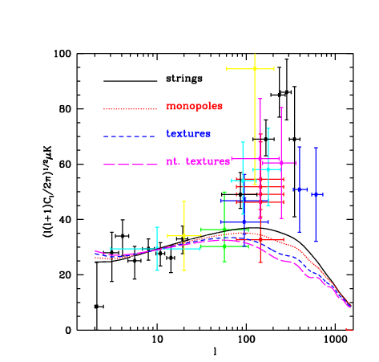
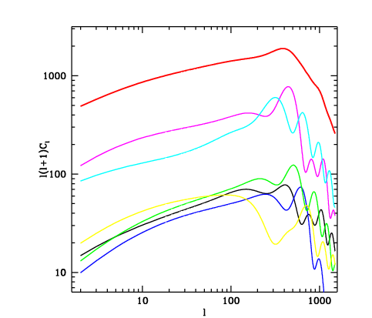
Pen, Seljak, Turok, http://arxiv.org/abs/astro-ph/9704165
Expansion of the defect source term in eigenvalues. Final spectrum does’nt show any
Feature or peak.

Slide 26
CMB Anisotropy: BASICS
Primary CMB anisotropies:
Gravity (Sachs-Wolfe effect)+ Intrinsic (Adiabatic) Fluctuations
Doppler effect
Time-Varying Potentials (Integrated Sachs-Wolfe Effect)

Slide 27
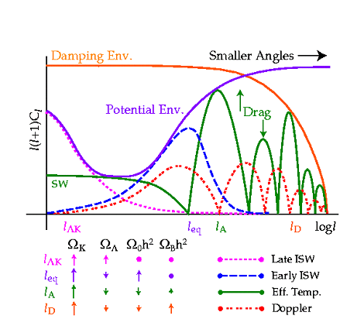
Hu, Sugiyama, Silk, Nature 1997, astro-ph/9604166

Slide 28


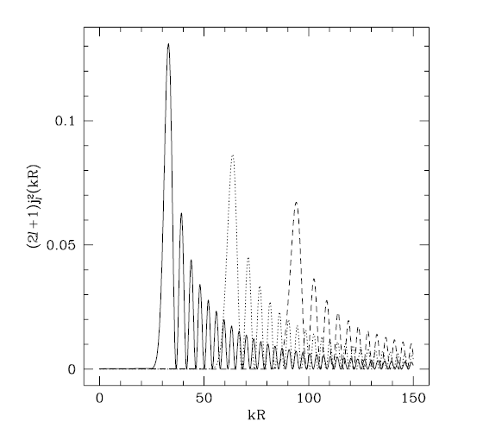
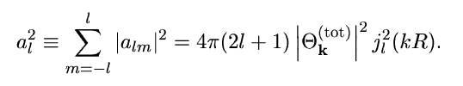

Projection
A mode with wavelength λ will show up on an angular scale θ ∼ λ/R, where R is the distance to the last-scattering surface, or in other words, a mode with wavenumber k shows up at multipoles l∼k.
l=30
l=60
The spherical Bessel function jl(x) peaks at x ∼ l, so a single Fourier mode k does indeed contribute most of its power around multipole lk = kR, as expected. However, as the figure shows, jl does have significant power beyond the first peak, meaning that the power contributed by a Fourier mode “bleeds” to l-values different from lk.
Moreover for an open universe (K is the curvature) :
l=90

Slide 29
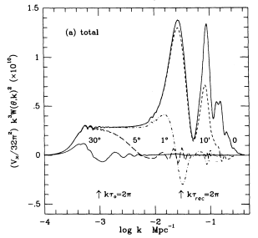
Projection

Slide 30
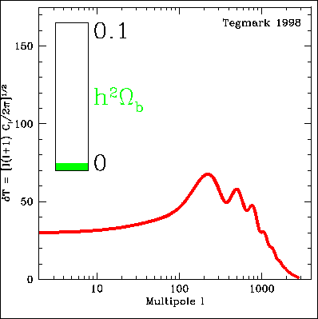

Slide 31
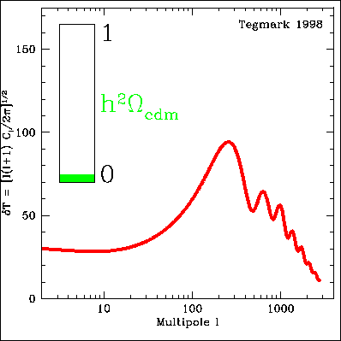

Slide 32
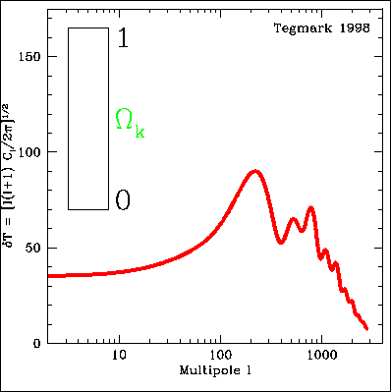

Slide 33
CMB Parameters
Baryon Density
CDM Density
Distance to the LSS, «Shift Parameter» :

Slide 34


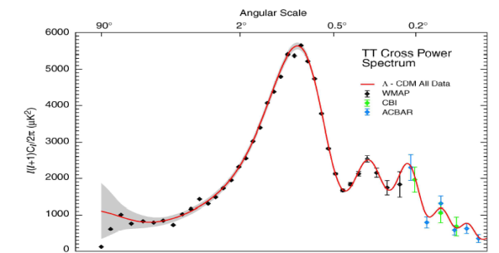
How to get a bound on a cosmological parameter
Fiducial cosmological model:
(Ω_{b}h² , Ω_{m}h² , h , n_{s} , τ, Σm_{ν} )
DATA
PARAMETER
ESTIMATES

Slide 35
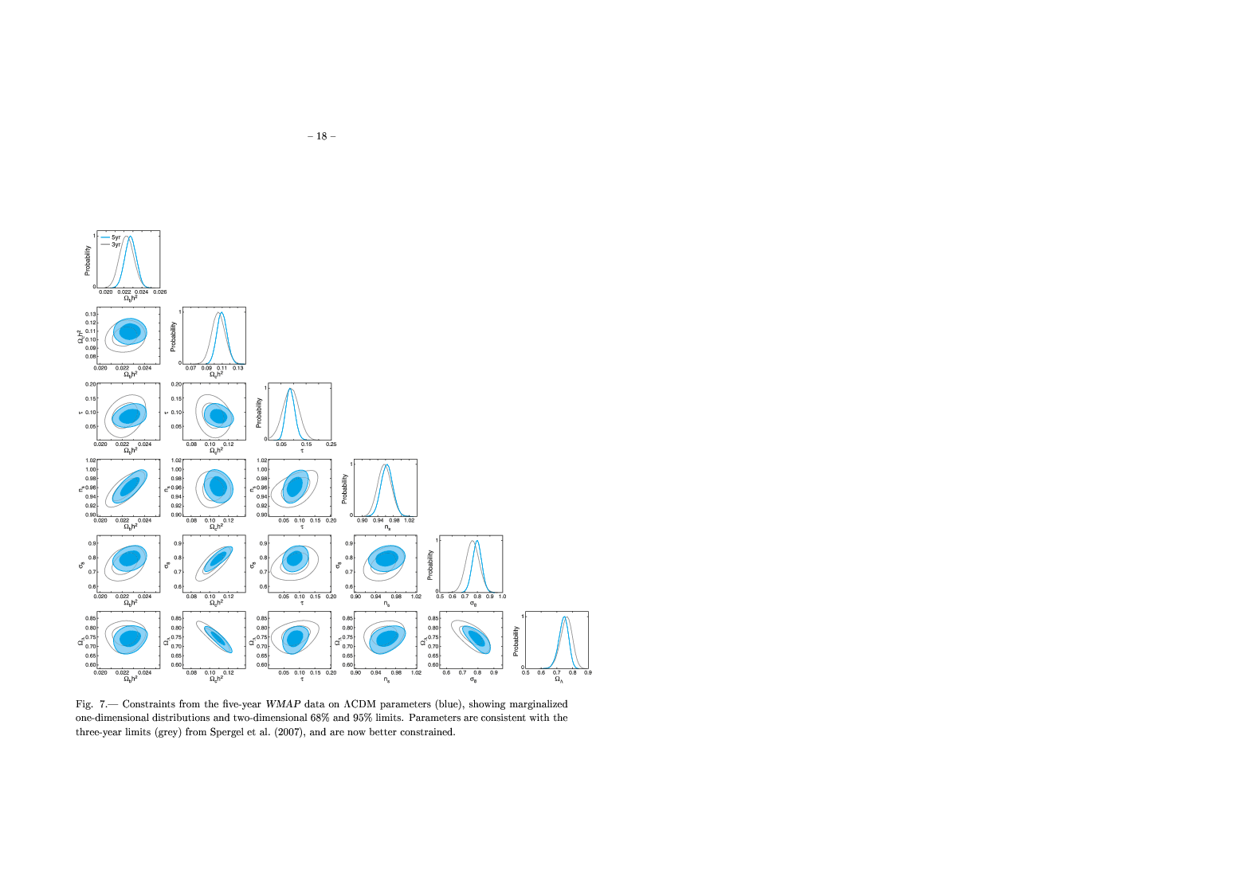
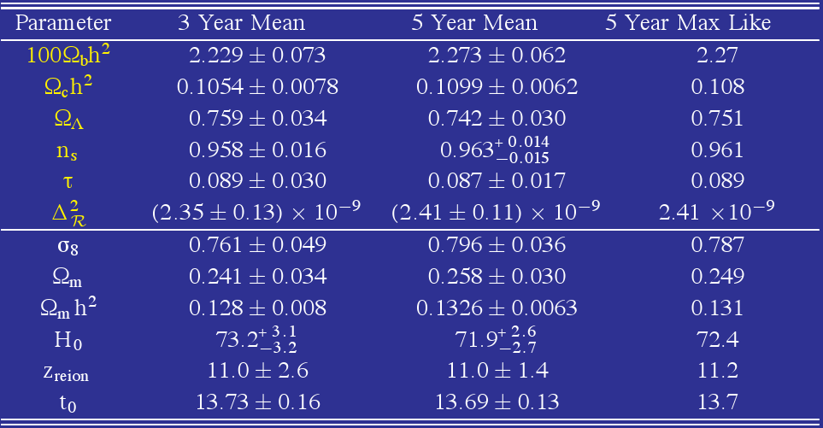
Dunkley et al., 2008

Slide 36
Too many parameters ?

Slide 37
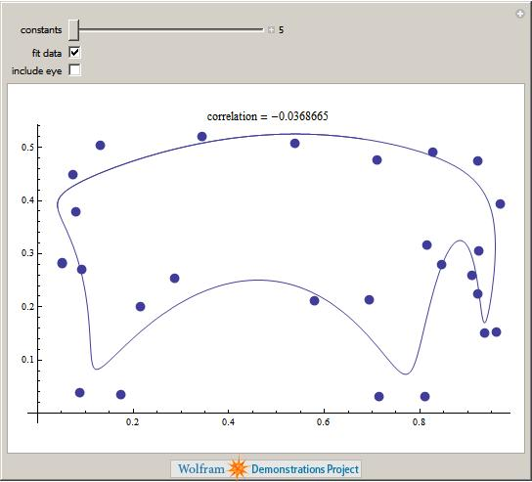
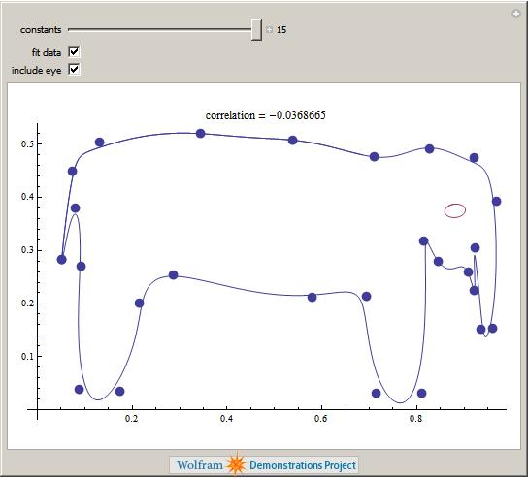
Enrico Fermi:"I remember my friend Johnny von Neumann used to say, 'with four parameters I can fit an elephant and with five I can make him wiggle his trunk.‘”

Slide 38
Extensions to the standard model
Dark Energy. Adding a costant equation of state can change constraints on H0 and the matter density. A more elaborate DE model (i.e. EDE) can affect the constraints on all the parameters.
Reionization. A more model-independent approach affects current constraints on the spectral index and inflation reconstruction.
Inflation. We can include tensor modes and/or a scale-dependent spectral index n(k).
Primordial Conditions. We can also consider a mixture of adiabatic and isocurvature modes. In some cases (curvaton, axion) this results in including just a single extra parameter. Most general parametrization should consider CDM and Baryon, neutrino density e momentum isocurvature modes.
Neutrino background and hot dark matter component.
Primordial Helium abundance.
Modified recombination by for example dark matter annihilations.
Even more exotic: variations of fundamental constants, modifications to electrodynamics, etc, etc.
…

Slide 39
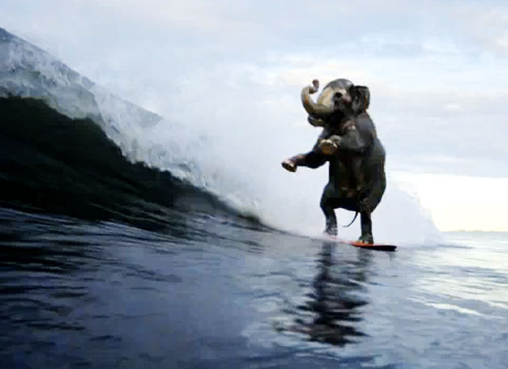

Slide 40
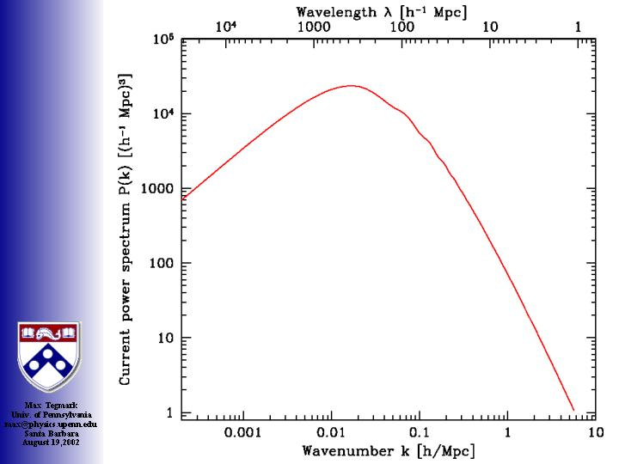
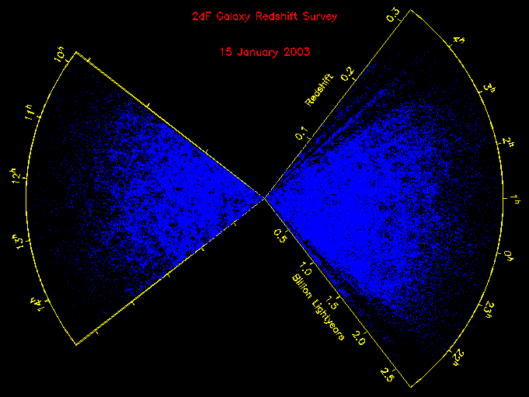
Galaxy Clustering: Theory

Slide 41
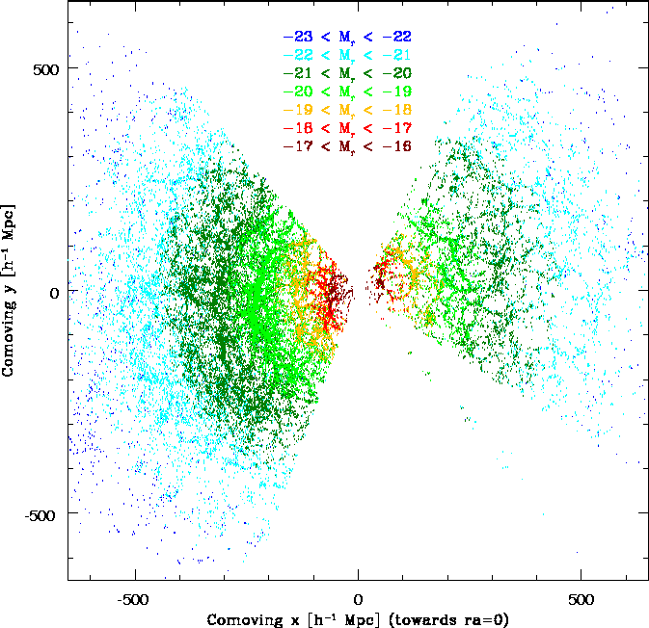
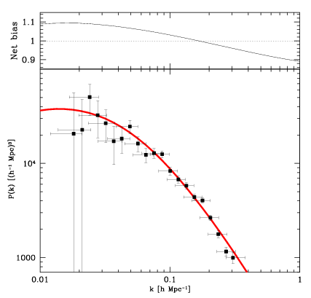
Galaxy Clustering: Data

Slide 42
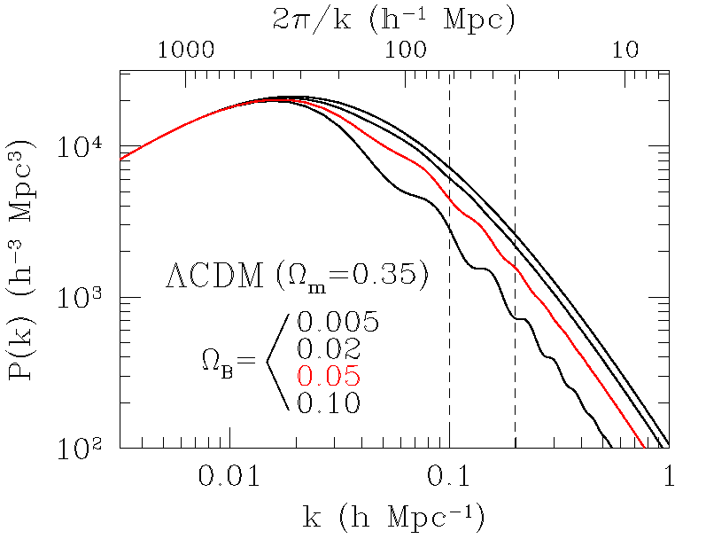
LSS as a cosmic yardstick
Imprint of oscillations less clear in LSS spectrum unless high baryon density
Detection much more difficult:
Survey geometry
Non-linear effects
Biasing
Big pay-off:
Potentially measure d_{A}(z) at many redshifts!

Slide 43
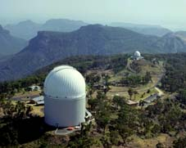
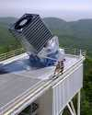
Recent detections of the baryonic signature
Cole et al
  221,414 galaxies, b_{J} < 19.45
  (final 2dFGRS catalogue)
Eisenstein et al
  46,748 luminous red galaxies (LRGs)
  (from the Sloan Digital Sky Survey)

Slide 44
The 2dFGRS power spectrum

Slide 45
The SDSS LRG correlation function

Slide 46
«Laboratory» Parameters
Some of the extra cosmological parameters can be measured in a independent way directly.
These are probably the most interesting parameters in the near future since they establish a clear connection between cosmology and fundamental physics.
Neutrino masses
Neutrino effective number
Primordial Helium

Slide 47
Primordial Helium

Slide 48
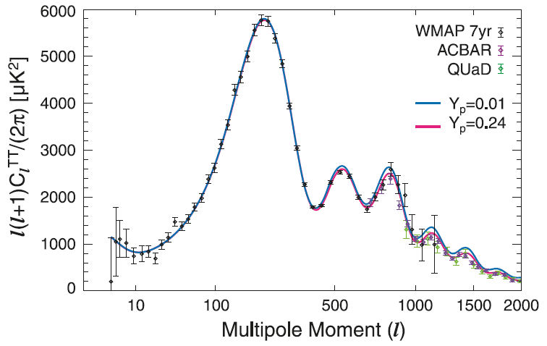
Small scale CMB can probe Helium abundance at recombination.
See e.g.,
K. Ichikawa et al., Phys.Rev.D78:043509,2008
R. Trotta, S. H. Hansen, Phys.Rev. D69 (2004) 023509

Slide 49
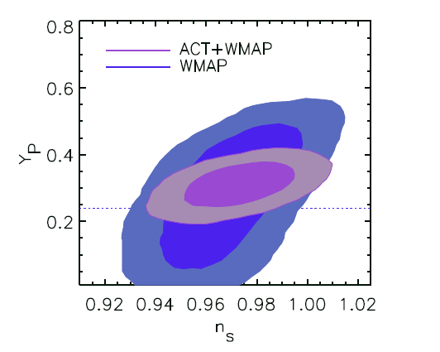
Primordial Helium: Current Status
Current data seems to prefer a slightly higher value than expected from standard BBN.
WMAP+ACT analysis provides (Dunkley, 2010):
YP = 0.313+-0.044
Direct measurements (Izotov, Thuan 2010,
Aver 2010):
Yp = 0.2565 ± 0.001 (stat) ± 0.005 (syst)
Yp = 0.2561±0.011
Assuming standard BBN and taking the baryon
density from WMAP:
Yp = 0.2485 ± 0.0005

Slide 50
Neutrino Mass

Slide 51
Cosmological (Active) Neutrinos
Neutrinos are in equilibrium with the primeval plasma through weak
interaction reactions. They decouple from the plasma at a temperature
We then have today a Cosmological Neutrino Background at a temperature:
With a density of:
That, for a massive neutrino translates in:

Slide 52
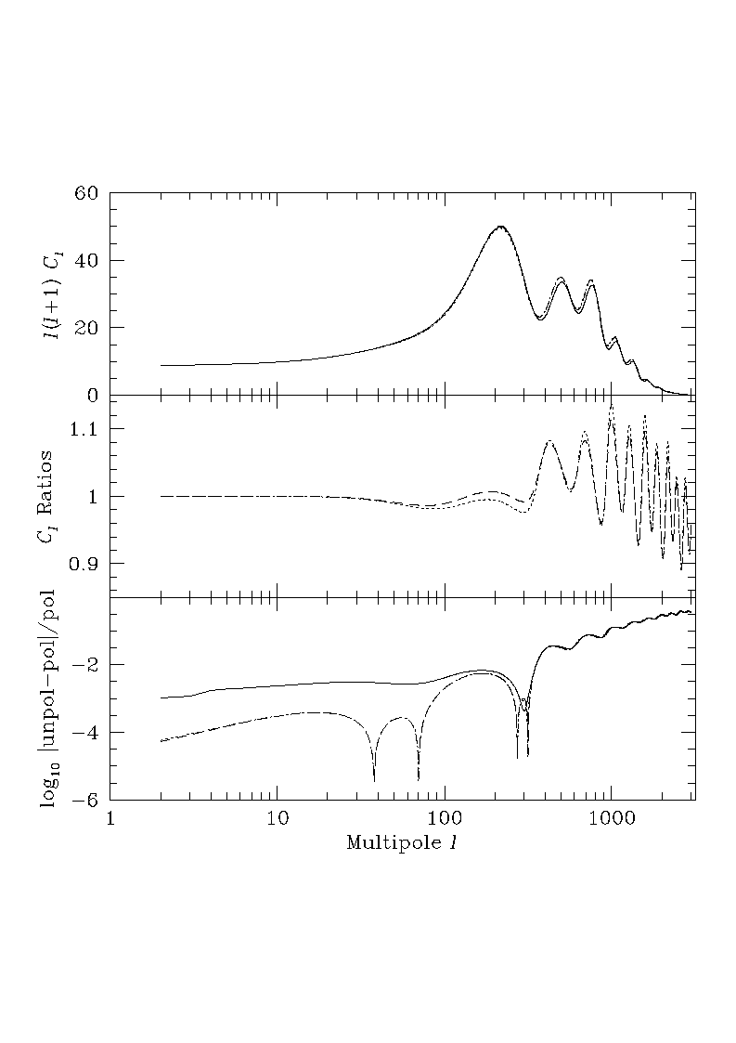
CMB anisotropies
CMB Anisotropies are weakly affected by massive
neutrinos.

Slide 53
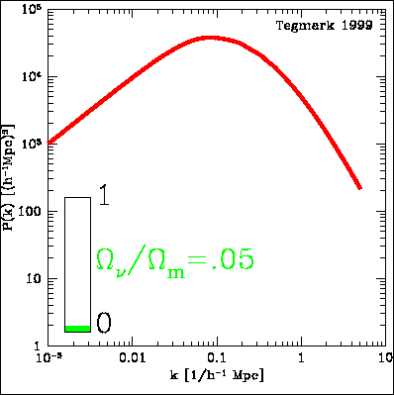

Slide 54
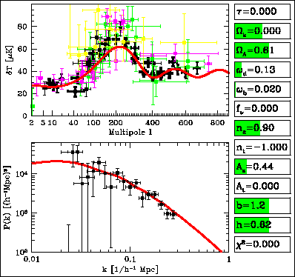

Slide 55
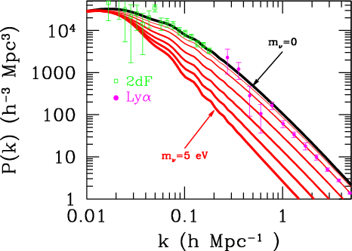

Slide 56
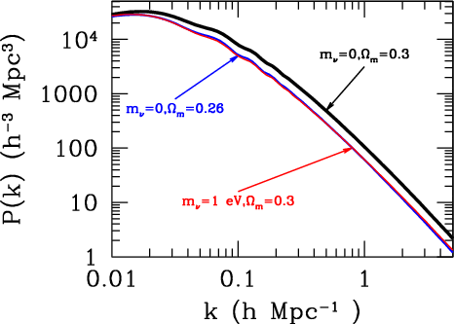

Slide 57

Current constraints on neutrino mass from Cosmology
Blue: WMAP-7
Red: w7+SN+Bao+H0
Green: w7+CMBsuborb+SN+LRG+H0
Current constraints (assuming ΛCDM):
Σmν<1.3 [eV] CMB
Σmν<0.7-0.5 [eV] CMB+other
Σmν<0.3 [eV] CMB+LSS (extreme)
[eV]
See also:
M. C. Gonzalez-Garcia, Michele Maltoni, Jordi Salvado, arXiv:1006.3795
Toyokazu Sekiguchi, Kazuhide Ichikawa, Tomo Takahashi, Lincoln Greenhill, arXiv:0911.0976
Extreme (sub 0.3 eV limits):
F. De Bernardis et al, Phys.Rev.D78:083535,2008, Thomas et al. Phys. Rev. Lett. 105, 031301 (2010)

Slide 58





Testing the neutrino hierarchy
Degenerate Hierarchy predicts:
$$\sum{m_{v}}>0.15 eV$$
Inverted Hierarchy predicts:
$$\sum{m_{v}}>0.10 eV$$
Normal Hierarchy predicts:
$$\sum{m_{v}}>0.05 eV$$
$$m_{}^{2}=0.0025{eV}^{2}$$
we assume

Slide 59
Neutrino Number

Slide 60
Hu, Sugiyama, Silk, Nature 1997, astro-ph/9604166

Slide 61

Effect of Neutrinos in the CMB: Early ISW
Changing the number of neutrinos (assuming them as massless) shifts the epoch of equivalence, increasing the Early ISW:

Slide 62


Slide 63

Results from WMAP5 Neff>0 at 95 % c.l. from CMB DATA alone
(Komatsu et al., 2008).
First evidence for a neutrino background from CMB data

Slide 64

Neutrino Number is Degenerate with Several Parameters. Especially with the age
Of the Universe t0
F. De Bernardis, A. Melchiorri, L. Verde, R. Jimenez, JCAP 03(2008)020

Slide 65

Age of the Universe
CMB data are able to tightly constrain the age of the Universe (see e.g. Ferreras, AM, Silk, 2002). For WMAP+all and LCDM:
(if w is included)
Direct
and “model
independent”
age aestimates
have much
larger
error bars !
Not so good
for constraining
DE
Spergel et al., 2007

Slide 66

Age of the Universe
…however the WMAP constrain is model dependent.
Key parameter: energy density in relativistic particles.
Error bars
on age
a factor 10
larger when
Extra
Relativistic
particles are
Included.
F. De Bernardis, A. Melchiorri, L. Verde, R. Jimenez, JCAP 03(2008)020

Slide 67

Independent age aestimates are important.
Using Simon, Verde, Jimenez aestimates plus WMAP we get:
F. De Bernardis, A. Melchiorri, L. Verde, R. Jimenez, JCAP 03(2008)020

Slide 68


Komatsu et al, 2010, 1001.4538
Neutrino background.
Changes early ISW.
Hint for N>3 ?

Slide 69

Gianpiero Mangano, Alessandro Melchiorri, Olga Mena, Gennaro Miele, Anze Slosar
Journal-ref: JCAP0703:006,2007

Slide 70

3 Active massless neutrinos+
Ns massive neutrinos
3 Active massive neutrinos +
Ns massless neutrinos
J. Hamann et al, arXiv:1006.5276

Slide 71



Latest analysis
Giusarma et al., 2011 http://arxiv.org/abs/1102.4774
includes masses both in active and sterile Neutrinos.
Blue: CMB+HST+SDSS
Red: CMB+HST+SDSS+SN-Ia

Slide 72


Slide 73



ACT confirms indication for extra neutrinos but still at about two standard deviations
Latest results from ACT, Dunkley et al. 2010
(95 % c.l.)
$$Neff=5.3±1.3$$
ACT+WMAP
ACT+WMAP+BAO+H0
$$Neff=4.8±0.8$$

Slide 74

3(massless)+2
Blue: WMAP7+ACT
Red:WMAP7+ACT+HST+BAO
Archidiacono et al., in preparation

Slide 75


Extra Neutrinos or Early Dark Energy ?
An «Early» dark energy component could be present in the early universe at recombination
and nucleosynthesis. This component could behave like radiation (tracking properties) and
fully mimic the presence of an extra relativistic background !
E. Calabrese et al, arXiv:1103.4132
E. Calabrese et al, Phys.Rev.D83:023011,2011

Slide 76
CMB Anisotropy: BASICS
Their evolution is governed by a nasty set of coupled partial differential equations:
CDM:
Baryons:
Photons:
Neutrinos:

Slide 77

Can we see them ?
Hu et al., astro-ph/9505043

Slide 78

Not directly!
But we can see the
effects on the
CMB angular
spectrum !
CMB photons see
the NB anisotropies
through gravity.
Hu et al., astro-ph/9505043

Slide 79


Slide 80

The Neutrino anisotropies can be parameterized through the “speed viscosity” cvis. which controls the relationship between velocity/metric shear and anisotropic stress in the NB.
Hu, Eisenstein, Tegmark and White, 1999

Slide 81

WMAP1+SLOAN
data provided evidence
at 2.4 σ for anisotropies
in the Neutrino
Background.
Standard Model o.k.
R. Trotta, AM
Phys Rev Lett.
95 011305 (2005)
AM, P Serra (2007)

Slide 82

Planck
Satellite launch
14/5/2009

Slide 83


Slide 84


The Planck Collaboration
Released 23 Early Papers last January.
Results are mostly on astrophysical
sources (no cosmology).
Other 30 papers expected to be
Released on 2012 (but still
«just» astrophysics).
Papers on cosmology (and neutrinos)
WILL be released in January 2013.

Slide 85



Slide 86


Slide 87

Blue: current data
Red: Planck

Slide 88


Let’s consider not only Planck but also
ACTpol (From Atacama Cosmology Telescope,
Ground based, results expected by 2013)
CMBpol (Next CMB satellite, 2020 ?)
Galli, Martinelli, Melchiorri, Pagano, Sherwin, Spergel, Phys.Rev.D82:123504,2010

Slide 89



Testing the neutrino hierarchy
Degenerate Hierarchy predicts:
$$\sum{m_{n}}>0.15 eV$$
Inverted Hierarchy predicts:
$$\sum{m_{n}}>0.10 eV$$
Normal Hierarchy predicts:
$$\sum{m_{n}}>0.05 eV$$
$$m_{}^{2}=0.0025{eV}^{2}$$
we assume

Slide 90

Constraints on Neutrino Mass
Blue: Planck ΔΣmν=0.16
Red: Planck+ACTpol ΔΣmν=0.08
Green: CMBPol ΔΣmν=0.05
Galli, Martinelli, Melchiorri, Pagano, Sherwin, Spergel, Phys.Rev.D82:123504,2010

Slide 91



CMB Temperature Lensing
When the luminous source is the CMB, the lensing effect essentially
re-maps the temperature field according to :
unlensed
lensed
Taken from http://www.mpia-hd.mpg.de/
(Max Planck Institute for Astronomy at Heidelberg )

Slide 92


Lensing Effect on Temperature Power Spectrum
We obtain a convolution between the lensing potential power spectrum and the unlensed anisotropies power spectrum:
Where the lensing potential power spectrum is given by :
The net result is a 3% broadening of the CMB angular power spectrum acustic peaks

Slide 93

Constraints on Neutrino Number
Blue: Planck ΔNν=0.18
Red: Planck+ACTpol ΔNν=0.11
Green: CMBPol ΔNν=0.044
Galli, Martinelli, Melchiorri, Pagano, Sherwin, Spergel, Phys.Rev.D82:123504,2010

Slide 94

Constraints on Helium Abundance
Blue: Planck ΔYp=0.01
Red: Planck+ACTpol ΔYp=0.006
Green: CMBPol ΔYp=0.003
Galli, Martinelli, Melchiorri, Pagano, Sherwin, Spergel, Phys.Rev.D82:123504,2010

Slide 95

Constraints on Helium Abundance
AND
neutrino number
Galli, Martinelli, Melchiorri, Pagano, Sherwin, Spergel, Phys.Rev.D82:123504,2010

Slide 96

Abazajan et al, arXiv:1103.5083

Slide 97
CONCLUSIONS
Recent CMB measurements fully confirm Λ-CDM. New bounds on neutrino mass.
Hints for extra relativistic neutrino background.
With future measurements constraints on new parameters related to laboratory
Physics could be achieved.
In early 2013 from Planck we may know:
If the total neutrino mass is less than 0.4eV.
If there is an extra background of relativistic particles.
Helium abundance with 0.01 accuracy.
- Combining Planck with a small scale future CMB experiment can reach 0.1 eV sensitivity.

Slide 98

Future constraints on steriles masses and numbers (Planck+Euclid/BOSS)
Giusarma et al., 2011 http://arxiv.org/abs/1102.4774.

