Slide 1
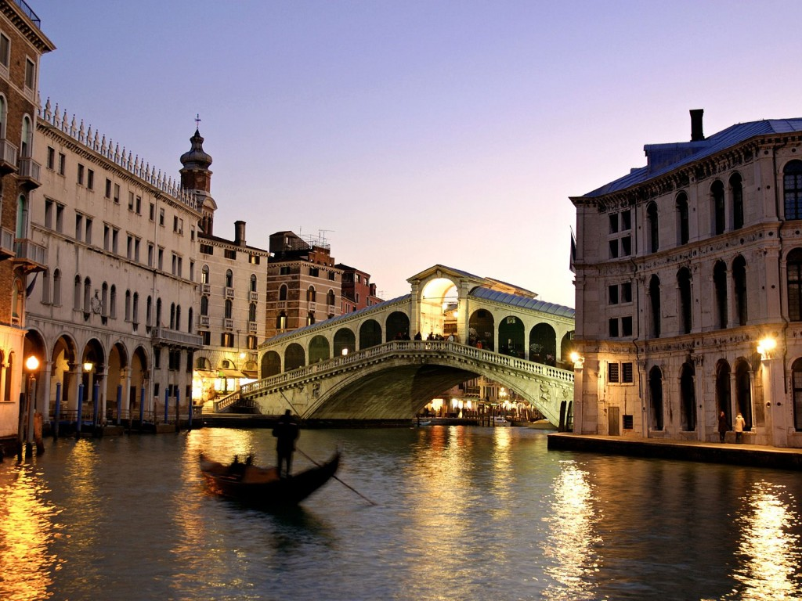
The INFN proposal to host
EPS-HEPP 2015
in VENICE
The INFN proposal to host
EPS-HEPP 2015
in VENICE
LIDO DI VENEZIA
9 – 15 July 2015
LIDO DI VENEZIA
9 – 15 July 2015

Slide 2
THE INFN BID
Venice is a great place for a conference.
F. Reines, 1992
INFN hosted EPS the last time in 1985 (Bari)
The past two editions had the candidature of INFN Rome.
This time the INFN candidature is taken by:
INFN Padova
INFN Laboratori Nazionali di Frascati
University of Padova - Department of Physics & Astronomy "Galileo Galilei”
Full support of INFN
Direct and full control of the web-site, registrations, booking and financial management

Slide 3
LOCAL ORGANIZING COMMITTEE
Chair:
Mauro Mezzetto (INFN-Padova), research director, INFN-Padova Director
Co-Chair:
Umberto Dosselli (INFN-Padova), research director, Director of INFN-Frascati National Laboratories
Scientists:
Paolo Checchia (INFN-Padova), research director
Tommaso Dorigo (INFN-Padova), researcher
Donatella Lucchesi (Univ. of Padova), associate professor
Antonio Masiero (Univ. of Padova), full professor, INFN Vice President
Francesca Soramel (Univ. of Padova), full professor, Director of the Dept. of Physics and Astronomy
Fabio Zwirner (Univ. of Padova), full professor
Technical staff:
Pina Salente (INFN-Padova)
Rossana Chiaratti (INFN-Padova)
Rita Bertelli (INFN-LNF)

Slide 4
LOCAL ORGANIZING COMMITTEE
INFN - Padova and Department of Physics and Astronomy of Padova constitute a community of about 500 physicists, engineers, technicians and administrative people, involved in many experiments, including e.g. CMS, LHCb, ALICE, BABAR, ICARUS, OPERA, CUORE, GERDA, T2K, VIRGO, MAGIC, FERMI, AGATA, etcetera. A strong community of theoretical physicists is also active in cutting-edge aspects of the field.
Frascati is the biggest INFN national lab (about 350 employees)
Consolidate experience in organizing top level conferences:
CHEP 2000
EGEE3 (2004)
EGI-OGF (2009)
Neutrino Telescopes series (active since 1988)
Planck 2009

Slide 5
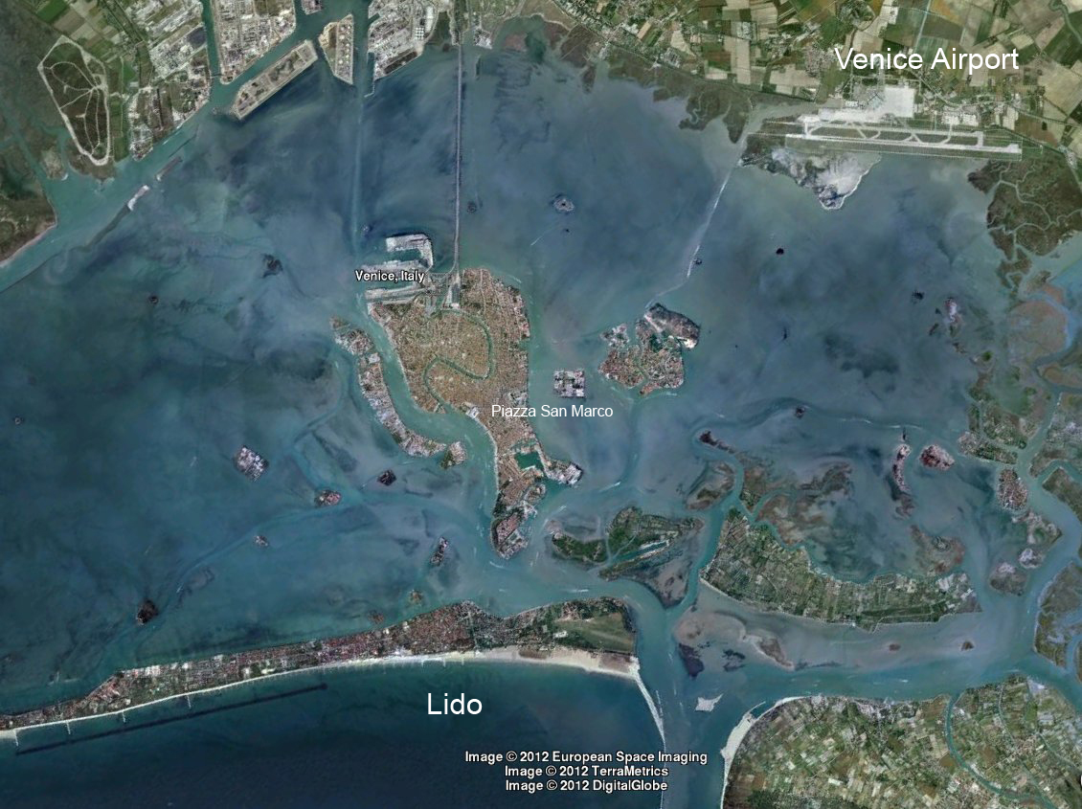
THE CONGRESS VENUE
VENICE LIDO is a neighborhood of Venice,
just 15 minutes boat from Venice center

Slide 6
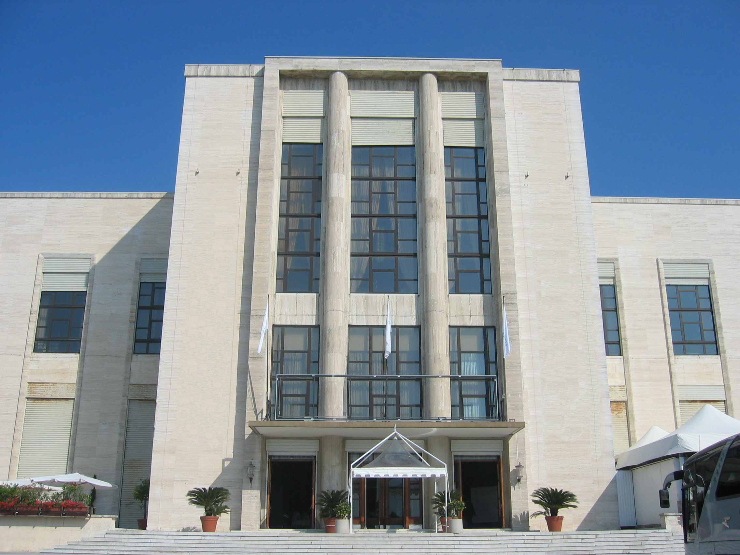
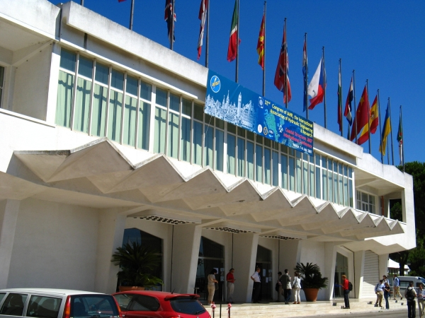
THE CONGRESS VENUE
PALAZZO DEL CINEMA and PALAZZO DEL CASINO’
This is where the first Film Festival was held and it is still today one of the most prestigious in the World.
A large exhibition area of over 4000 squares meters, two auditorium and several meeting rooms.

Slide 7
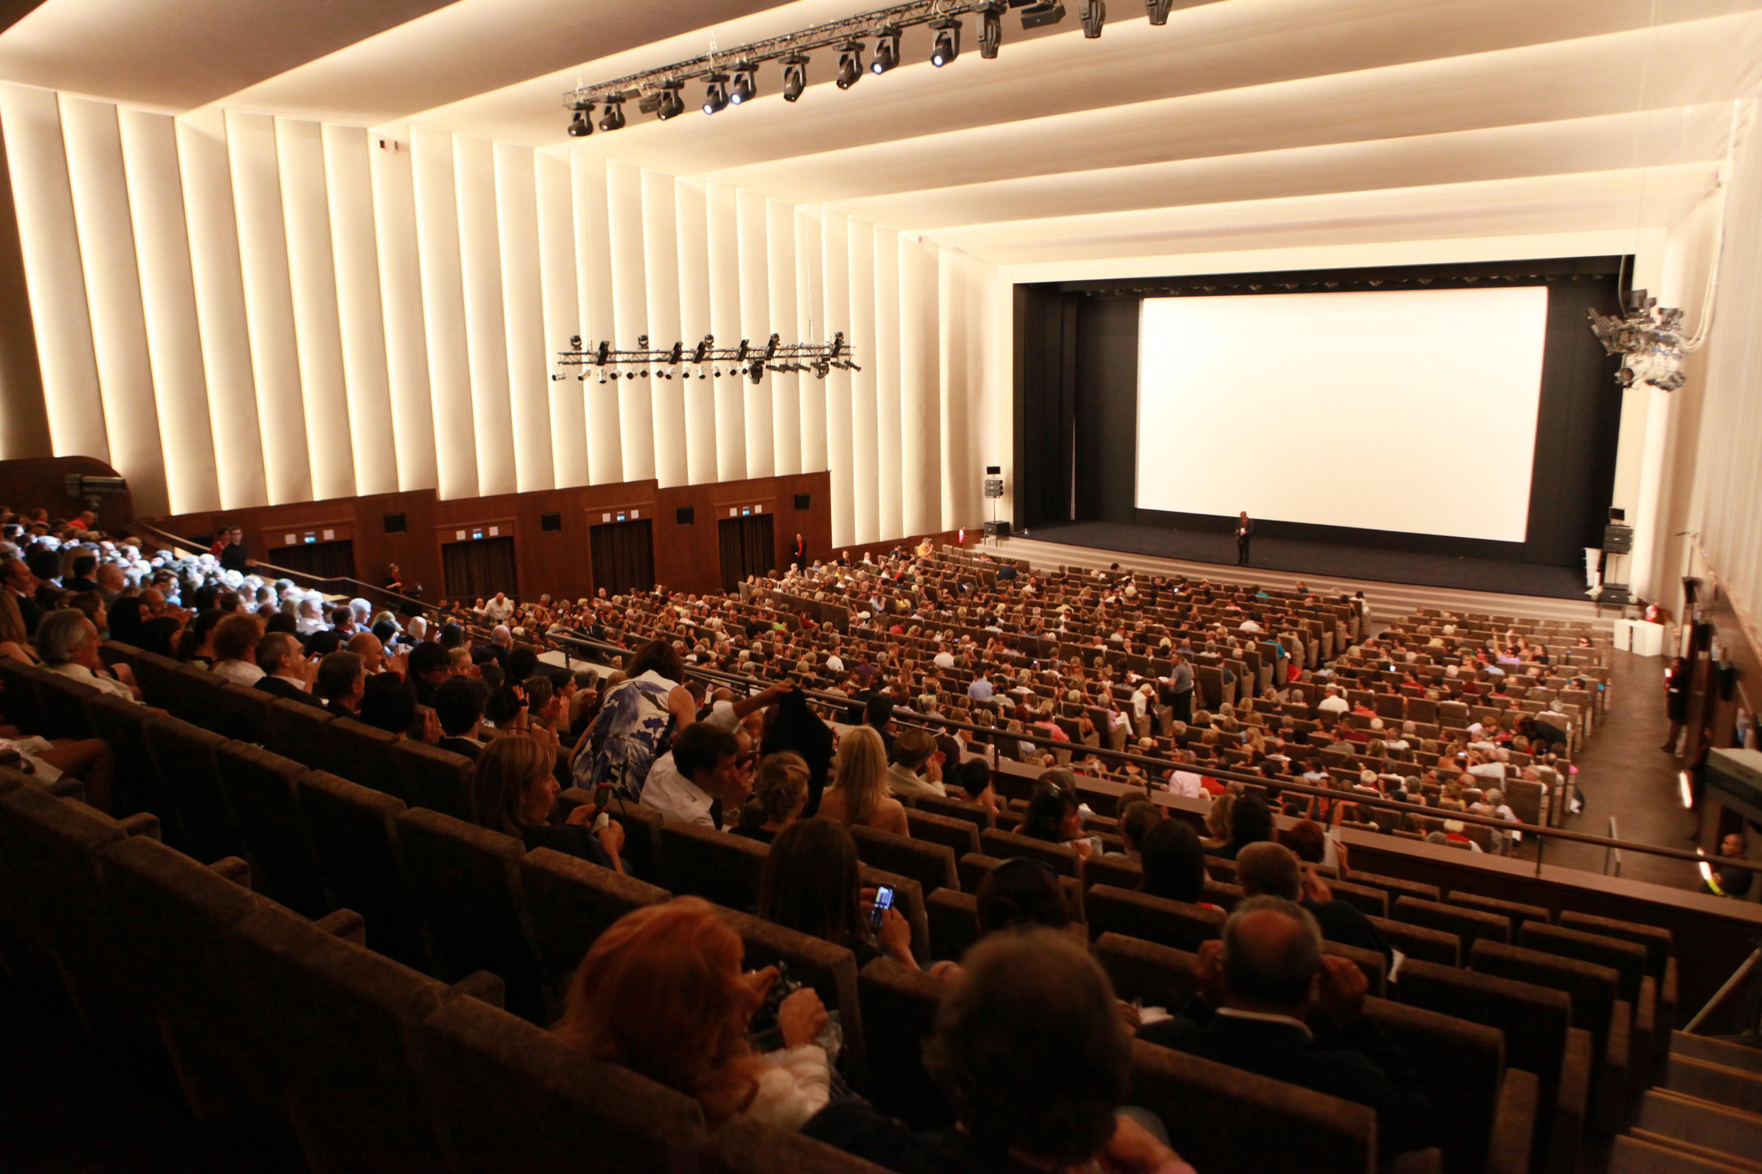
THE CONGRESS VENUE: PLENARY SESSION
can accommodate up to 1.017 people
Auditorium “SALA GRANDE”
It can accommodate up to 1047 people

Slide 8
THE CONGRESS VENUE: PARALLEL SESSIONS
 | ROOM | M² | THEATRE
1 | SALA PERLA (to be used also for EPS-ECFA meeting) |  | 594 pax
2 | SALA LAGUNA | 680 | 200 pax
3 | SALA MOSAICI I | 252 | 200 pax
4 | SALA MOSAICI II | 252 | 200 pax
5 | SALA DELLE FESTE | 250 | 150 pax
6 | SALA PASINETTI | 151 | 120 pax
7 | SALA DEGLI AMICI | 100 | 100 pax
8 | SALA FRAU | 103 | 70 pax
9 | SALA ZORZI | 60 | 48 pax
10 | SALE WELLES | 55 | 60 pax
Other 10 additional meeting rooms (up to 20-25 people) for board meetings, slides centre, etc.
All the rooms are equipped with projector and laptop, audio, microphones and wifi.

Slide 9
THE CONGRESS VENUE: PARALLEL SESSIONS
SALA PERLA
Auditorium “SALA PERLA”
seating up to 594 people

Slide 10
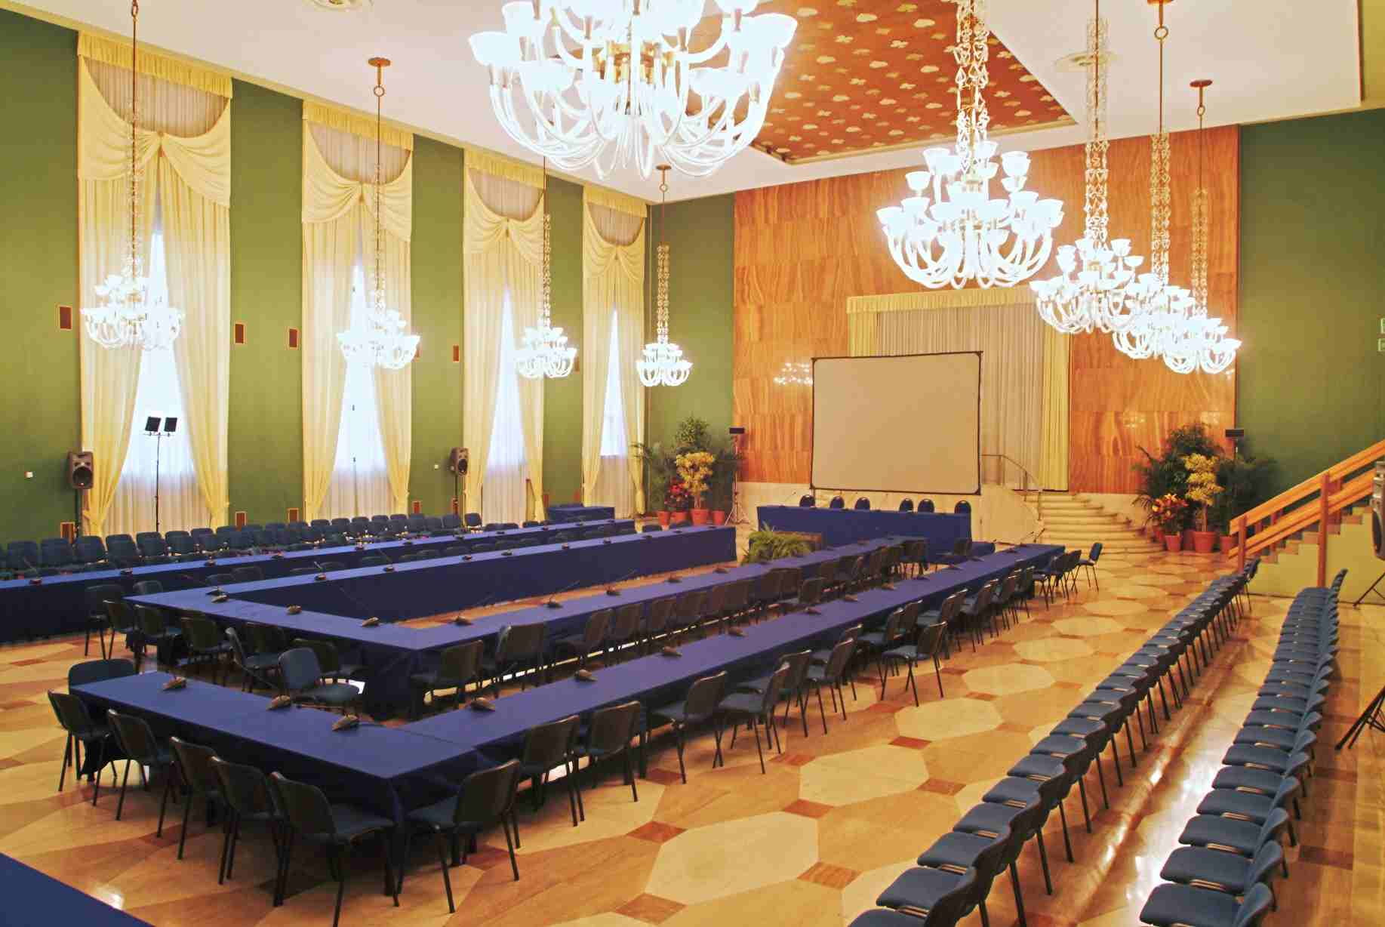
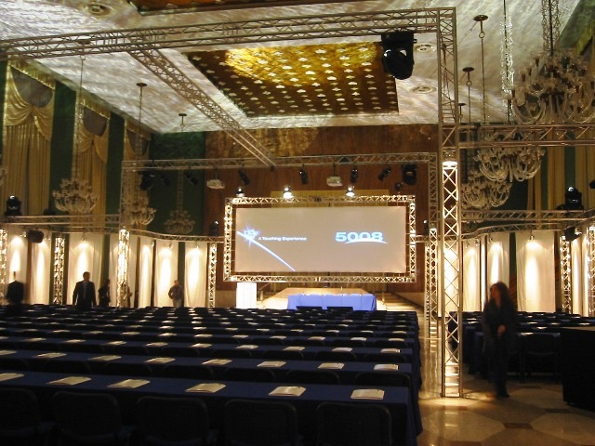
THE CONGRESS VENUE: PARALLEL SESSIONS
SALA LAGUNA

Slide 11
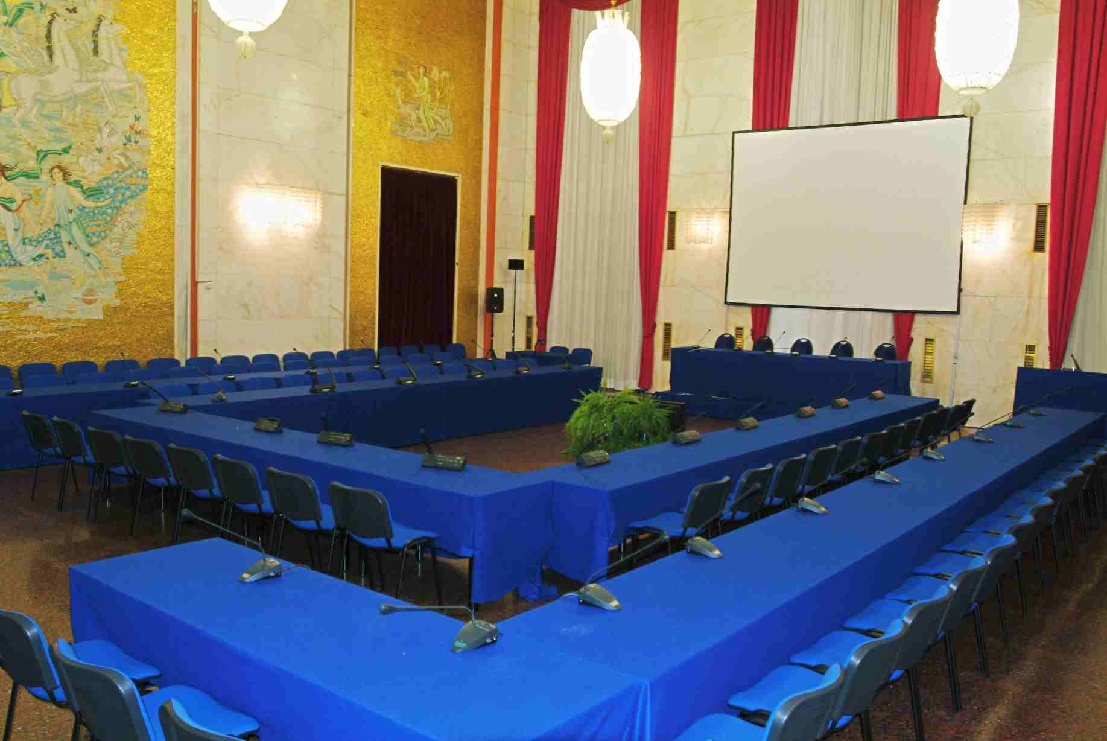
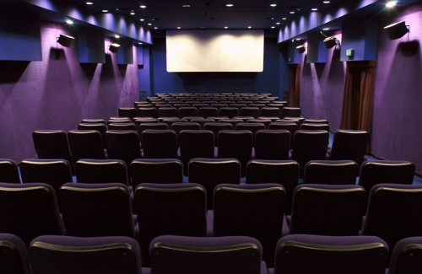
THE CONGRESS VENUE: PARALLEL SESSIONS
SALA MOSAICI
SALA PASINETTI

Slide 12
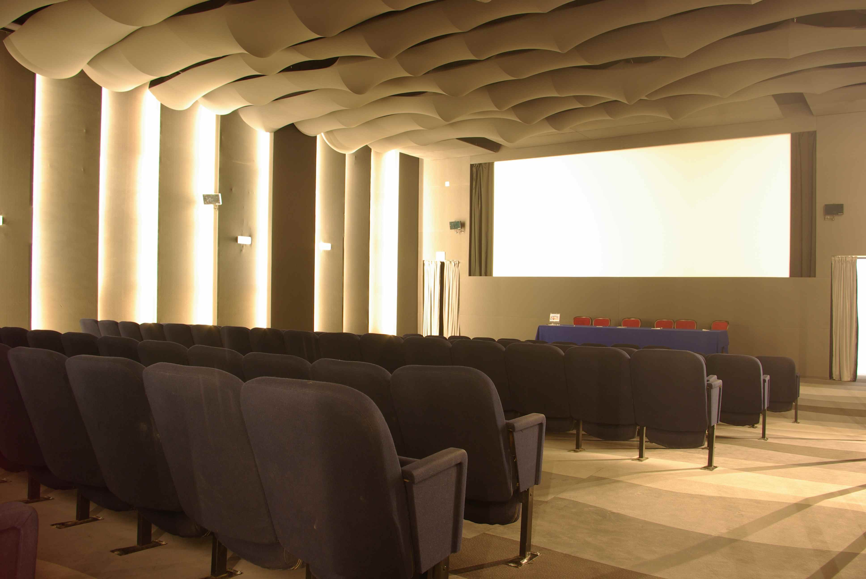
THE CONGRESS VENUE: PARALLEL SESSIONS
SALA DELLE FESTE

Slide 13
THE CONGRESS VENUE: TECHNICAL SERVICES
Designed to match the needs of a world leader film festival.
Video projections professional
Camera and video cameras with professional graphics
Systems for multiple projections
Traditional slide projectors
Plasma Monitor
Avid video editing system for post-production.
Sound systems
Recording Systems
DCN Conference System
Audio Mixer
Video Conferencing Systems
Illuminations spectacular
Vote wireless electronic
Centers Slides and Systems

Slide 14
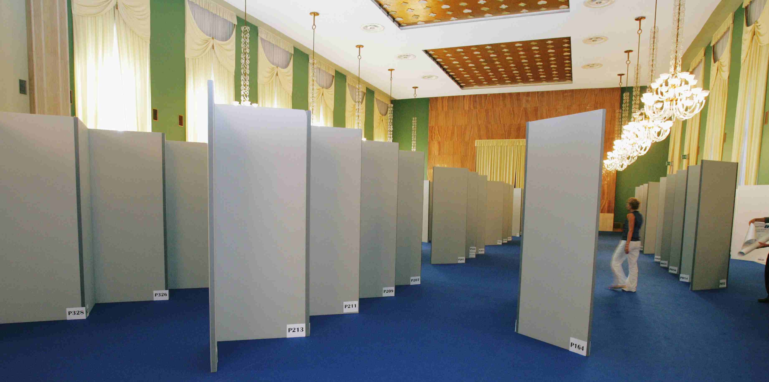
THE CONGRESS VENUE: POSTER SESSION

Slide 15
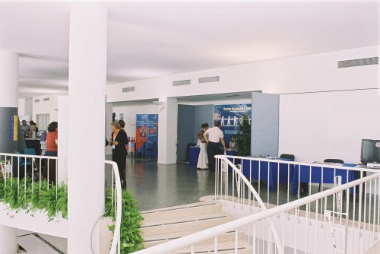
THE CONGRESS VENUE: SPONSORS AREA

Slide 16
THE ACCOMMODATION
HOTELS at VENEZIA LIDO
Hotels from 4 to 2 stars have already been selected:
4 stars: ~ Euro 150 (single) - 175 (dus) - 185 (double)
3 stars: ~ Euro 110 (single) - 135 (dus) - 145 (double)
2 stars: ~ Euro 95 (single) - 105 (dus) - 115 (double)
Breakfast and tax included
At today 12 LIDO hotels are offering rooms at less than 100 Euro for July 2013 (under Tripadvisor)

Slide 17
THE ACCOMMODATION
DISTANCE FROM THE CONGRESS VENUE
STARS | ROOMS | HOTEL | DISTANCE FROM THE CONGRESS VENUE
5L | 380 | HILTON MOLINO STUCKY | 15 mins. by boat-giudecca
5 L | 233 | DANIELI | 15 mins. by boat-san marco area
5 L | 91 | GRITTI PALACE | 15 mins. by boat-san marco area
5 L | 191 | BAUER | 15 mins. by boat-san marco area
5 L | 195 | S.CLEMENTE PALACE | 15 mins. by boat
5 | 189 | EXCELSIOR | Walking distance
5 | 117 | LUNA BAGLIONI | 15 mins. by boat-san marco area
4 | 69 | BIASUTTI | Walking distance
4 | 70 | GRANDE ALBERGO AUSONIA E HUNGARIA | Walking distance
4 | 50 | LE BOULEVARD | Walking distance
4 | 60 | QUATTRO FONTANE | Walking distance
4 | 31 | PETIT PALAIS | walking distance
4 | 22 | PANORAMA | 2 mins. by bus
4 | 22 | RUSSO PALACE | 5 mins. by bus
4 | 66 | VILLA MABAPA | 5 mins. by bus
4 | 34 | Viktoria Palace Hotel | 5 mins by bus
4 | 20 | VILLA LAGUNA | 5 mins by bus
4 | 30 | VILLA PANNONIA | 5 mins by bus
4 | 192 | EUROPA & REGINA | 15 mins. by boat-san marco area
4 | 95 | CAVALLETTO | 15 mins. by boat-san marco area
4 | 107 | BONVECCHIATI | 15 mins. by boat-san marco area
4 | 170 | Starhotel Splendid Venice | 15 mins. by boat-san marco area
4 | 87 | MONACO GRAND CANAL | 15 mins. by boat-san marco area
STARS | ROOMS | HOTEL | DISTANCE FROM THE CONGRESS VENUE
4 | 21 | Ca' del Borgo e Ca' Alberti | 15 mins by bus
4 |  | Hotel Sant'Elena
3 | 38 | BYRON | walking distance
3 | 33 | LA MERIDIANA | Walking distance
3 | 42 | RIGEL | Walking distance
3 | 11 | VILLA DELLE PALME | Walking distance
3 | 22 | VILLA PARCO | Walking distance
3 sup. | 23 | VILLA EDERA | 5 mins by bus
3 | 38 | ATLANTA AUGUSTUS | 5 mins by bus
3 | 30 | BELVEDERE | 5 mins by bus
3 | 14 | GIARDINETTO | 5 mins by bus
3 | 50 | HELVETIA | 5 mins by bus
3 | 62 | RIVIERA | 5 mins by bus
3 | 46 | VENEZIA 2000 | 5 mins by bus
3 | 17 | VILLA CIPRO | 5 mins by bus
3 | 16 | VILLA TIZIANA | 5 mins by bus
3 | 85 | CA' del Moro | 10 mins by bus
3 | 25 | ORIO | 15 mins by bus
3 | 10 | VILLA BEATRICE | 15 mins by bus
2 | 28 | RIVAMARE | walking distance
2 | 24 | CRISTALLO | 5 mins by bus
2 | 27 | REITER | 5 mins by bus
2 | 36 | SORRISO | 5 mins by bus
2 | 12 | STELLA | 5 mins by bus
2 | 10 | VILLA ALBERTINA | 5 mins by bus
1 | 17 | LA PERGOLA | 5 mins by bus
 | 39 | GREEN HOUSE ALBERONI | 15 mins by bus
 | 6 | GREEN HOUSE LAGUNA

Slide 18
THE ACCOMMODATION
LOW COST SOLUTIONS
No better chance for a low cost visit of Venice than participating to EPS 2015
University Residence Maria Ausiliatrice (Arsenale - 12 minutes by boat)
5 single rooms (45 Euro per night)
20 double rooms (35 Euro per person per night)
5 triple rooms (30 Euro per person per night)
All the rooms have private bathroom.
Collegio Navale Morosini (S. Elena – 5 minutes by boat)
40 beds (50 Euro per night)
Convitto Foscarini (Cannaregio – 20 minutes by boat):
10 rooms with 4/5 beds each (20 Euro per bed per night)
Bungalows in the Lido Camping:
5 bungalows for 4 peoples each: (20 Euro per person per night)
Rent of tents is also possible
A TOTAL OF 170 BEDS THAT COST LESS THAN 50 EURO EACH

Slide 19
CONFERENCE FEE
The fee is expected not to exceed 420 Euro, assuming the registration of 600 participants. As usual it includes:
conference venue and facilities
Proceedings
coffee-breaks
welcome party
social dinner
logistic support for accommodation
EXPENDITURE |  |  |  | INCOME
Structure rental and setting-up | € 80.000,00 |  |  | Participants fees | 600 pax | € 252.000,00
Technical equipment | € 14.304,00
Poster sessions | € 4.500,00 |  |  | INFN contribution |  | € 30.000,00
Subtotal | € 98.804,00 |  |  | Padova University contribution |  | € 10.000,00
Subtotal + VAT 21% |  | € 119.552,84
 |  |  |  | Sponsorships |  | € 20.000,00
Social concert (included VAT) |  | € 10.000,00
Other costs (included EPS fee) |  | € 47.000,00
Variable costs (included VAT) |  | € 133.760,00
TOTAL EXPENDITURE |  | € 310.312,84 |  | TOTAL INCOME |  | € 312.000,00
Surplus |  | € 1.687,16

Slide 20
 | BUDGET EPS HEP 2015 IN EURO
 | EXPENDITURE |  |  | INCOME
FIXED COSTS | STRUCTURE RENTAL AND SETTING-UP (VAT 21%) |  |  | REGISTRATION FEES
 | PALAZZO DEL CASINO': Parallel Sessions (1st, 2nd and 3rd day) + Gala dinner |  |  | CONFERENCE FEES (420 EURO PER PERSON) | € 252.000,00
 | Meeting rooms for parallels sessions
 | Area for registration, standing buffets, other meeting rooms | € 33.000,00 |  | INFN CONTRIBUTION | € 30.000,00
 | PALAZZO DEL CINEMA: Plenary Sessions (5th, 6th and 7th day)
 | Sala Grande (1036 pax): 9000 euro *3 days | € 27.000,00 |  | PADOVA UNIVERSITY CONTRIBUTION | € 10.000,00
 | SETTING UP: audio and video equipment
 | Costs for rooms setting up | € 20.000,00 |  | SPONSORSHIPS | € 20.000,00
 | POSTER SESSION
 | 100 poster-holders double side (45,00 euro each) | € 4.500,00
 | TECHNICAL EQUIPMENT
 | 50 connections 2kw in Sala Grande (80 euros each) | € 4.000,00
 | 50 connections 2kw in Sala Perla (80 euros each) | € 4.000,00
 | 2 distribution boards 40 kw (750 euros each) | € 1.500,00
 | 1 distribution board 20 kw (400 euro) | € 400,00 |  | TOTAL INCOME | € 312.000,00
 | Electricians and firefighters (32 euro/hour) Compulsory (1 +1 *12hour*6days) | € 2.304,00
 | Roll-off container rental | € 1.000,00
 | 2 Analog Telephone Lines | € 300,00
 | Internal Sign 100x200 with map of the buildings | € 200,00 |  | SURPLUS | € 1.687,16
 | External Sign 130x250 | € 400,00
 | Secretariat Sign | € 50,00
 | 3 Banners 50x100 50euro each | € 150,00
 | SUBTOTAL | € 98.804,00 |  | Number of participants considered: | 600
 | SUBTOTAL INCLUDED VAT 21% | € 119.552,84
 | SOCIAL CONCERT (VAT Included)
 | Cost for artists | € 10.000,00
 | TOTAL SOCIAL CONCERT | € 10.000,00
 | OTHER COSTS (VAT Included)
 | EPS FEE | € 30.000,00
 | PROCEEDINGS | € 9.000,00
 | INVITED SPEAKERS | € 8.000,00
 | TOTAL OTHER COSTS | € 47.000,00
 | TOTAL FIXED COSTS | € 176.552,84
VARIABLE COSTS | TRAVEL AGENCY FOR ADMINISTRATIVE SUPPORT
 | REGISTRATION (18,00 EURO * PERSON) | € 10.800,00
 | TOTAL TRAVEL AGENCY SUPPORT | € 10.800,00
 | OTHER COSTS (included VAT)
 | Conference bag and gadget | € 9.000,00
 | TOTAL OTHER COSTS | € 9.000,00
 | CATERING EXCLUDING LUNCHES (VAT 10%)
 | Social Dinner (#pax *80 euro each) | € 48.000,00
 | Dinner for prize winners | € 4.000,00
 | Coffee break (12 cb * 6,00 euro each) | € 43.200,00
 | Welcome cocktail (#pax * 14,00 euro each) | € 8.400,00
 | TOTAL CATERING | € 103.600,00
 | TOTAL CATERING INCLUDED VAT 10% | € 113.960,00
 | TOTAL VARIABLE COSTS | € 133.760,00
 | TOTAL EXPENDITURE | € 310.312,84

Slide 21
CONFERENCE FINANCIAL SUPPORT
Forms of Financial and Logistic Supports from various Bodies are being pursued. i.e :
INFN contribution | 30000 Euro
Padova University | 10000 Euro
Commercial Sponsorship | 20000 Euro
TOTAL | 60000 Euro
Depending on the general budget of the event, some supports for deserving students will be considered.

Slide 22
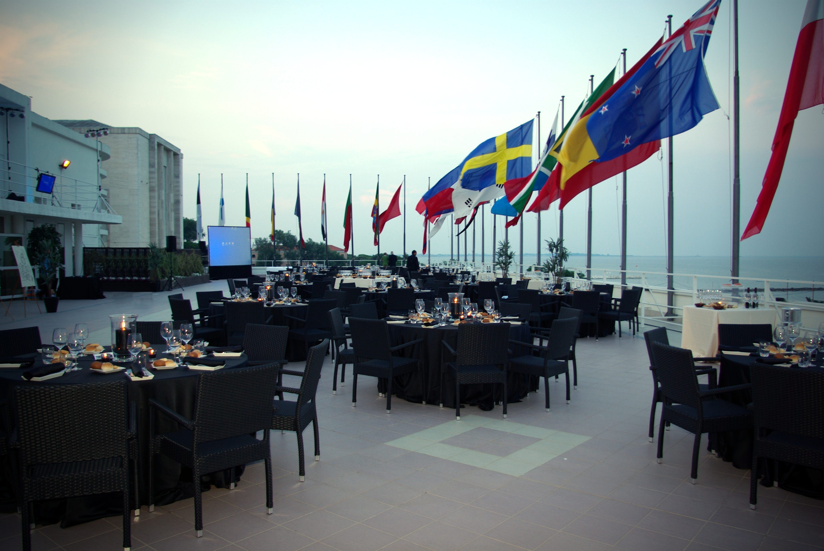
SOCIAL EVENTS: WELCOME PARTY
The WELCOME PARTY will take place on Thursday
afternoon, July 9th, in the Terrace of Palazzo del Cinema.

Slide 23
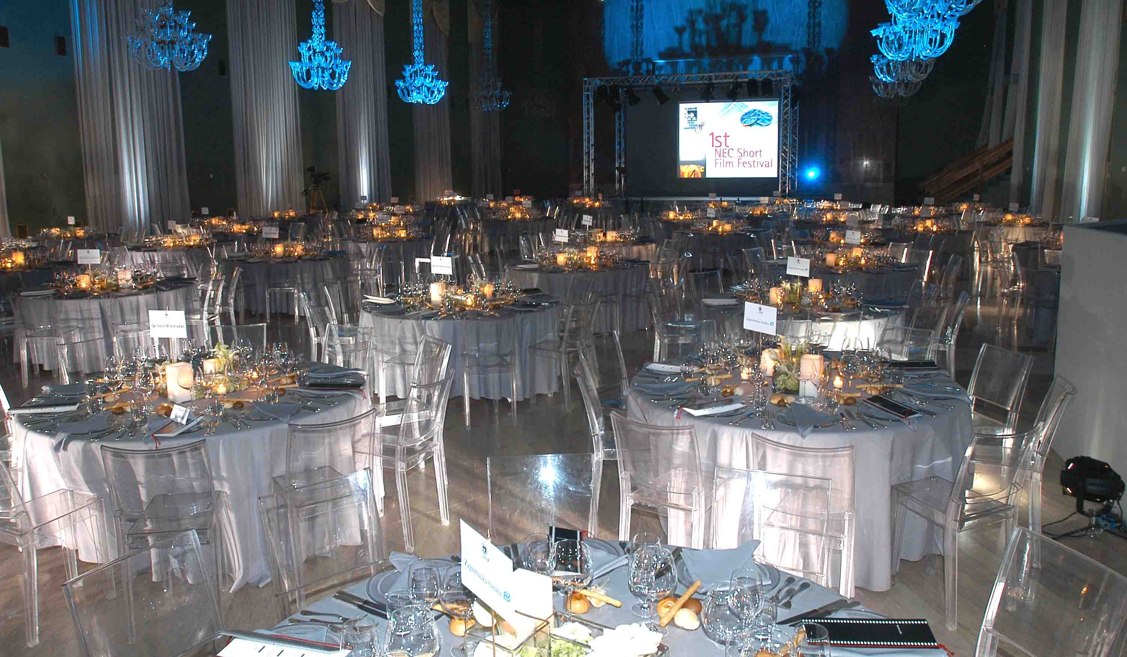
SOCIAL EVENTS: CONFERENCE DINNER
The CONFERENCE DINNER will take place at “Casinò Laguna Lights”. Typical Italian finest foods and wines will be served at tables, as the Italian courtesy tradition dictates.

Slide 24
THE DATES
First option (preferred)
From Thursday 9 July to Wednesday 15 July 2015
Second option
From Thursday 2 July to Wednesday 8 July 2015
Third option
From Thursday 23 July to Wednesday 30 July 2015
Problematic
From Thursday 16 July to Wednesday 22 July 2015 (because of the “Festa del Redentore” on 18-19 July)
We wait for you next 2015 in
VENEZIA

Slide 25
In the backup slides
Maps of the buildings
Maps of the low cost locations
Possibilities for the social events
Offers for the dinner and lunches

Slide 26
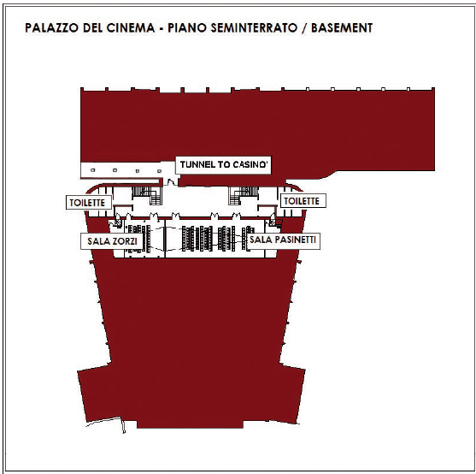
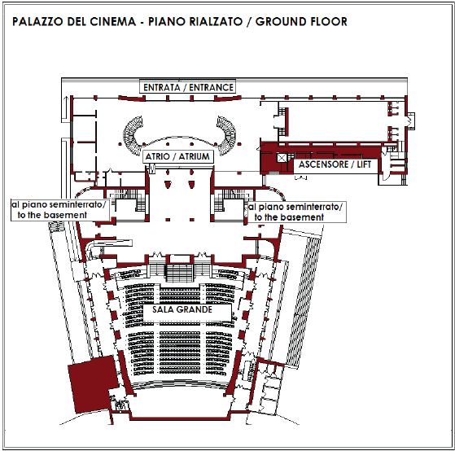
PALAZZO DEL CINEMA
CONGRESS VENUE: PLANS OF THE BUILDINGS

Slide 27
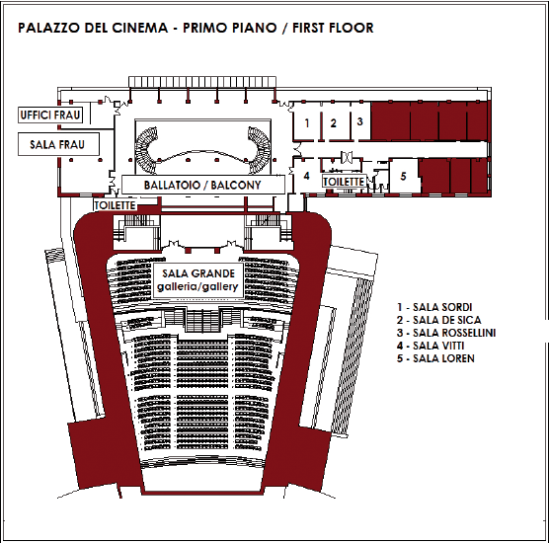
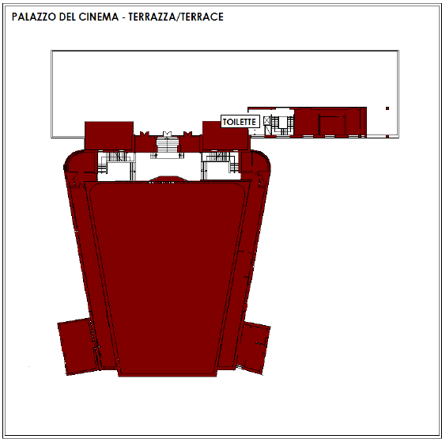
PALAZZO DEL CINEMA
CONGRESS VENUE: PLANS OF THE BUILDINGS

Slide 28
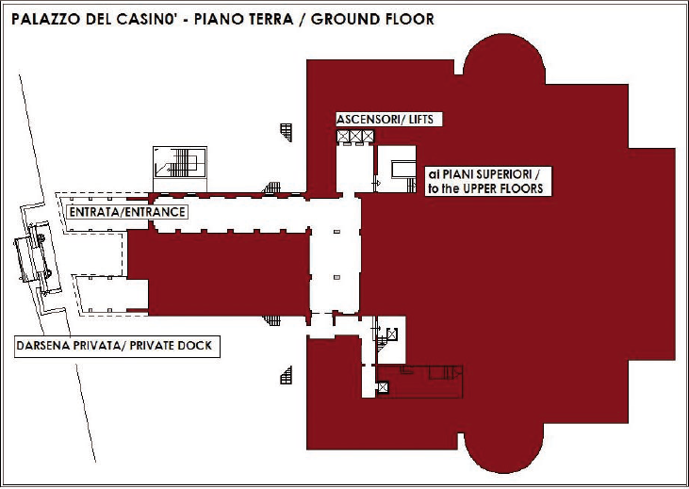
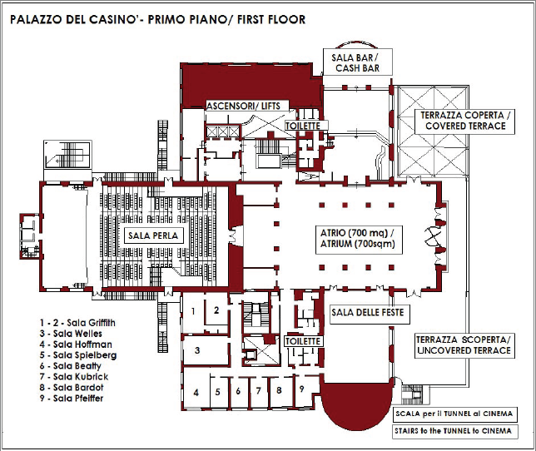
PALAZZO DEL CASINO’
CONGRESS VENUE: PLANS OF THE BUILDINGS

Slide 29
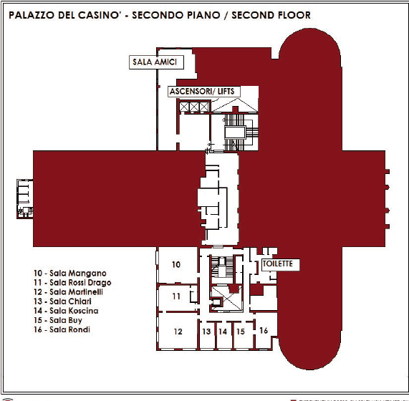
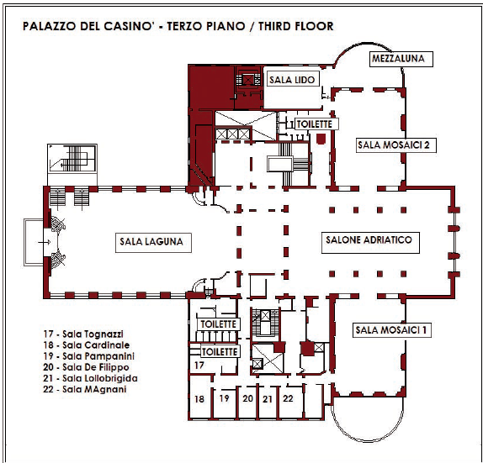
PALAZZO DEL CASINO’
CONGRESS VENUE: PLANS OF THE BUILDINGS

Slide 30
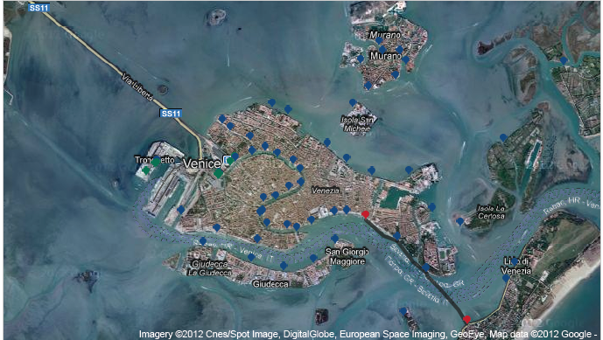
U
University Residence S. MARIA AUSILIATRICE
ACTV BOAT: Route # 1
From ARSENALE to LIDO SME
Every 10 minutes Duration: 12 minutes

Slide 31
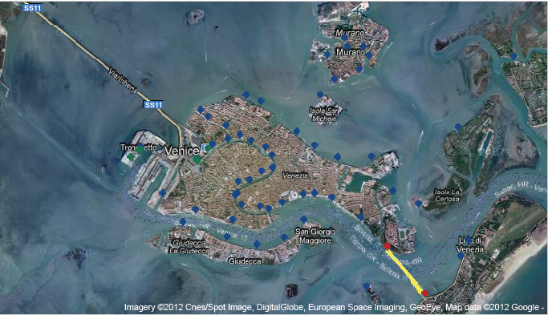
COLLEGIO NAVALE MOROSINI
ACTV BOAT: Route # 5.1
From S.ELENA to LIDO SME
Every 20 minutes Duration: 5 minutes

Slide 32
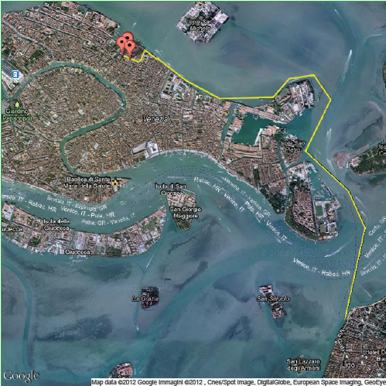
CONVITTO FOSCARINI
ACTV BOAT:
Route # 5.2
From
FONDAMENTE NOVE
to
LIDO SME
Every 20 minutes
Duration: 24 minutes

Slide 33
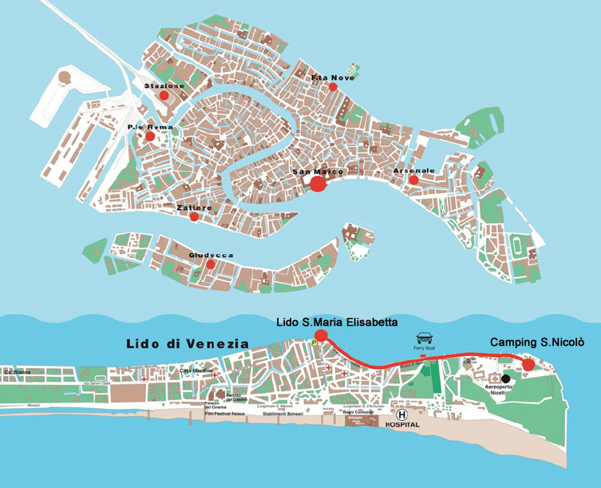
From Marco Polo Airport (Venice): take the airport shuttle bus for the airport harbour, where the “Alilaguna” boat will take you directly to the Lido di Venezia. From there take the ACTV bus, line A or B, destination “San Nicolò” and get off at the roundabout. Follow the signs to the camping. Its about 2 minutes walking.
CAMPING S. NICOLO’

Slide 34
SOCIAL EVENTS: EXCURSIONS
At ~ 1 hour from Venice still a lot of beautiful surroundings to visit!
Padova: Galileo's University City
Verona: Arena, Romeo and Juliet
Cortina d'Ampezzo: the breathtaking scenario of Dolomites' pearl
all well connected by road, rails and bus transports

Slide 35
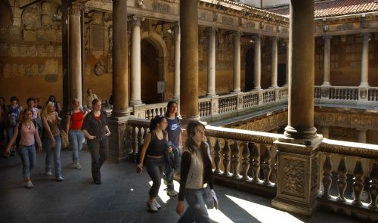
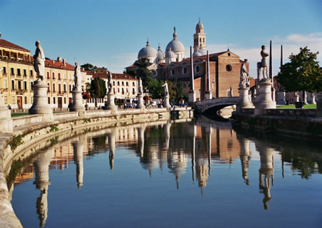
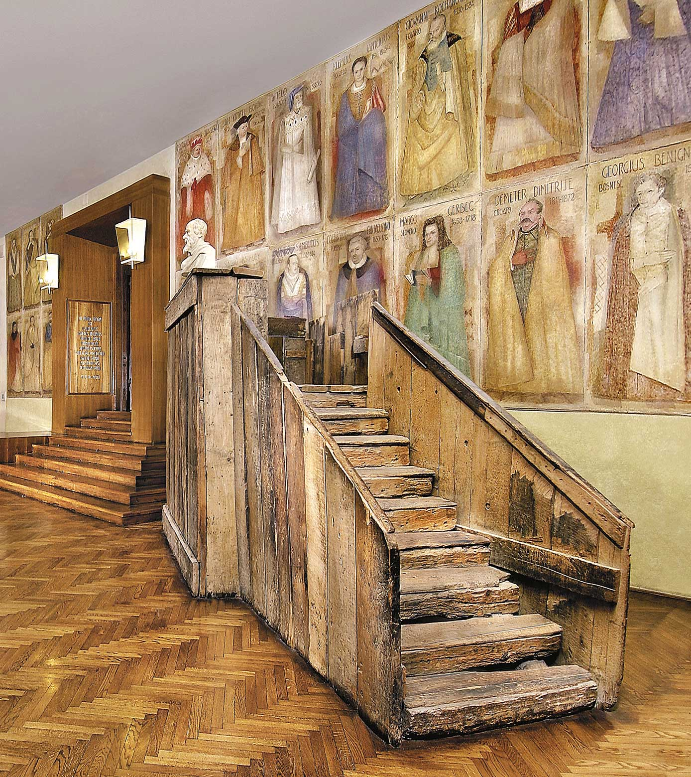
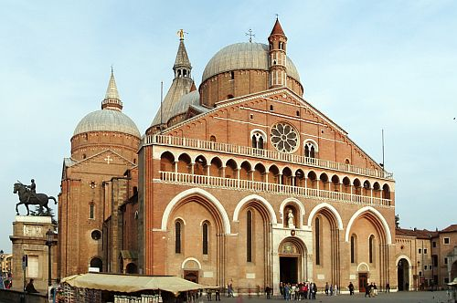
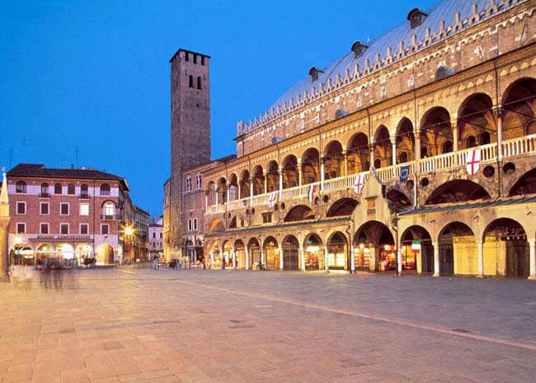
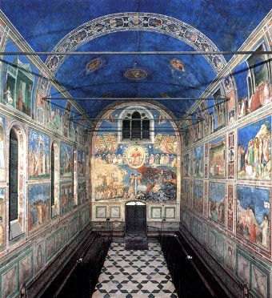
SOCIAL EVENTS: EXCURSIONS
GUIDED VISIT TO PADOVA

Slide 36
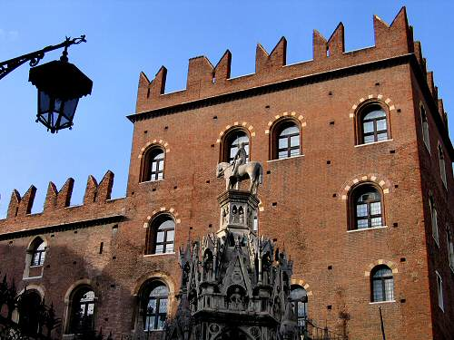
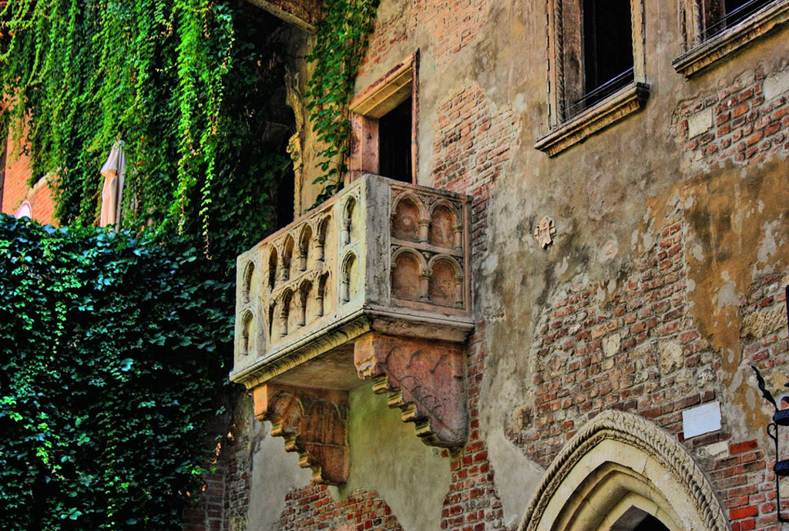
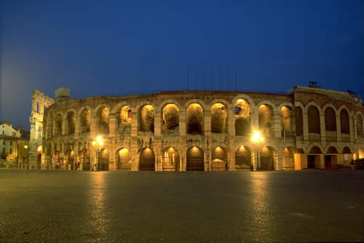
SOCIAL EVENTS: EXCURSIONS
GUIDED VISIT TO VERONA

Slide 37
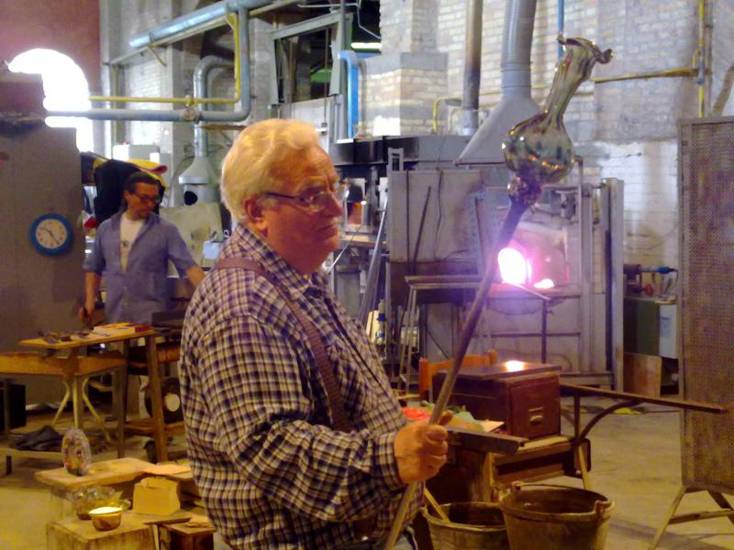
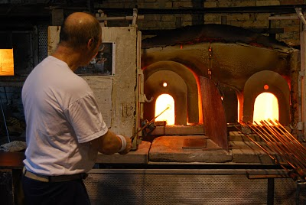
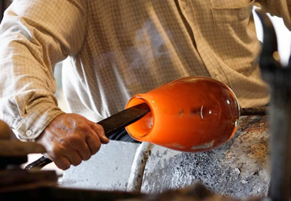
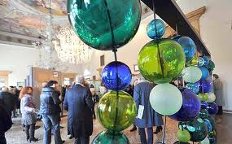
SOCIAL EVENTS: EXCURSIONS
Excursion to the famous Venetian handcrafted glass workshops in MURANO

Slide 38
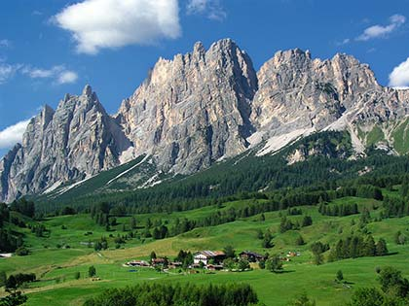
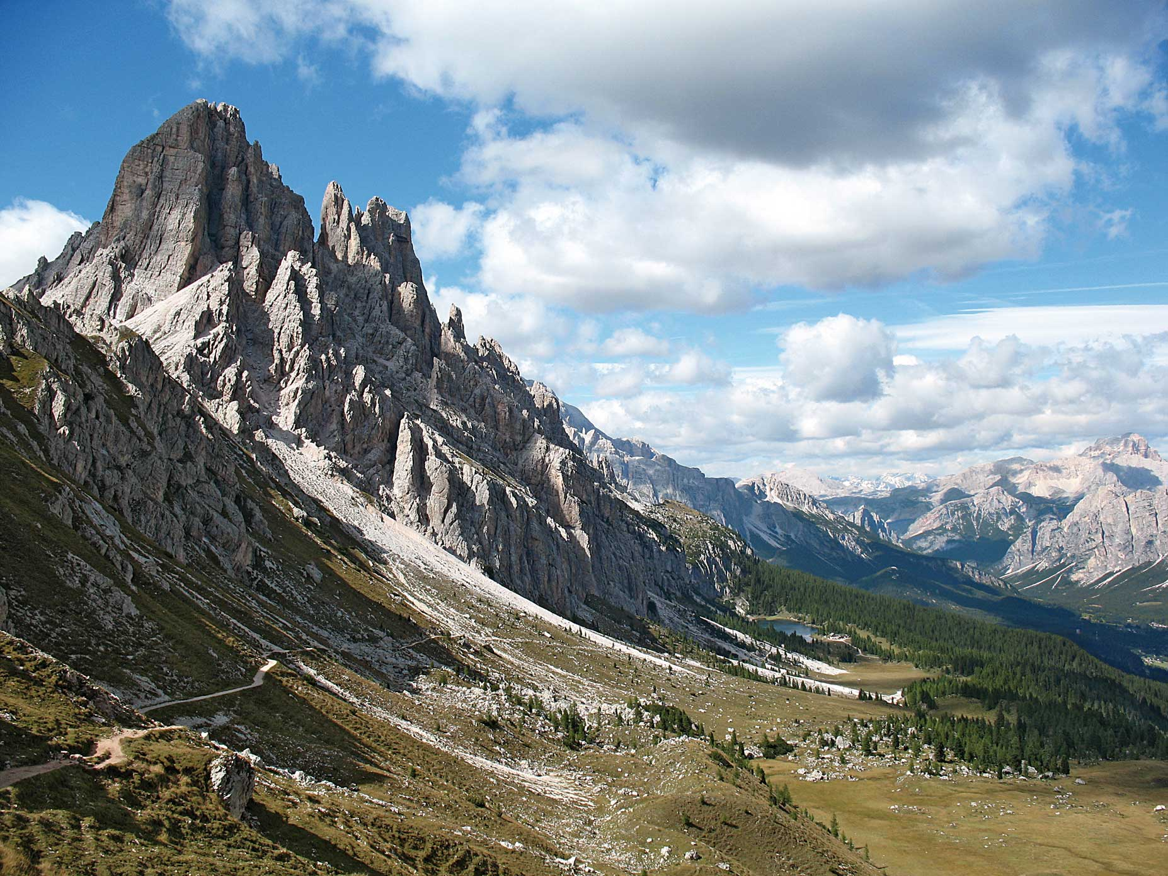
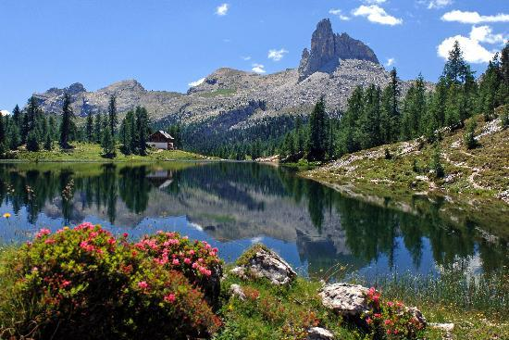
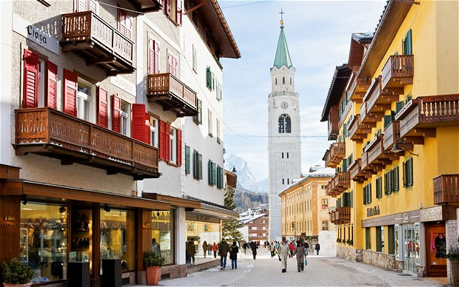
SOCIAL EVENTS: EXCURSIONS
GUIDED VISIT TO CORTINA D’AMPEZZO

Slide 39
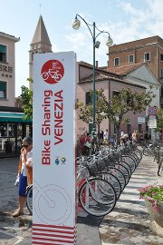
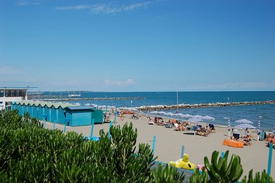
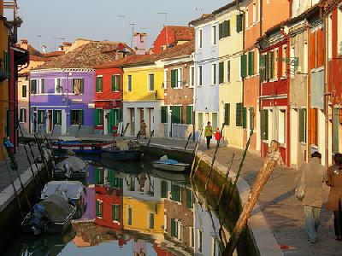
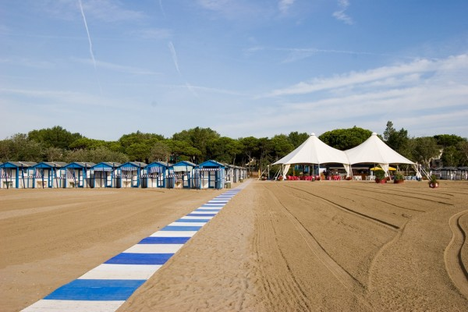
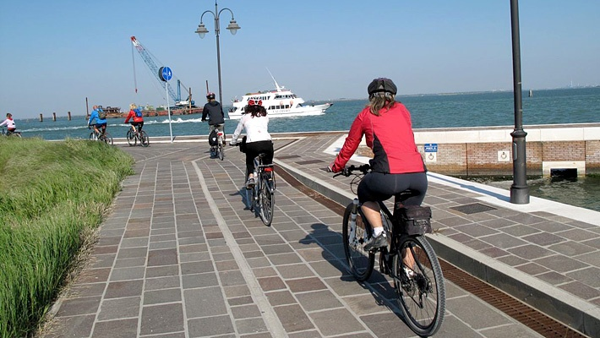
SOCIAL PROGRAM FOR COMPANIONS
relax on the front beach of the Lido, biking, visits, etc., etc.....

Slide 40
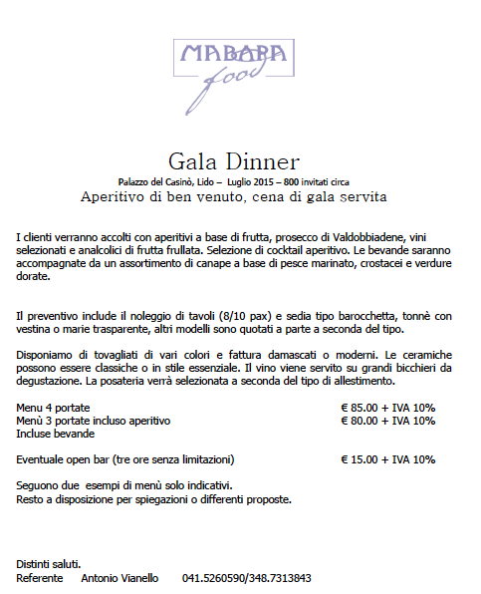

Slide 41
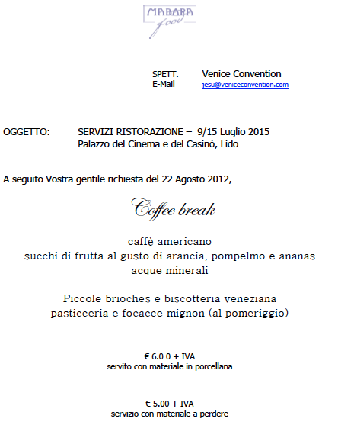

Slide 43
LINK UTILI
http://www.alilaguna.it/
http://www.actv.it/

